Slide 1
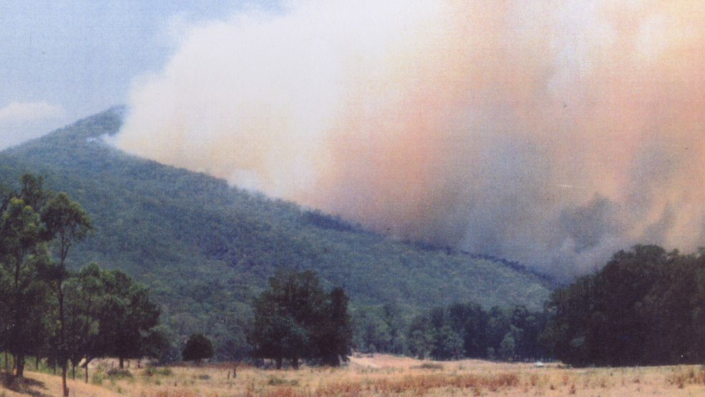
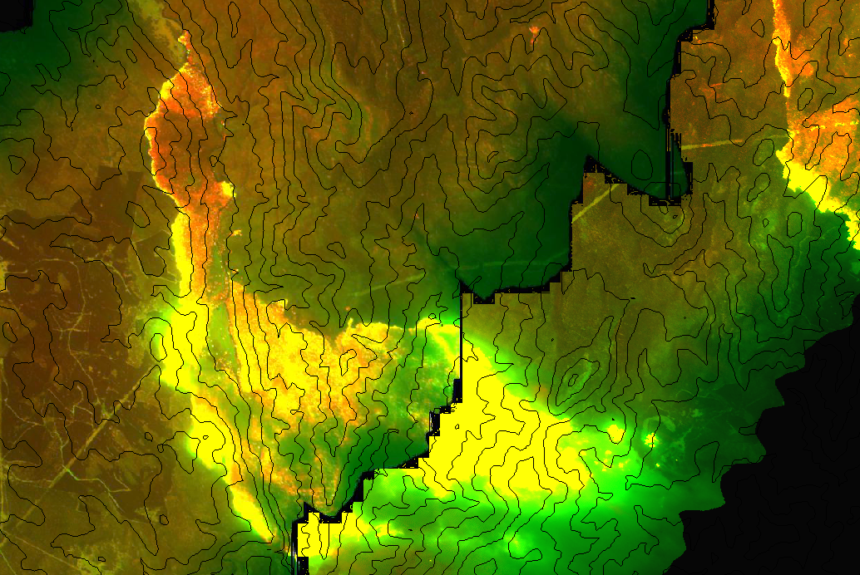

MANAGING EXTREME WILDFIRES
The first case: Early VLS edge (red line) (photo: Wayne West); 2hr later VLS escalation (linescan: NSWRFS)
A virtual PDP Workshop for the 2021 AFAC Conference.
Rick McRae, Jason Sharples
UNSW Bushfire Research Group.

Slide 2
INTRODUCTION

Slide 3
Objective
This one day virtual workshop will show senior bushfire management personnel the lessons from recent fire activity and the science from it. Improved procedures for incident management will be indicated.
Attendees will be shown how to be better prepared for future extreme wildfire activity.

Slide 4
Blue text is something that will be explained shortly.
Red text is that explanation.

Slide 5
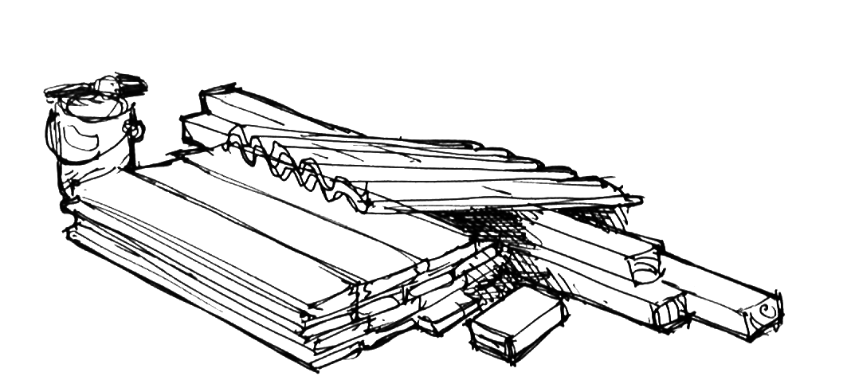
What is this?

Slide 6
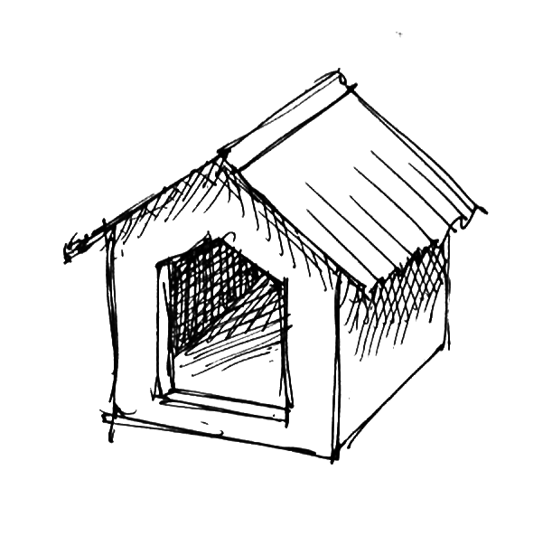
What is this?

Slide 7
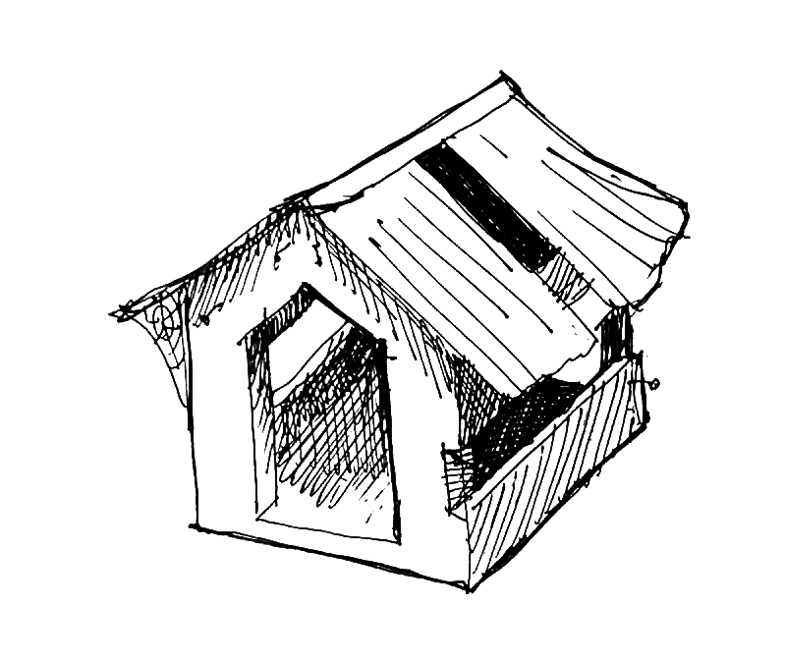
A: They are both Dog Houses.
Everything needed for the second is there in the first. It just needs a plan and a bit of effort to bring it all together, and viola!
BUT just looking at the parts doesn’t tell you much about the whole.
This is the Dogma House – only fit for demolition.
It is creaky, leaks and is falling apart.
It needs replacing!

Slide 8
Definitions
It is vitally important that terms used are fully defined and used in the correct contexts.
Adjectives are ambiguous!
Extreme Wildfires
Blow-Up Fire Events
Deep Flaming

Slide 9
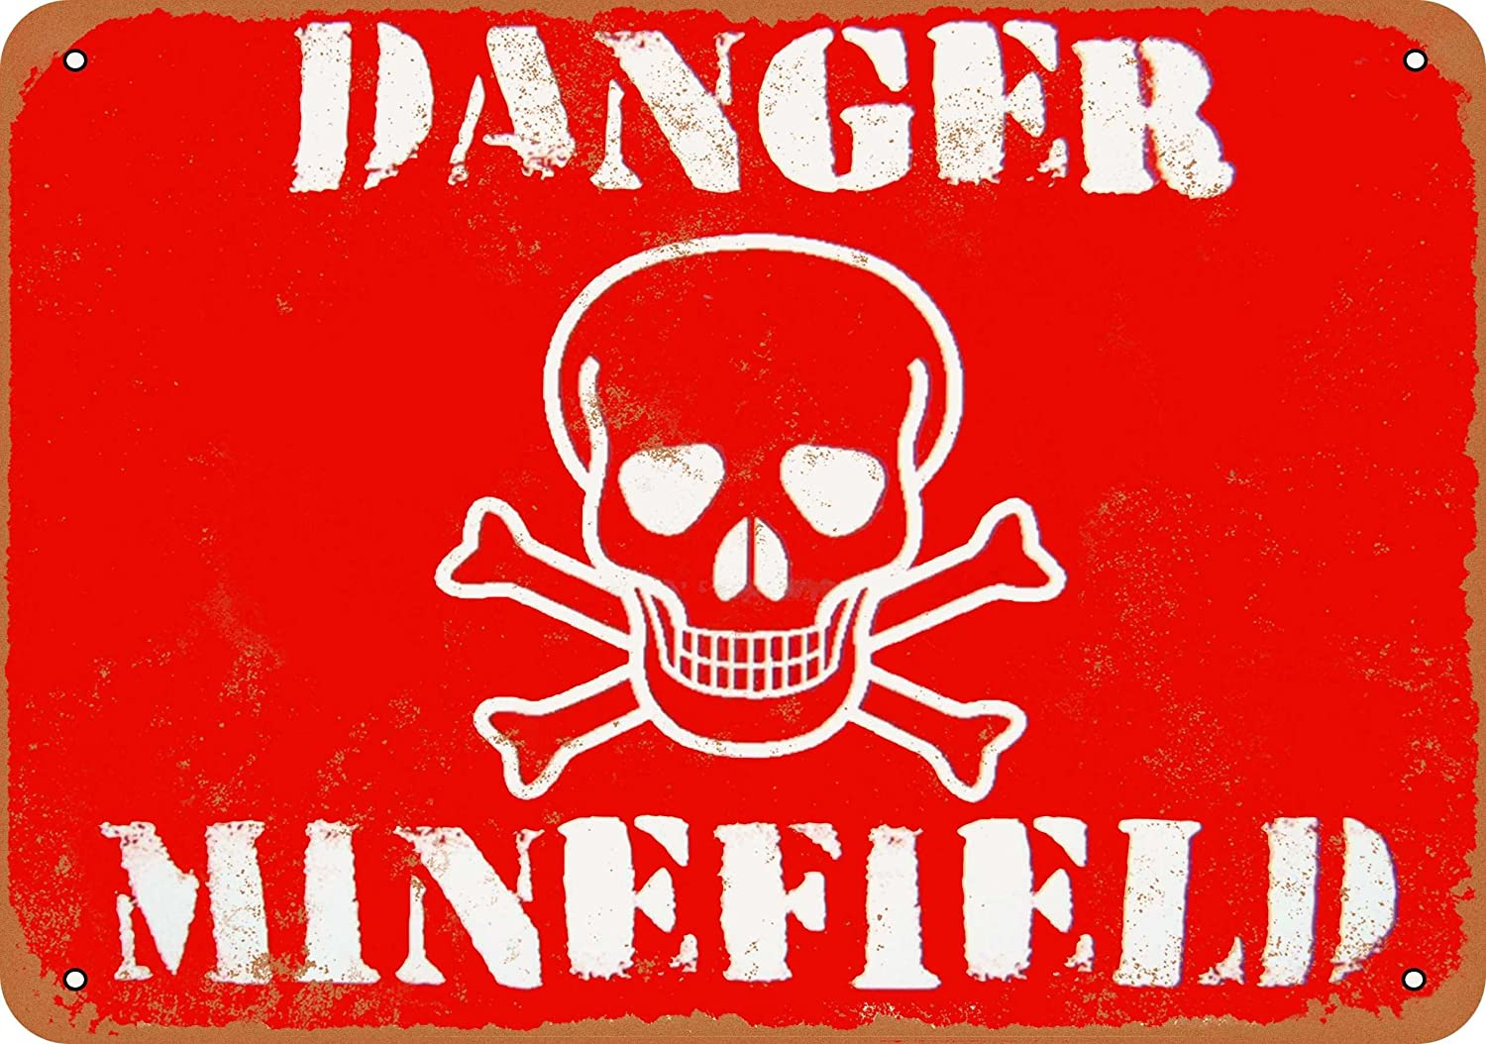
Ever used these out of context?
EXTREME
BAD
WORST
SEVERE
MASSIVE
UNPRECEDENTED
ELEVATED
VIOLENT
EXTREMELY BAD
EXCEPTIONAL
Image: amazon.com

Slide 10
Extreme wildfires
An extreme wildfire is one that, on one or more occasions, develops a blow-up fire event.
Sharples, J.J., Cary, G.J., Fox-Hughes, P. et al. (2016). Natural hazards in Australia: extreme bushfire. Climatic Change, DOI 10.1007/s10584-016-1811-1

Slide 11
Two species of fire
There are now two species of fire in Australia.
Steady-state fire behaviour
Dynamic fire behaviour

Slide 12
Blow-Up Fire Events
A blow-up fire event occurs when a fire couples with the atmosphere above.
Without this coupling, it is a steady-state fire – if you know the fuel, the terrain, and the weather then you know the fire’s behaviour.
After coupling feedbacks develop, it becomes a dynamic fire. You also need to know the stability and the fire.
Deep flaming occurs and triggers the coupling.

Slide 13
Deep Flaming
Deep flaming is where a fire’s perimeter becomes deeper (or thicker) than the normal flaming depth due to fuel burn-out times.
There are 7 known causes of deep flaming, discussed later.

Slide 14
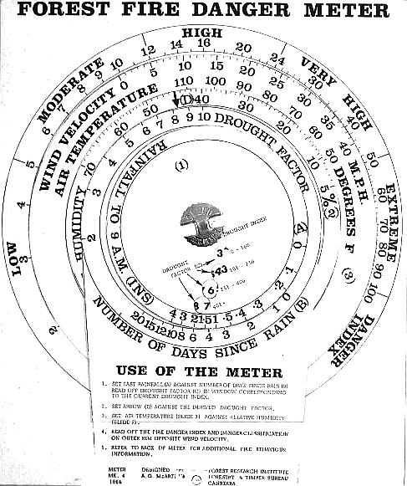
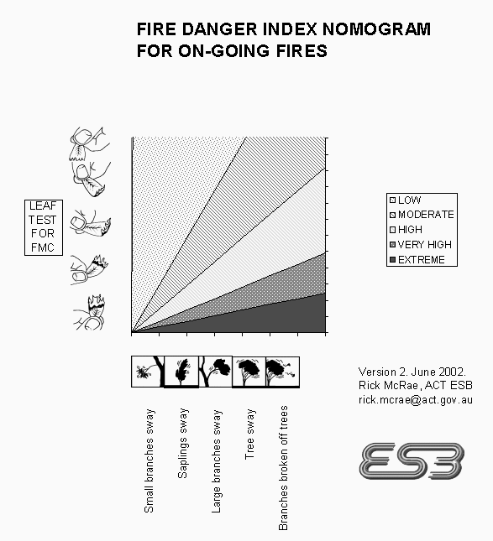
Steady-state fire behaviour
Used for decades.
Quasi-steady-state fire behaviour: If you know the fire weather, the terrain (slope/aspect) and the fuel, then you know what the fire will do.
Not necessarily true in early stages
after ignition, etc.
The basis of fire behaviour models (McArthur, Phoenix, Aurora, etc)
Top right image: McRae, R. (2004). Virtually volvelles. Bushfire 2004 Conference, Adelaide.

Slide 15
Dynamic fire behaviour
The fire couples with the atmosphere, creating feedback loops, based on:
- weather
- stability
- the fire
- terrain (not slope and aspect, but landform metrics)
Fuel is not in that list. Should it be?

Slide 16
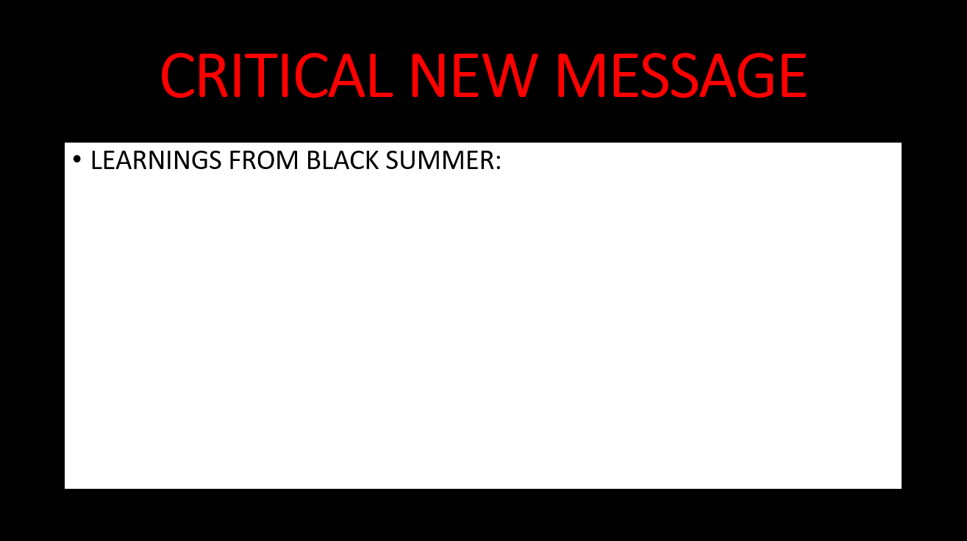
There is little explicit role for fuel load in BUFE occurrence. One year-since-last-fire only is effective. Drought-stricken grasslands may not be able to carry BUFEs.

Slide 17
Next:
CLIMATE CHANGE

