Slide 1
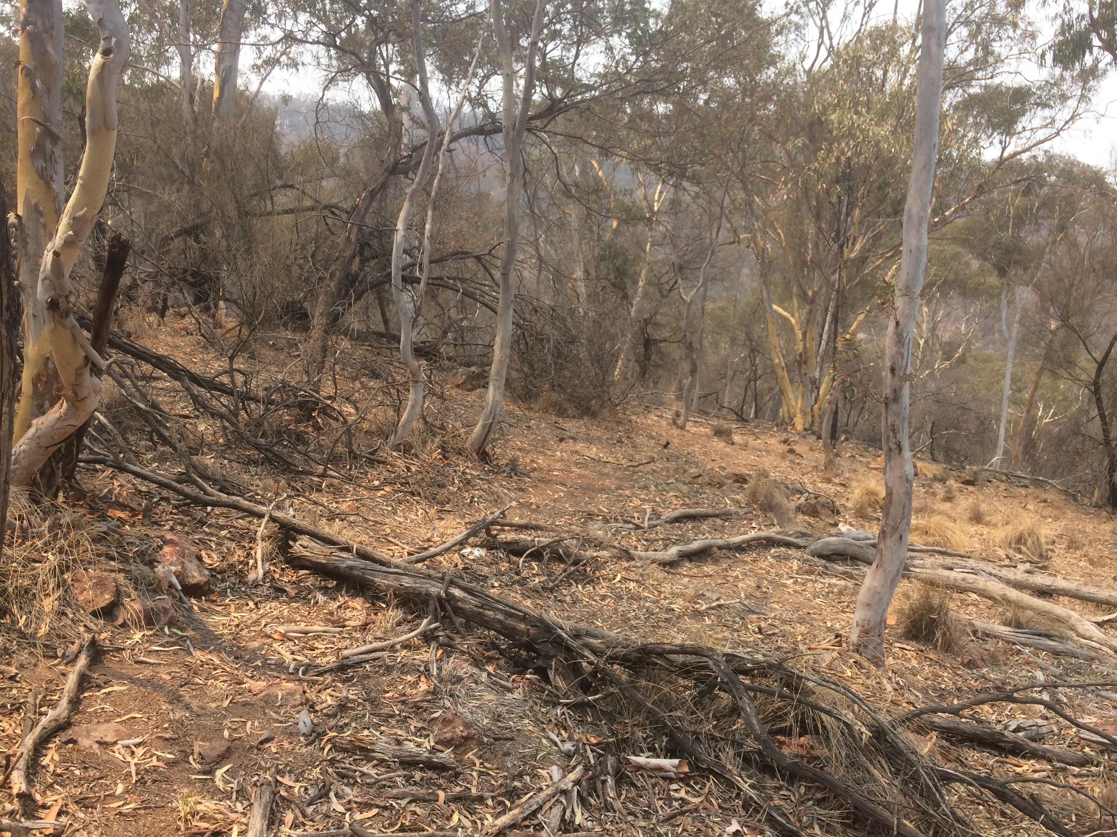

MANAGING EXTREME WILDFIRES
A virtual PDP Workshop for the 2021 AFAC Conference.
Rick McRae, Jason Sharples
UNSW Bushfire Research Group.
Mt Ainslie during BS. Photo: McRae

Slide 2
CLIMATE CHANGE

Slide 3
Background
It is now known that the risk from dynamic wildfires is increasing, primarily due to climate change.
This makes being prepared a lot harder for all stakeholders.

Slide 4
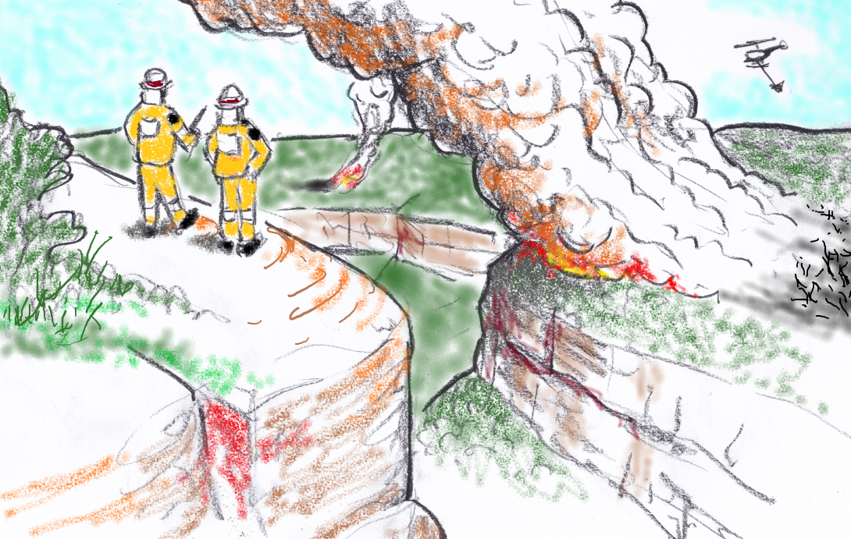
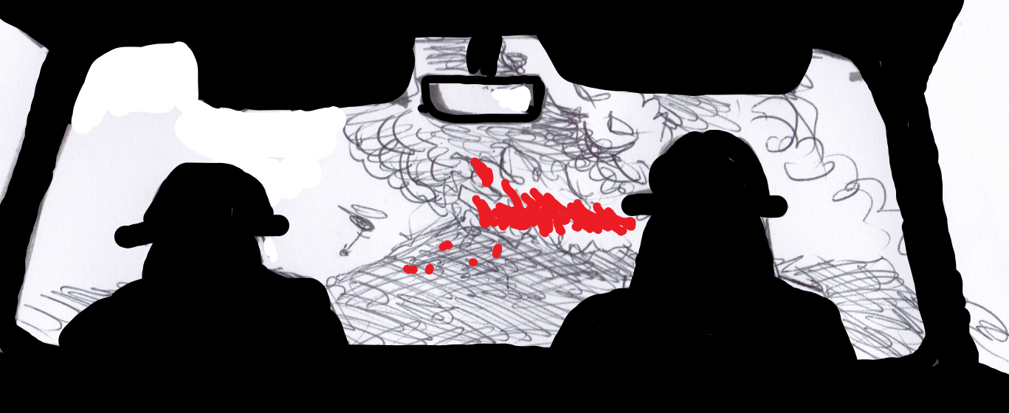
Climate
Change
“You know, I don’t believe what they say about climate change.”
Image: McRae

Slide 5
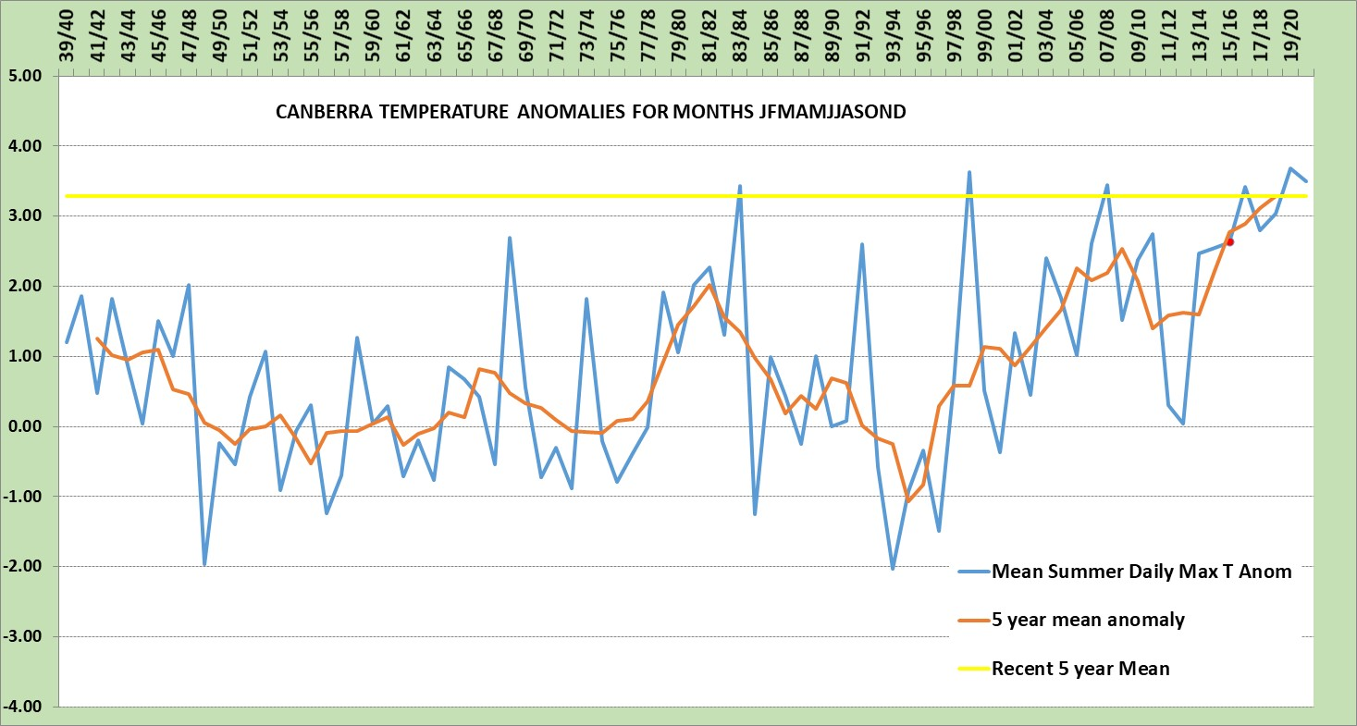
Record heat @ Canberra Airport
Already up
3.2°C on the
5 year mean.
Mean now
equal to past
peaks due to
major El Nino
events.
Climbing
rapidly.
Data: BoM,
Analysis : McRae

Slide 6
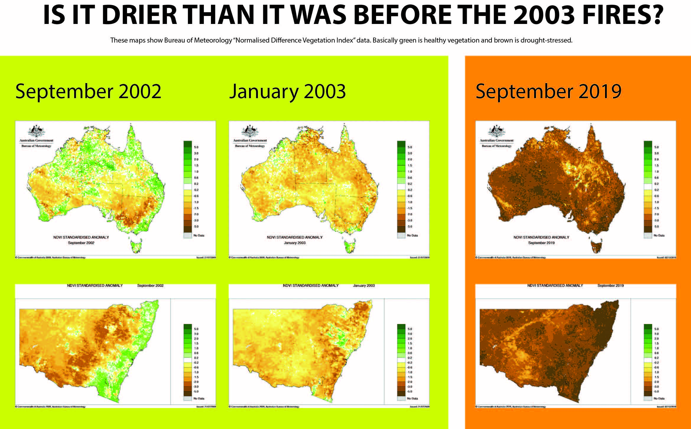
Record drought
We thought
2003 was bad…
BoM NDVI data.
Note: 3 sigma = 1 in 370 chance.

Slide 7
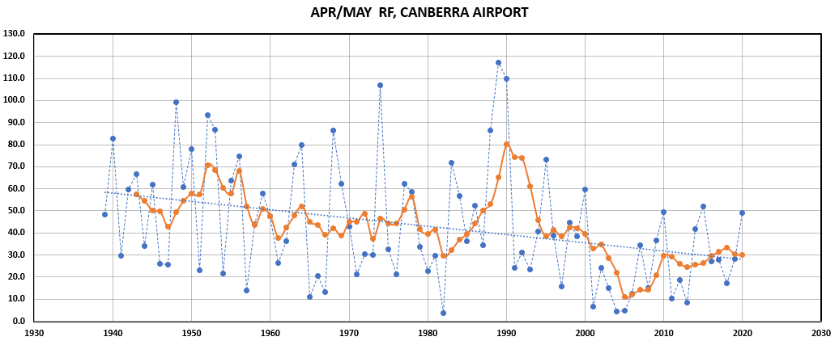
Declining rainfall
Data: BoM,
Analysis : McRae
2020-2021, a La Nina year, logged 48.0 mm.

Slide 8
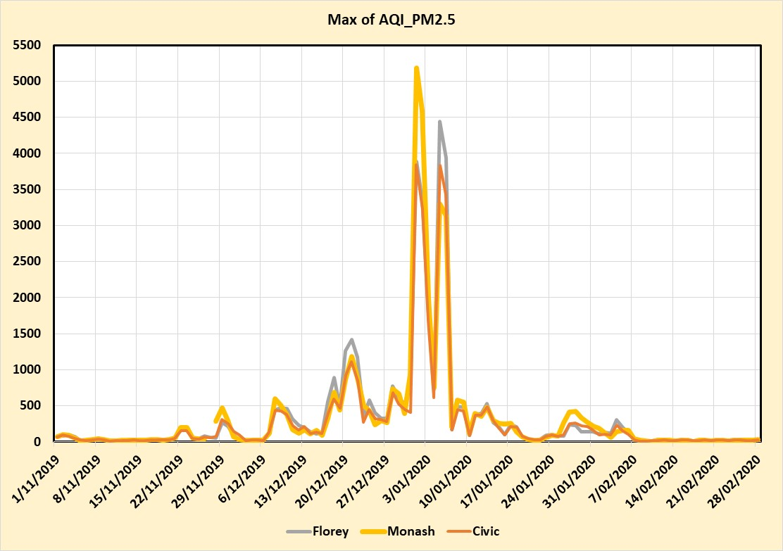
Record smoke
Now the ACT’s major natural hazard – estimated 31 deaths.
Arriagada, N.B., Palmer, A.J., Bowman, D.M.J.S., et al. (2020). Unprecedented smoke‐related health burden associated with the 2019–20 bushfires in eastern Australia. Med J Aust 213 (6): 282-283.
At the time, the worst air quality in the world.
[ACT Health]

Slide 9
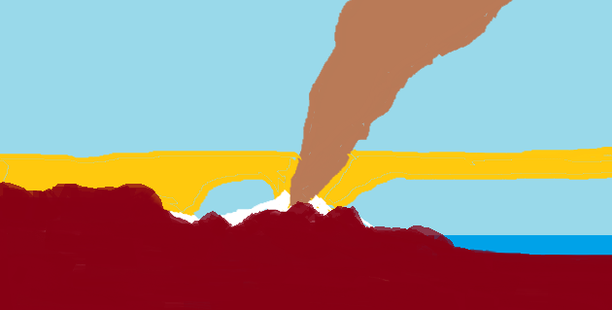
The BS Novel Smoke Problem
Brown = smoke from main fire – low oxygen combustion, rapidly lofted.
Yellow = smoke from hot fire, locked below LCL, circulated back & forth by sea breezes. Not normally encountered, elevated health risks.
White = smoke from mild burning, lies low to ground. Normally encountered.

Slide 10
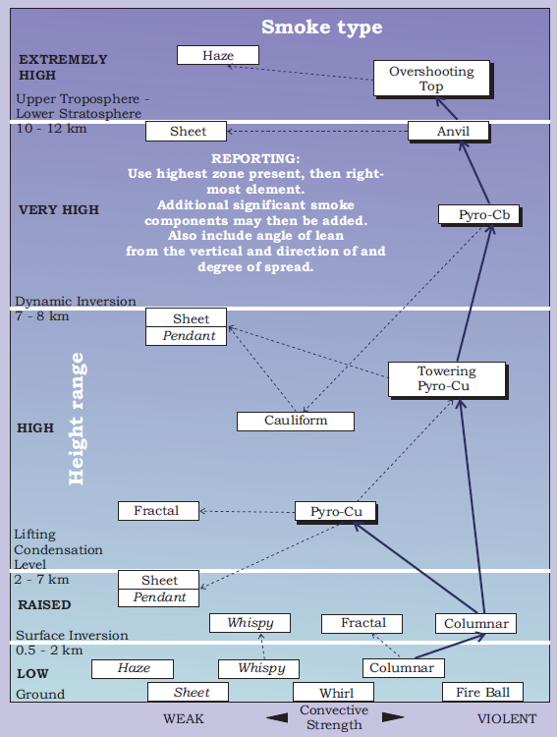
SMOKE
http://www.highfirerisk.com.au/tools/tool6_v2.pdf
Smoke is a complex problem.

Slide 11
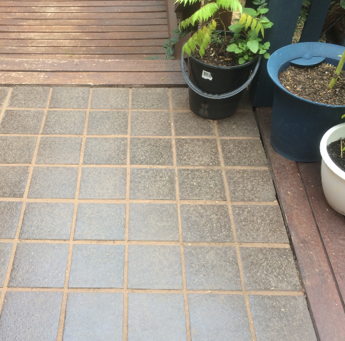
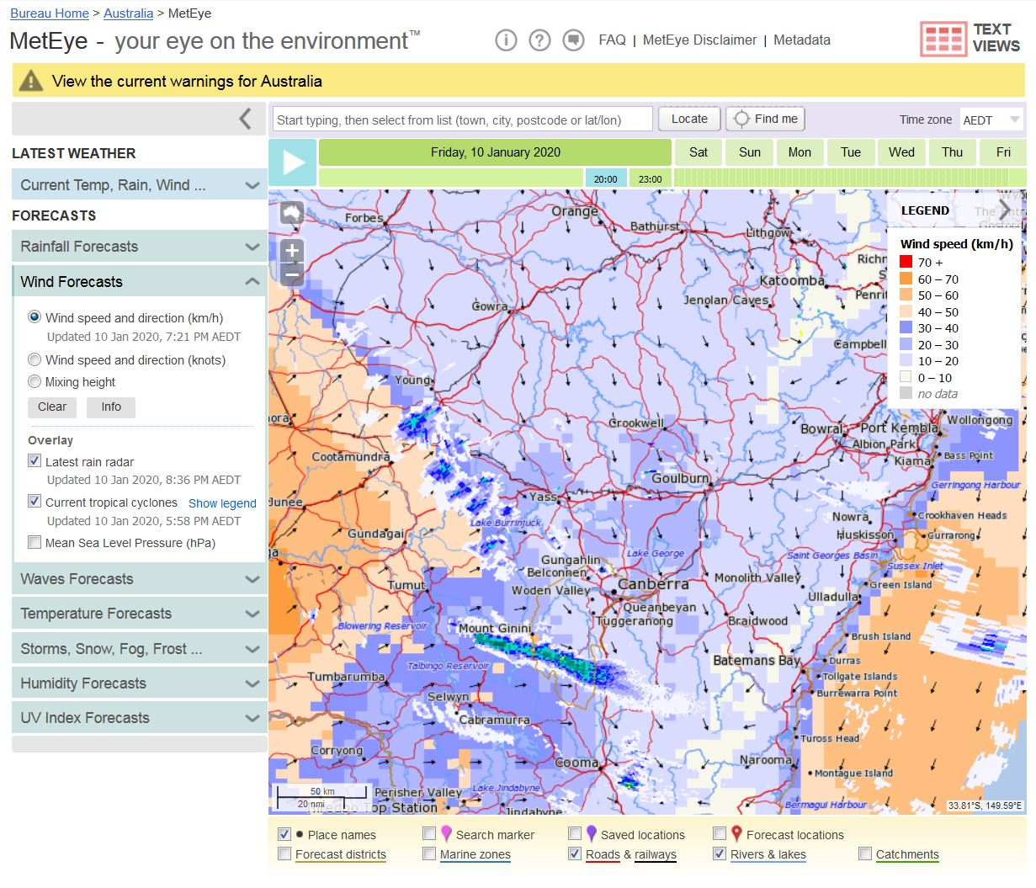
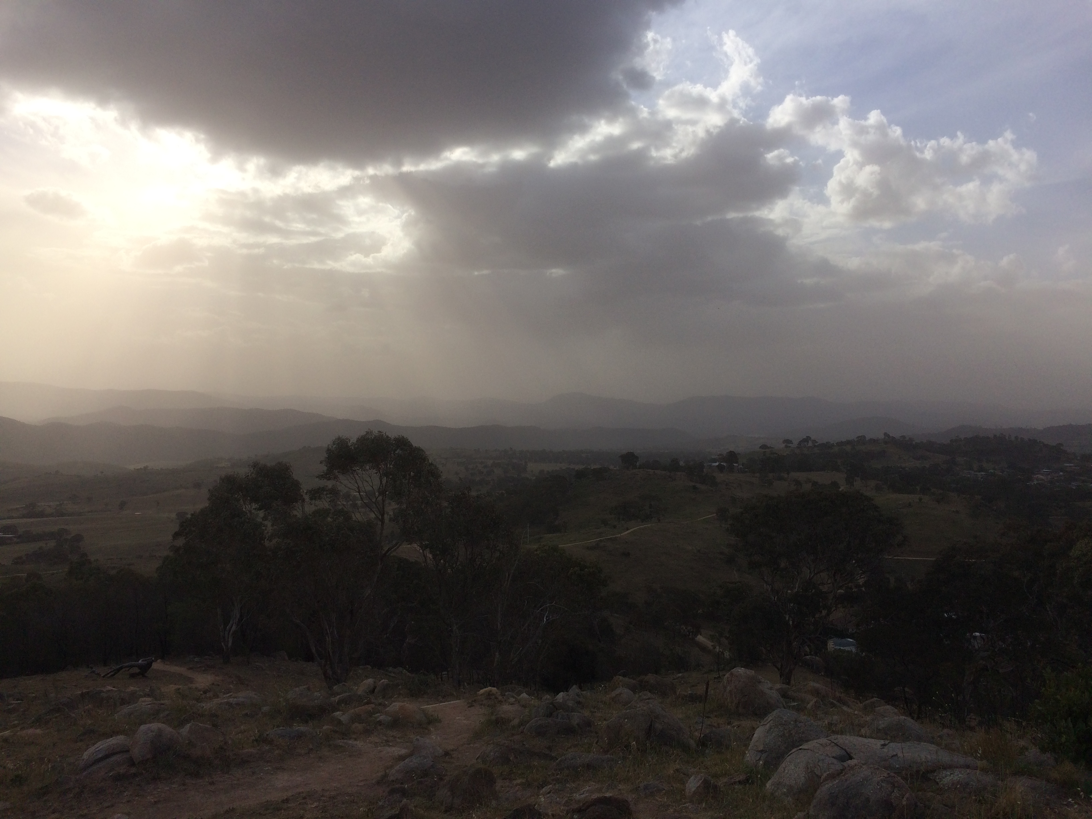
Record dust
Canberra dust storm, 10 Jan 2020. [McRae]
Deposited dust afterwards. [McRae]
Radar showing smoke plumes and dust front. [BoM]

Slide 12
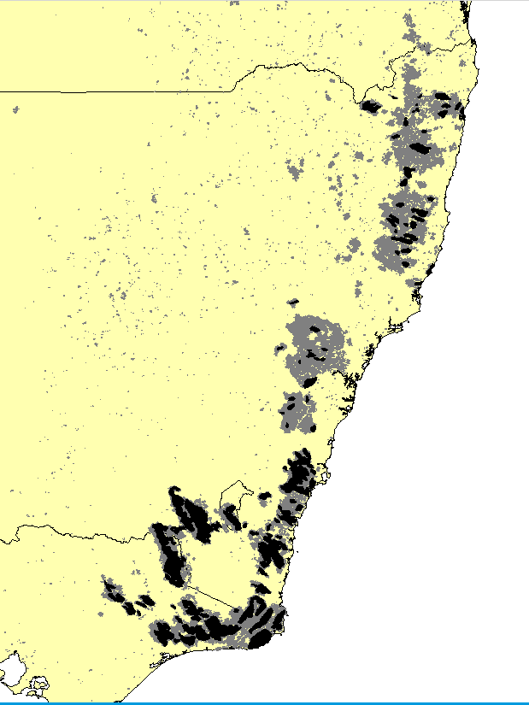
Record fire
9 million ha burnt
36,000 km perimeter
2.2 million ha of BUFE (black)

Slide 13
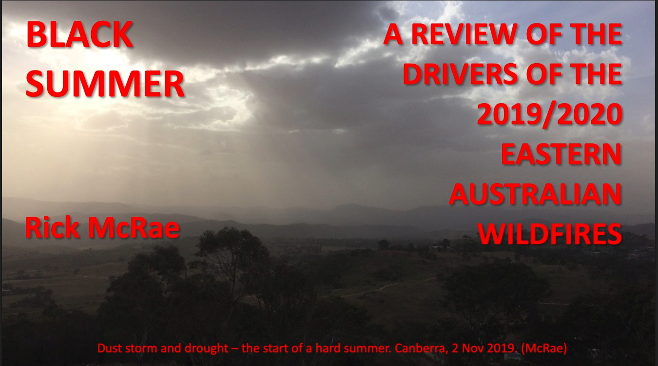
Video
http://highfirerisk.com.au/black_summer/black_summer_overview_mcrae.mov

Slide 14
Climate change
1997 Hockey Stick inflection point for many areas in E Australia.
Rapid changes since then – often still accelerating.
No “New Norm”.
No “Black Swans” – more like Cane Toads (genus Bufo).

Slide 15
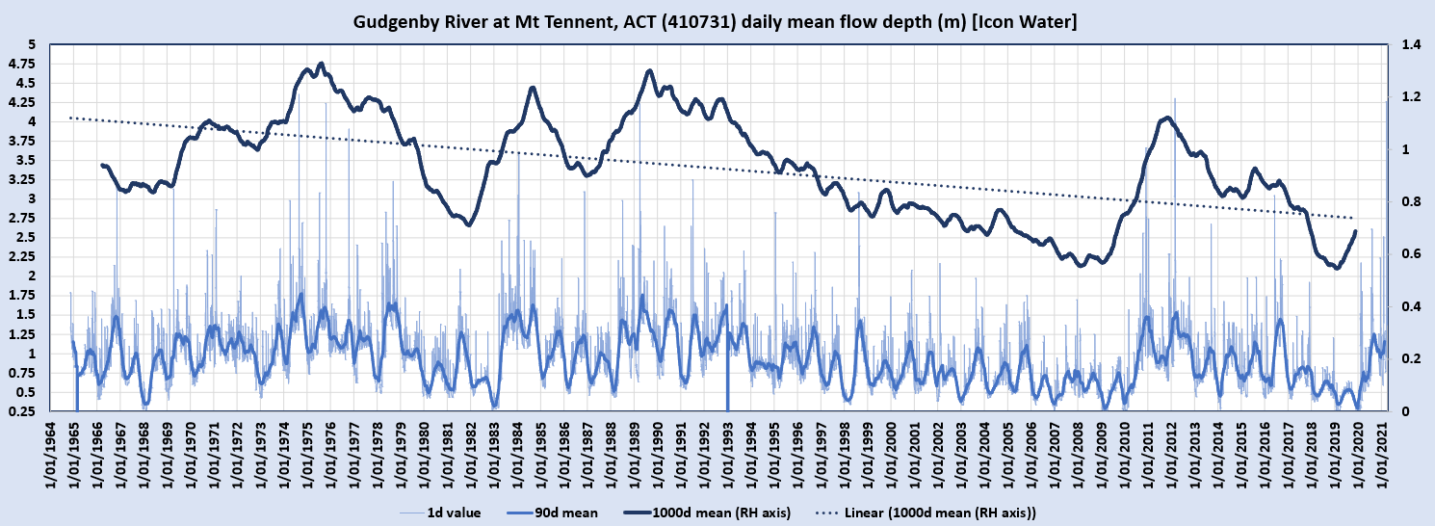
Heat & Drought
The Gudgenby is an un-dammed river draining much of the ACT’s high country. 3-month and 3-year means.
Orange circles = critical dry events.
Data: BoM/EcoWise/Icon,
Analysis : McRae

Slide 16

Increasing drying out of streamflows on a regional scale is a useful portent of BUFE occurrence.

Slide 17
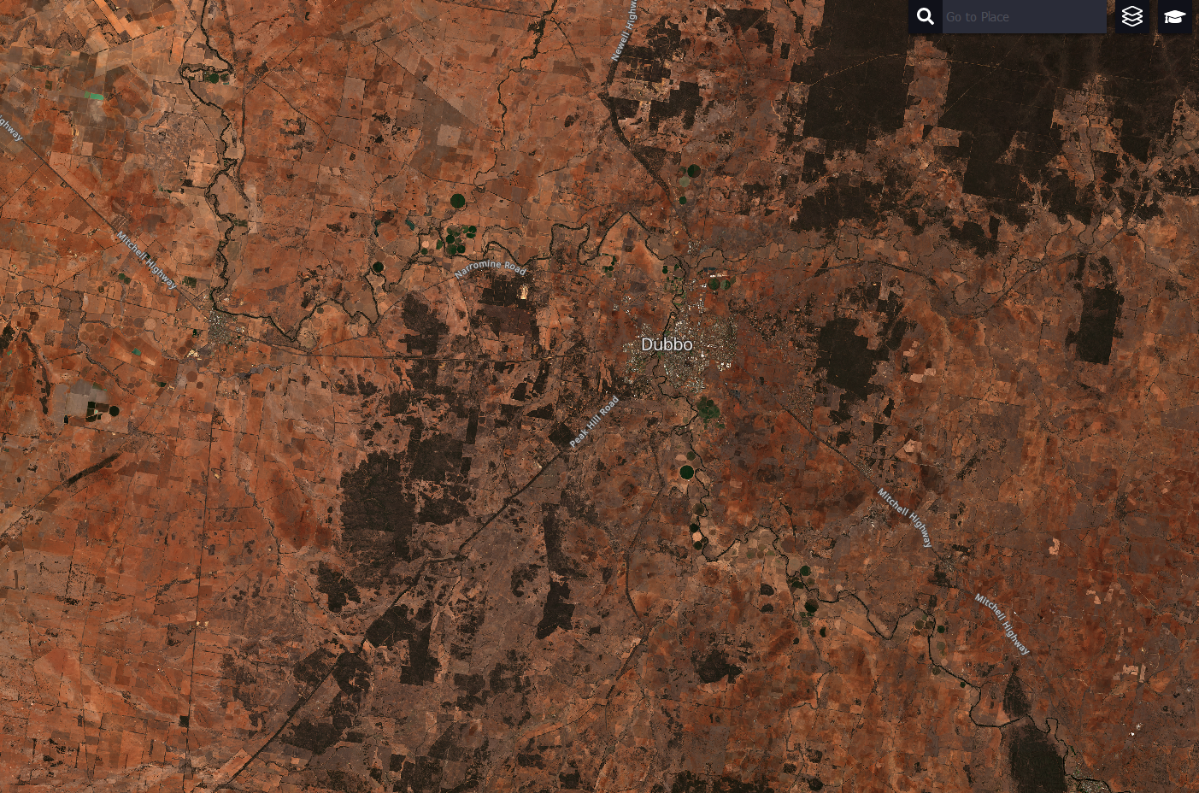
Changed inland conditions
S2 image, Sentinel-hub, 9/11/2019

Slide 18
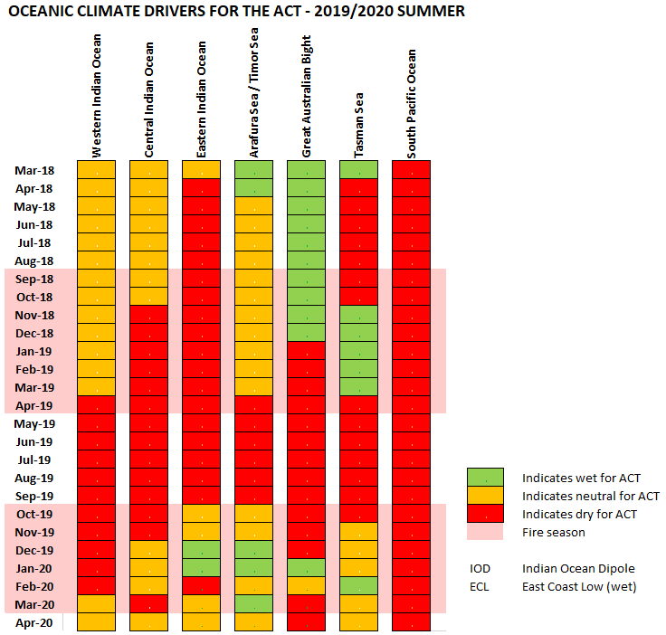
Changed oceanic dynamics
El Nino – La Nina no longer “the big kid on the block”.
Mid-range: IOD, SAM, MJO, central South Pacific.
Short-range: Great Australian Bight, Arafura Sea, Tasman Sea.
BS

Slide 19
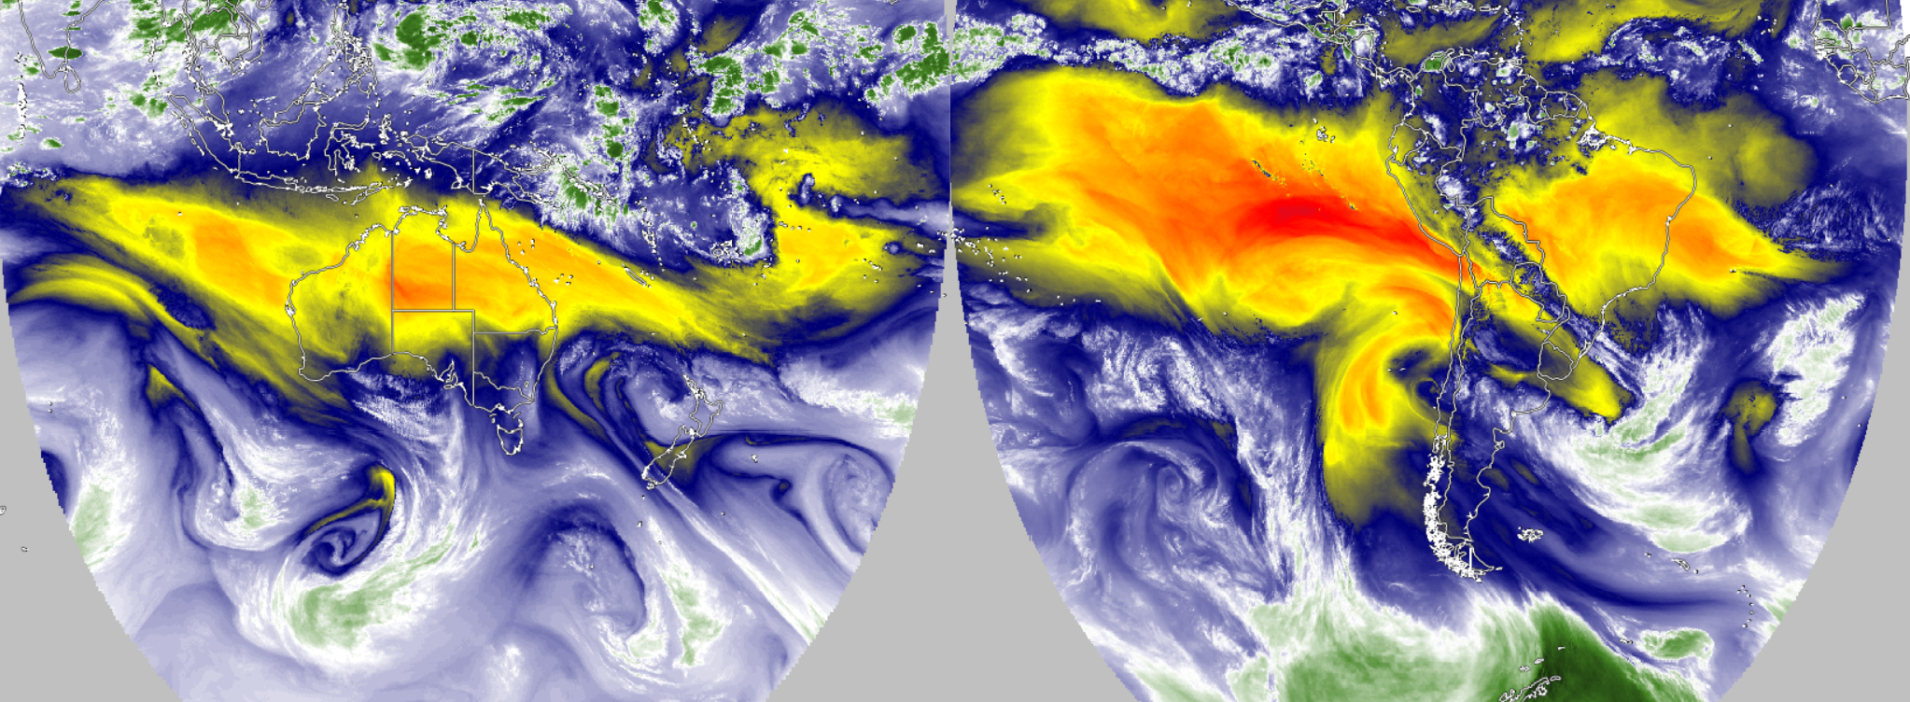
Simultaneous mid-level water vapo[u]r imagery from 2 Advanced Baseline/Himawari Imagers. [SSEC Real Earth]
The red areas are large masses of dry air upwind of major fire areas (Australia and Bolivia).

Slide 20
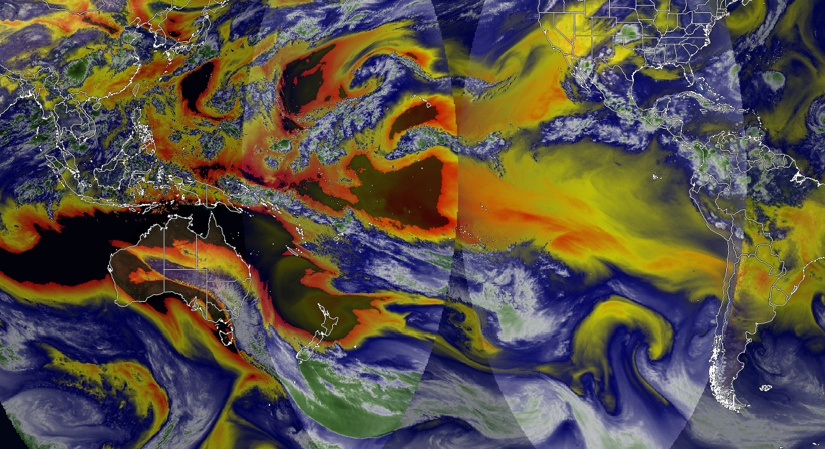
Sept 2021 – outlook…
Australia – v.dry Rockies Brazil

Slide 21
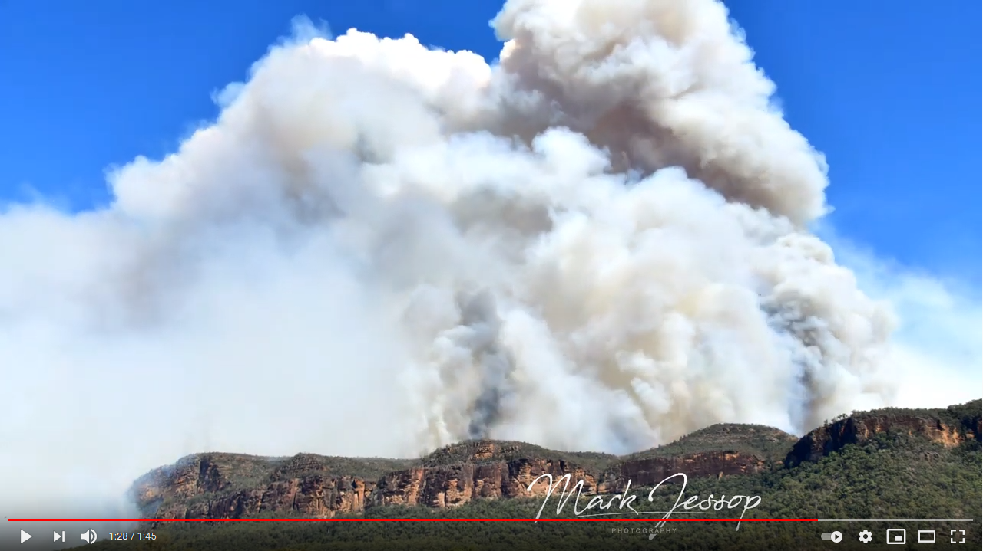
Changed sea breeze dynamics
https://www.youtube.com/watch?v=NuQM0dw74T0
Fire in Wolgan
Valley 20191116
Shows sea breeze
pushing fire to west.

Slide 22
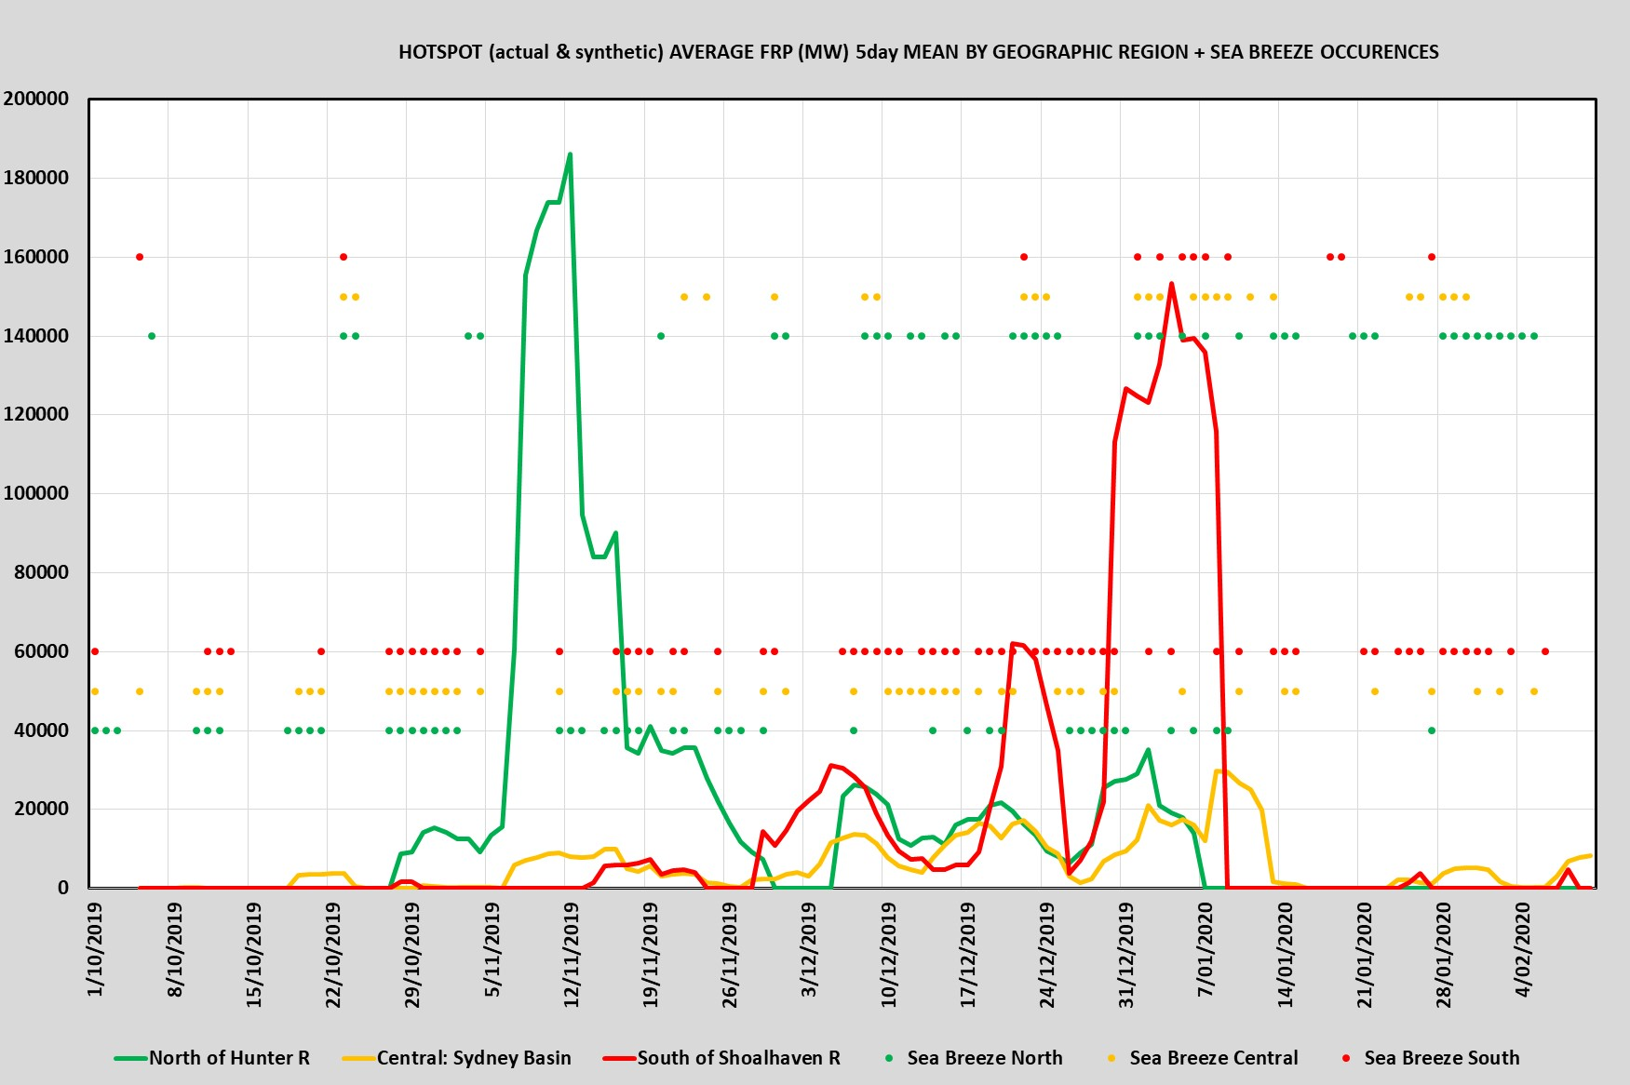
Sea breezes vs FRP
Major role during instability events in south (red lines).
Lesser role during foehn events to north (green lines).
Upper dots = strong sea breeze,
Lower dots = weak sea breeze.
Data: BoM & NASA FIRMS
Analysis: McRae.

Slide 23
Sea breezes are now, due to climate change, able to push BUFEs inland for considerable distances.

Slide 24
