Slide 1
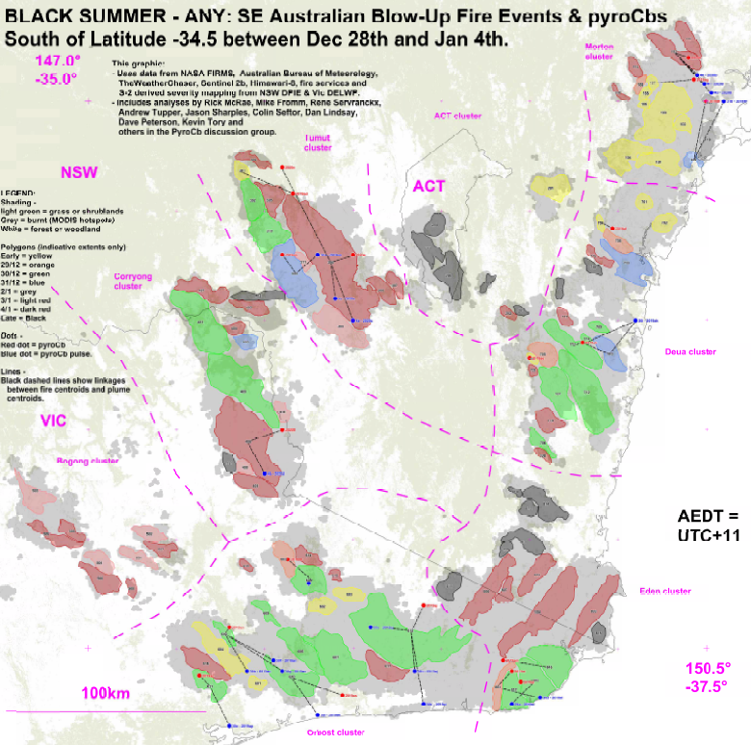
MANAGING EXTREME WILDFIRES
A virtual PDP Workshop for the 2021 AFAC Conference.
Rick McRae, Jason Sharples
UNSW Bushfire Research Group.
Graphic: McRae

Slide 2
BLACK SUMMER

Slide 3
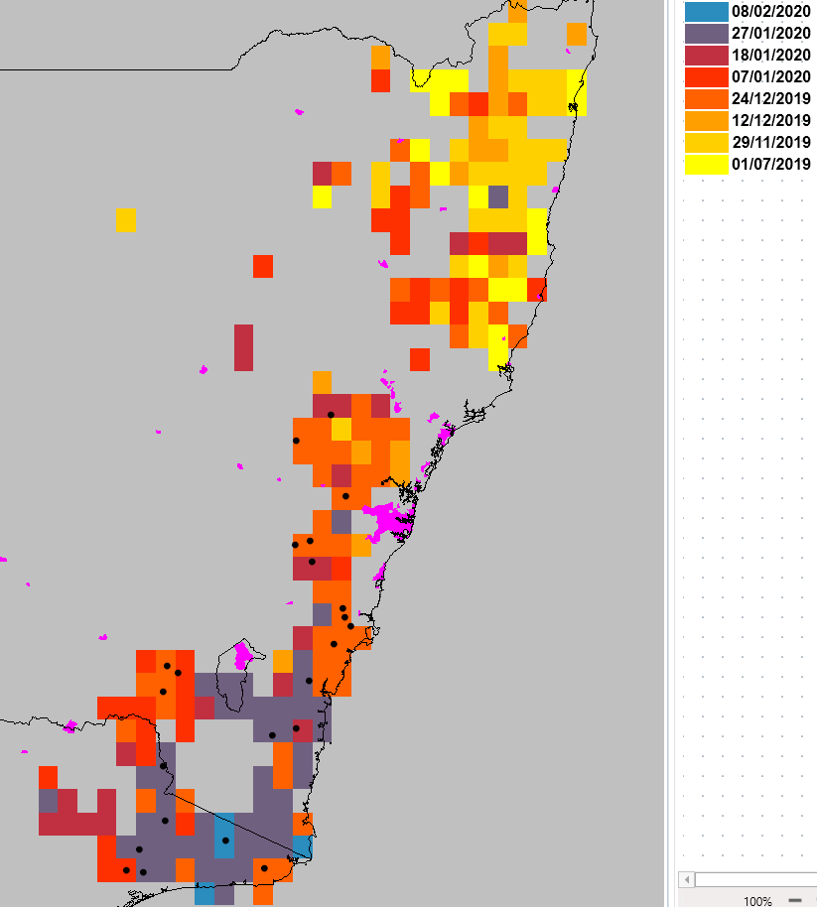

Black Summer
Yellow = Before November
Orange = mid December
Red = early January
Grey = late January
Blue = early February
Latitudinal/time blocks
Overall southwards trend.
Northwards shift around New Year’s.
Pseudo-cyclic activity pattern shows need to switch IMT between defensive and offensive modes.

Slide 4
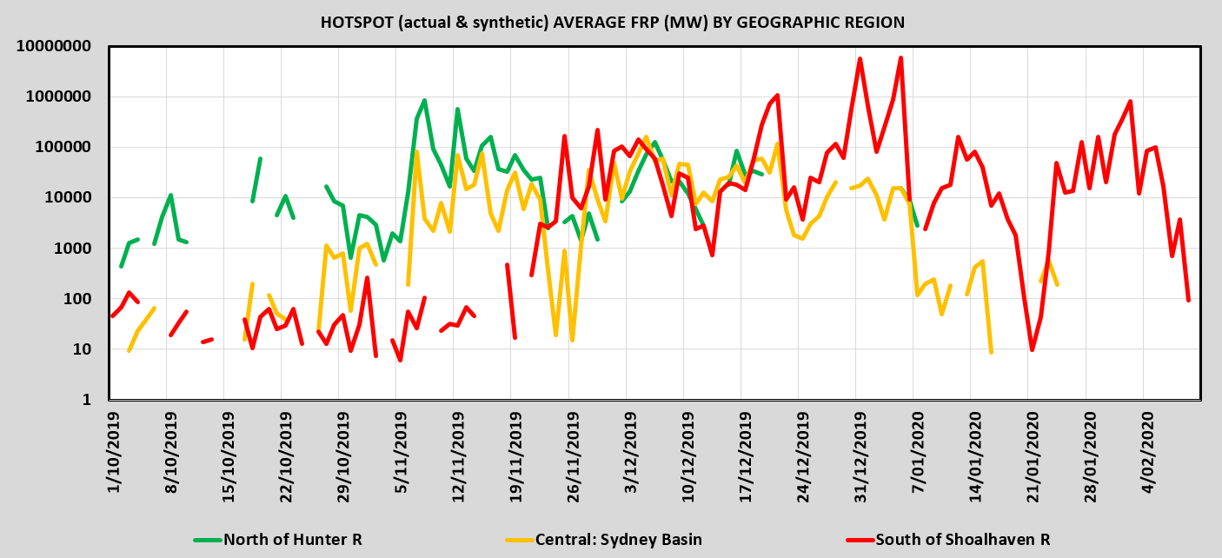

Slide 5
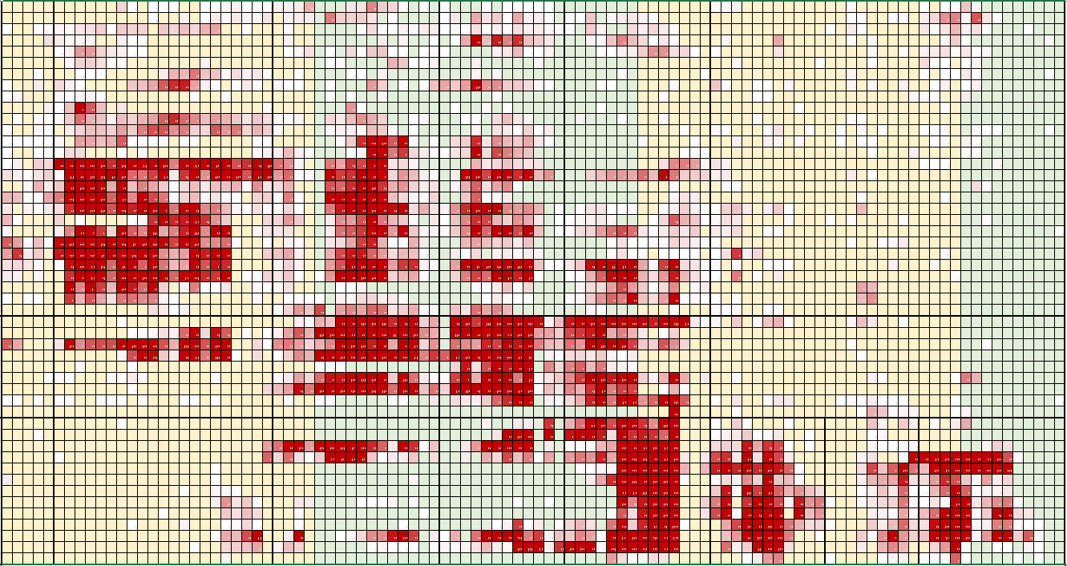
Hotspot density – by day & ¼ degree latitude
1st October
10th February
Brisbane
Orbost

Slide 6

BUFEs, on a district-scale, go through cycles of activity allowing switching between defensive and offensive IAPs.

Slide 7
Discussion
What might be the difference between OFFENSIVE and DEFENSIVE IAPs?

Slide 8
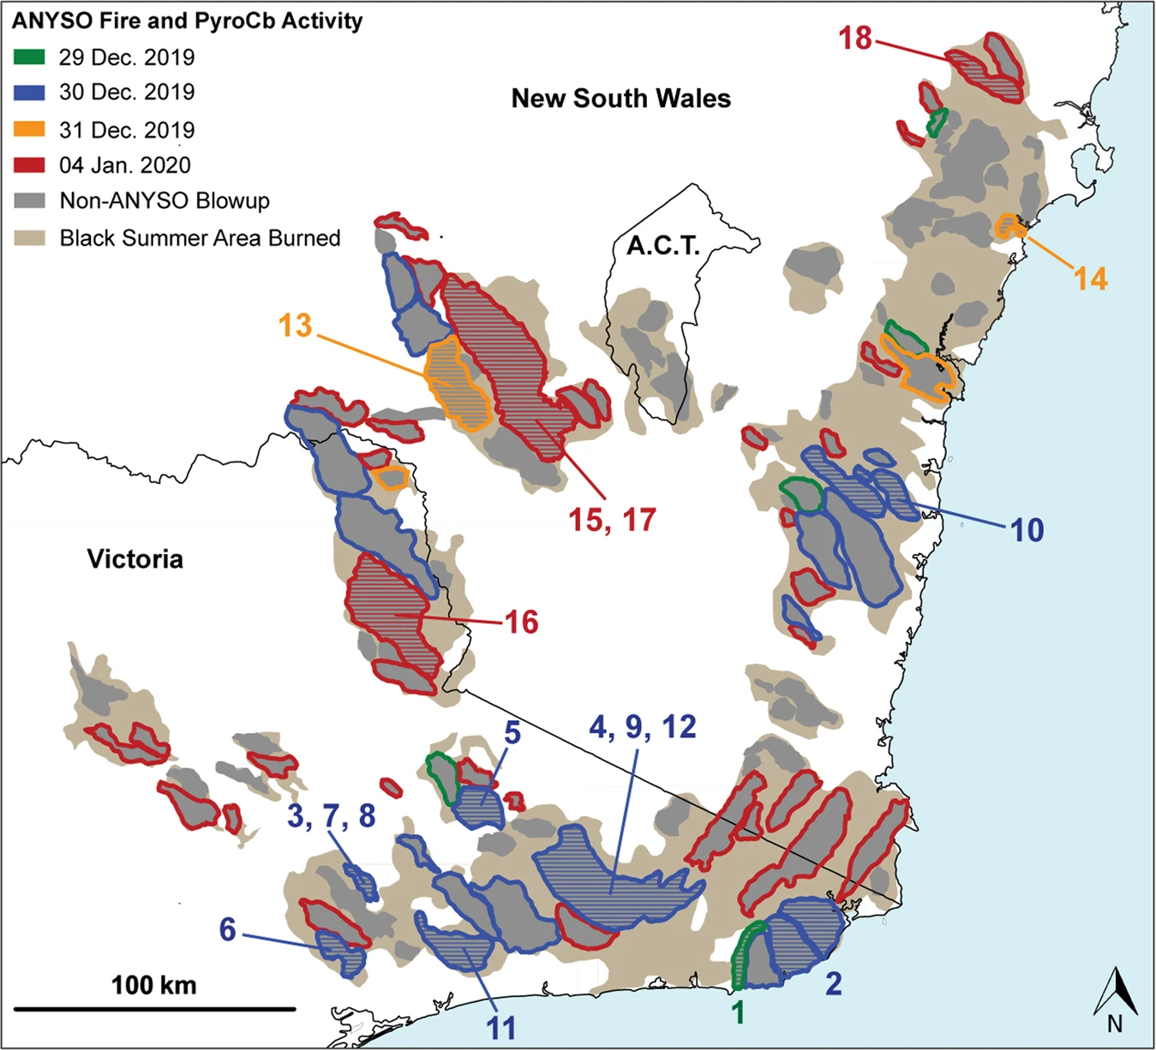
ANYSO
In this area alone:
Australian New Year Super Outbreak
Most extreme fire and convective activity group ever observed.
38 distinct pyroCb updrafts over 51 hours of activity. 109 BUFEs involved.
Smoke tracked to 35km ASL.
Perhaps 5% of burnt fuel mass was injected into the stratosphere.

Slide 9
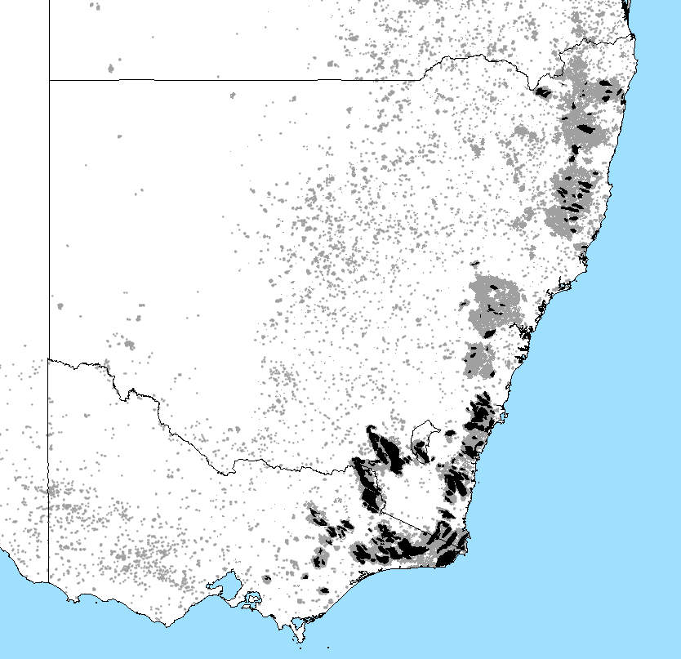
BUFEs
176 events discriminated (so far).
Covering 2.2 million ha of forested land.
1 Mar 2019 to 4 Feb 2020.

Slide 10
Because of climate change, BUFEs and pyroCbs now occur in extended clusters, called Sustained Outbreaks.
We have seen one Super Outbreak.

Slide 11
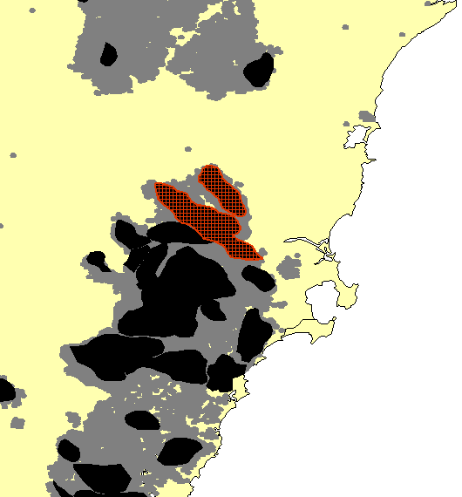
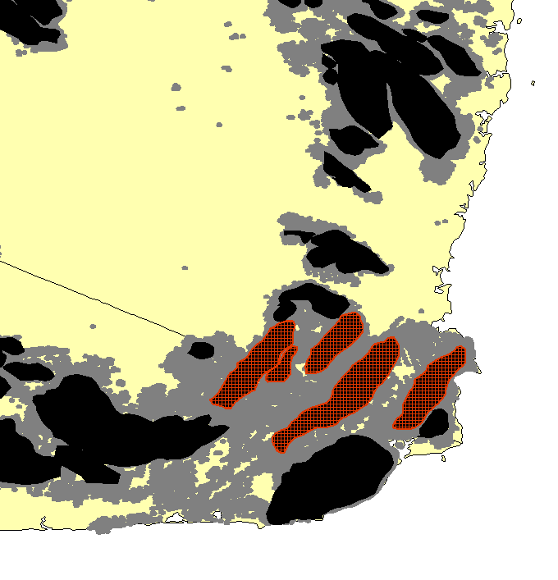
Fire run direction
Most BUFE runs were broadly from NW to SE, as expected. Some were unprecedented.
4 Jan 2020 between Nowra and Bundanoon 2 BUFEs ran from SE to NW with headfire widths from 5 km to 9 km and a total run length of 30 km.
4 Jan 2020 between Orbost and Eden 5 BUFEs ran from SW to NE with headfire widths from 6 km to 11 km and a total run length of 180 km.
Two other runs to the NE here hit burnt ground.

Slide 12
From the ANYSO paper…
Two distinct phases of ANYSO pyroCb activity resulted in two of the three largest smoke particle injections into the lower stratosphere observed to date, rivalling or exceeding the stratospheric impact from volcanic eruptions observed over the last decade.
The large stratospheric smoke plumes ensuing from ANYSO reached altitudes higher than smoke has ever been observed, encircled the Southern Hemisphere, altered dynamic circulation and persisted for nearly a year.
Fewer than three years earlier, the Pacific Northwest Event (PNE) in Canada produced a persistent smoke plume that encircled the Northern Hemisphere. These regional pyroCb outbreaks represent a new and previously unimaginable class of volcanic-scale smoke plumes in the lower-stratosphere.
Peterson, D.A., Fromm, M.D., McRae, R.H.D., Campbell, J.R., Hyer, E.J., Taha, G., Camacho, C.P., Kablick, G.P., Schmidt, C.C. & DeLand M.T. (2021). The unprecedented pyrocumulonimbus super outbreak in Australia at the dawn of 2020: cause and perspective. npj Climate and Atmospheric Science, 2021.

Slide 13
DISCUSSION (@ minutes)
What were your relevant experiences during BS?

