Slide 1
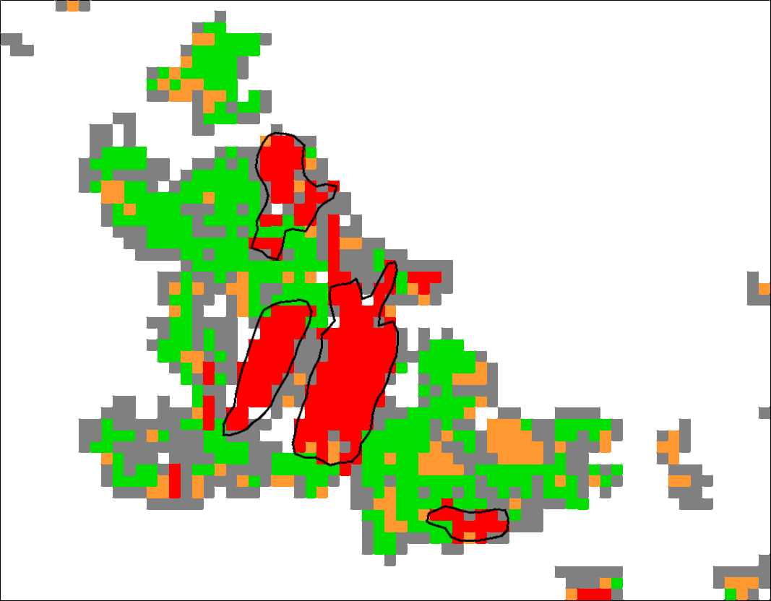
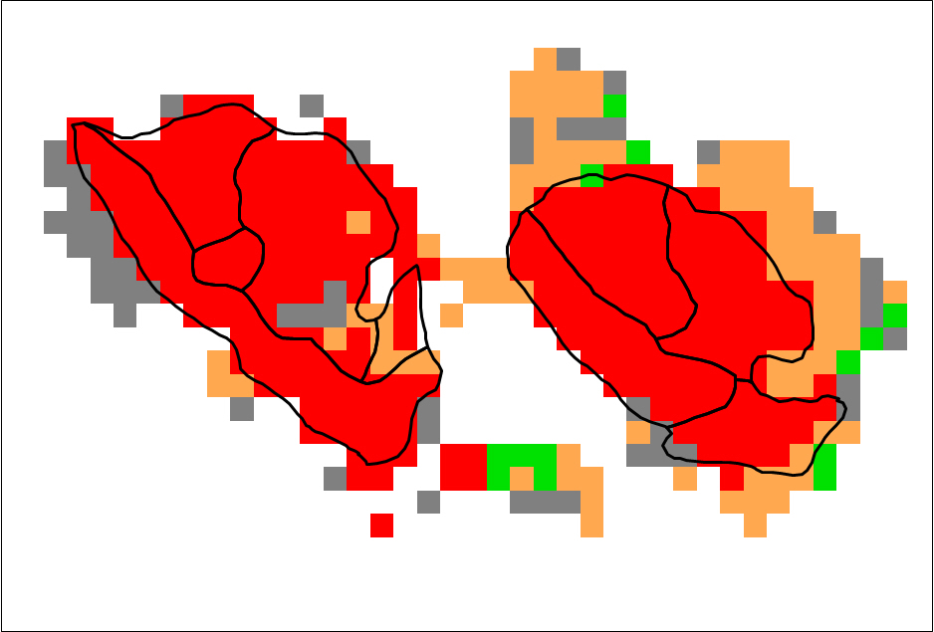
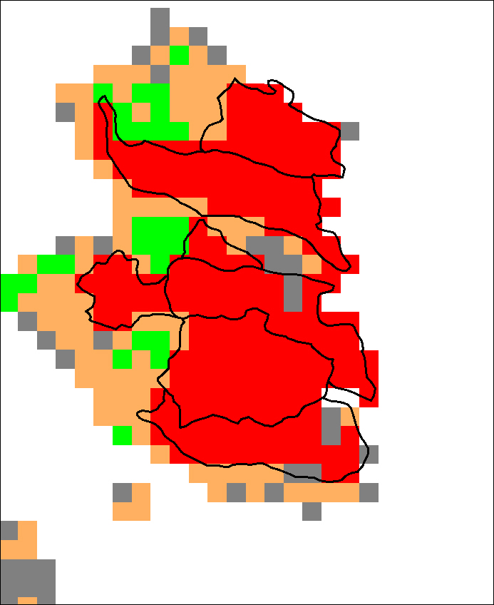
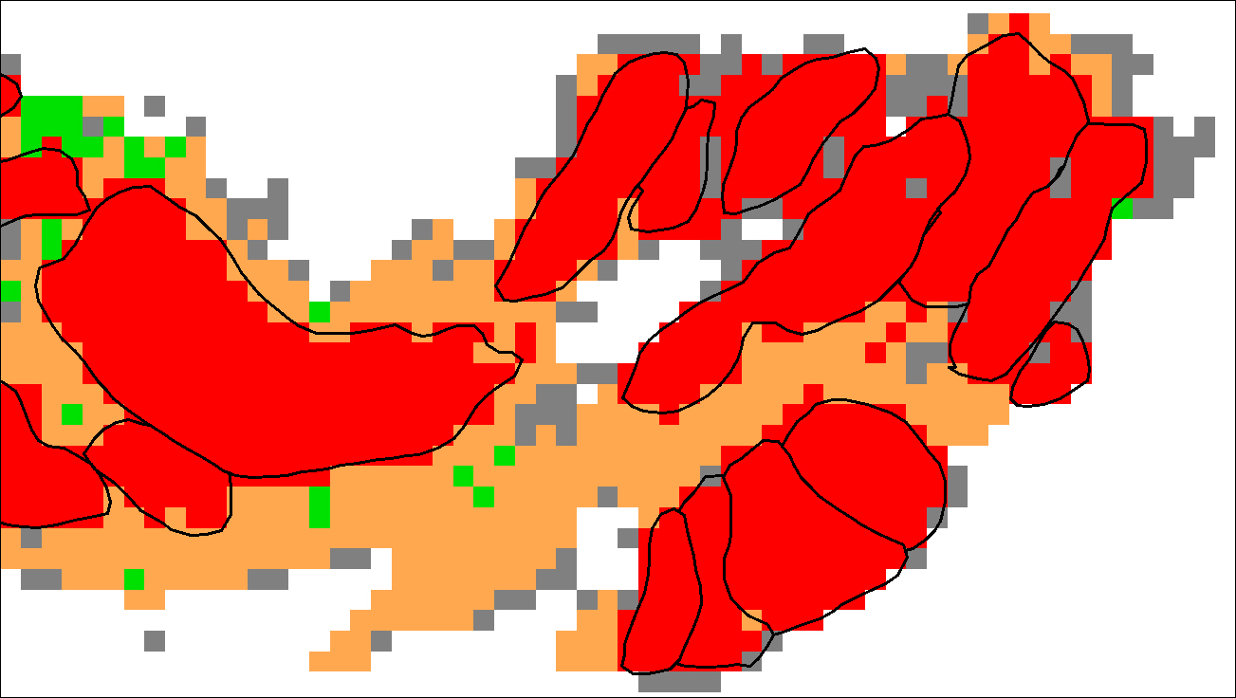

MANAGING EXTREME WILDFIRES
BUFOgrams showing structure of extreme wildfires: red = BUFE; orange = one-pass fire runs; green = multi-day burn-outs; grey = edge effects. Black outlines are BUFEs. Each pixel is 2.5km on-a-side.
Top left: Black Saturday 2019; Top right = Plateau Complex (BC), 2017; Lower right = Mallacoota to Eden, BS; lower left = ACT, 2003.
A virtual PDP Workshop for the 2021 AFAC Conference.
Rick McRae, Jason Sharples
UNSW Bushfire Research Group.
Data: NASA FIRMS

Slide 2
DEEP FLAMING

Slide 3
Deep Flaming
From case studies we know of 7 causes of deep flaming:
  Strong wind
  Wind change
  Eruptive fire growth
  VLS
  Dense spotting
  Interior ignition
  Inappropriate use of accelerant

Slide 4
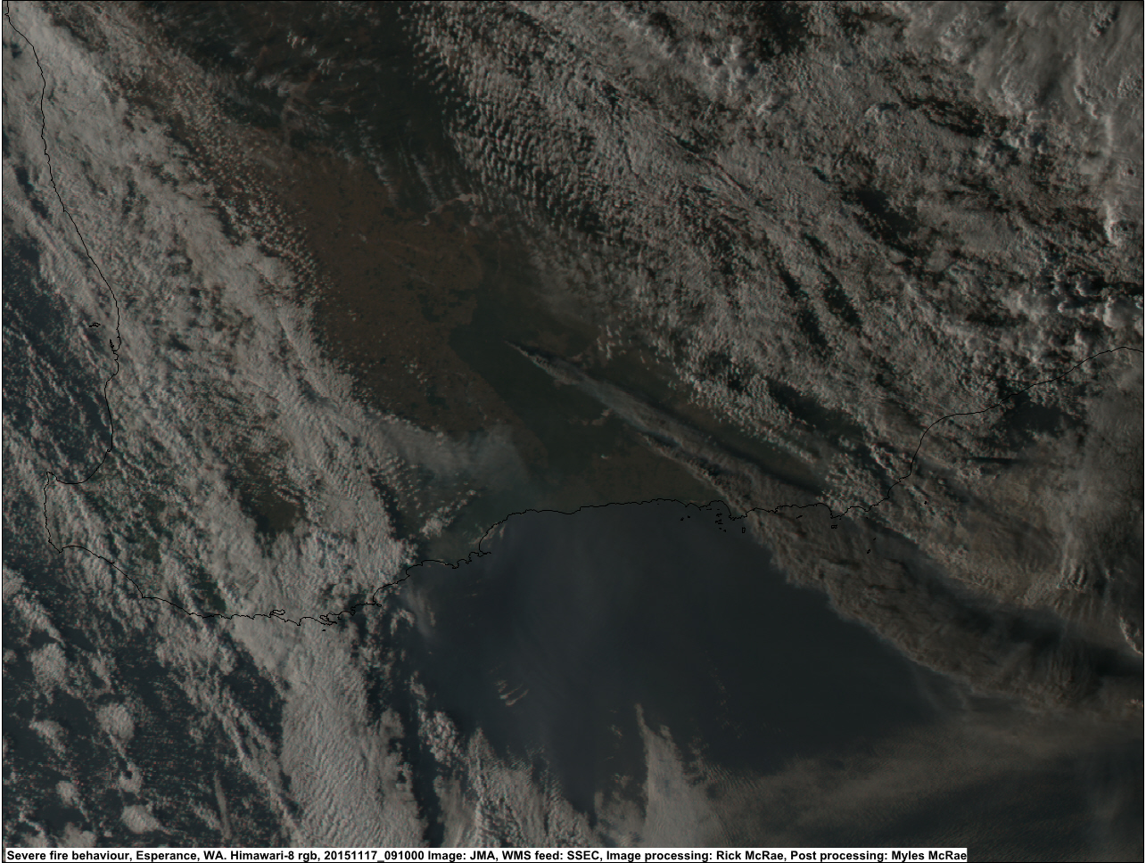
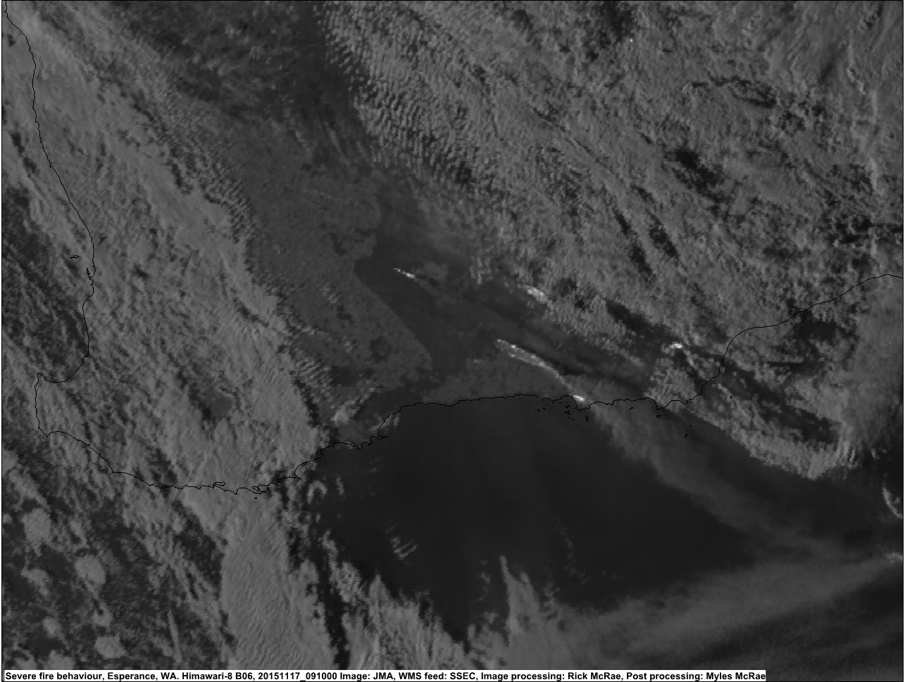
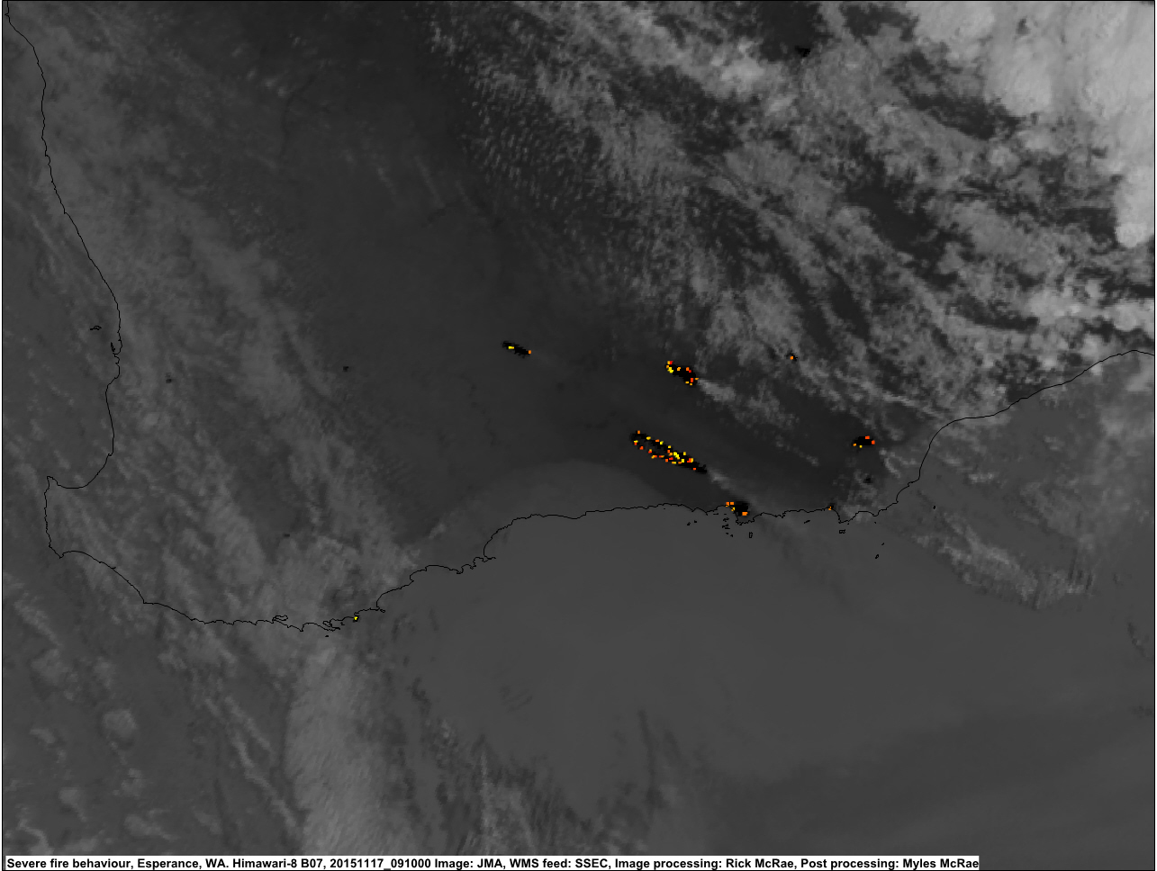
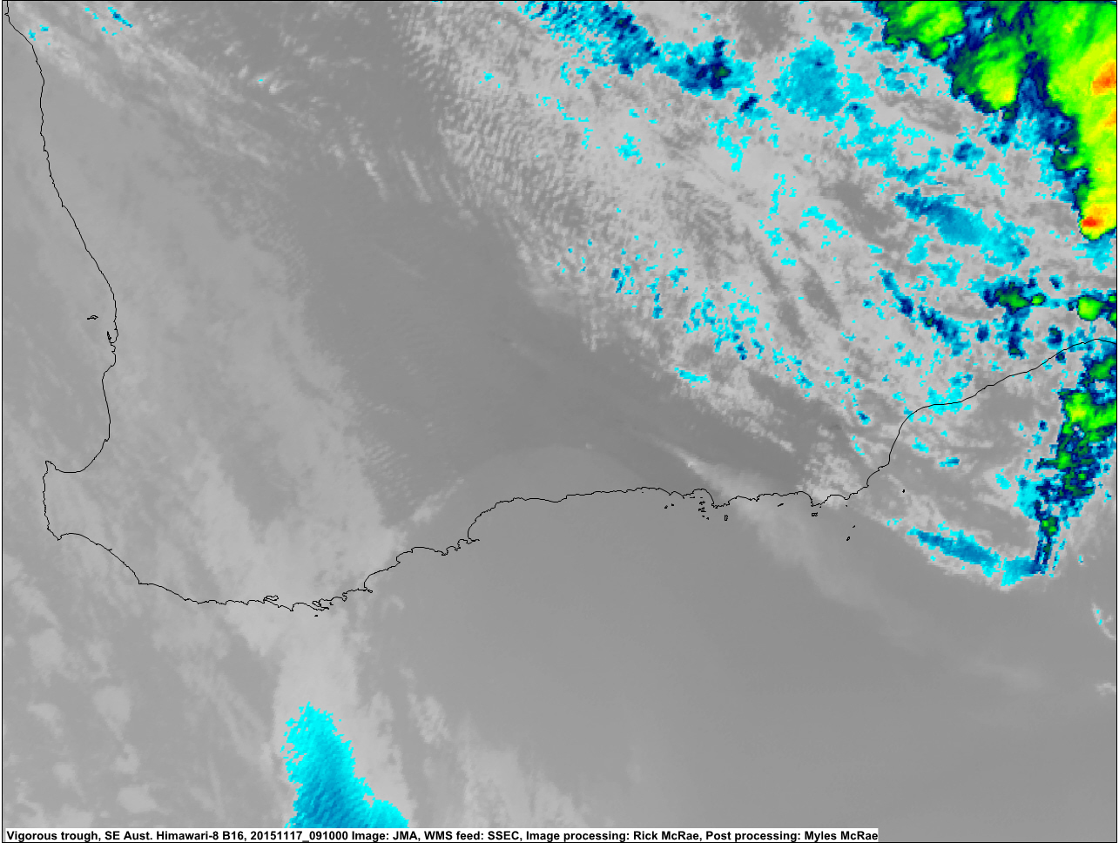
Strong wind
  Esperance fires 20171115
H8 images for 0911 UTC: UL = real colour; UR = thermal IR; LL = 3.9µm NIR; LR = 2.2µm NIR.
[SSEC RealEarth]

Slide 5
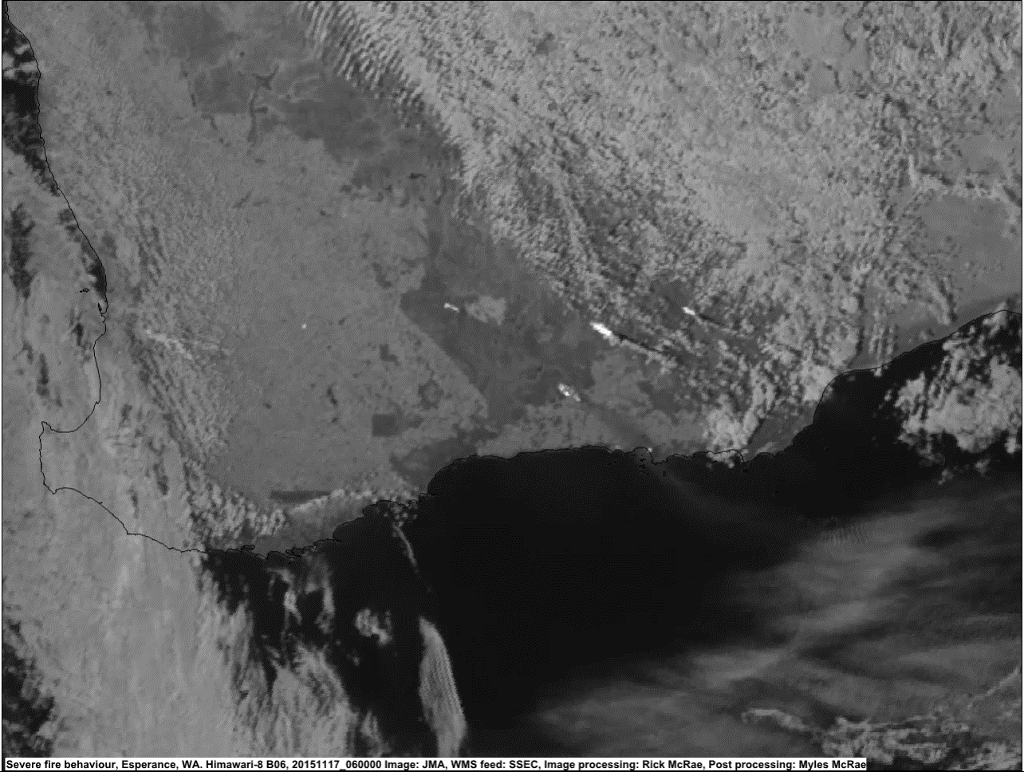

Slide 6
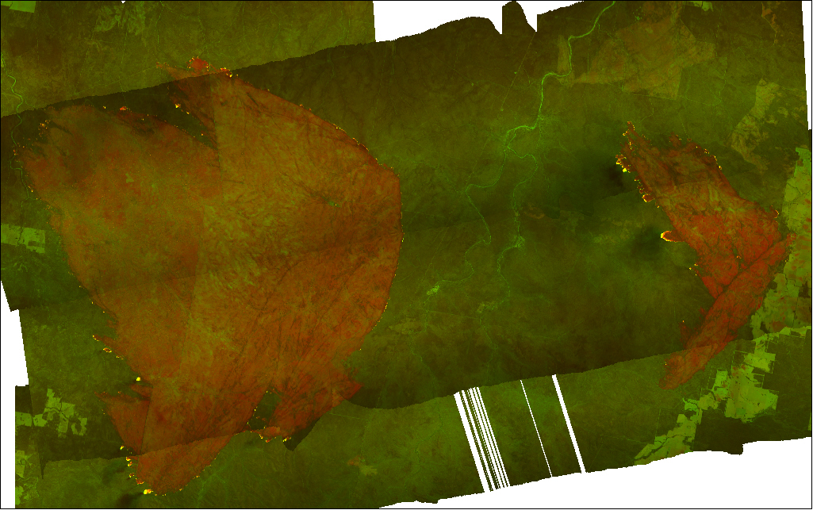
Wind change
  Pilliga Fire 20061130
A second wind change underway (SW – SE – E). A pyroCb resulted. [NSWRFS]

Slide 7
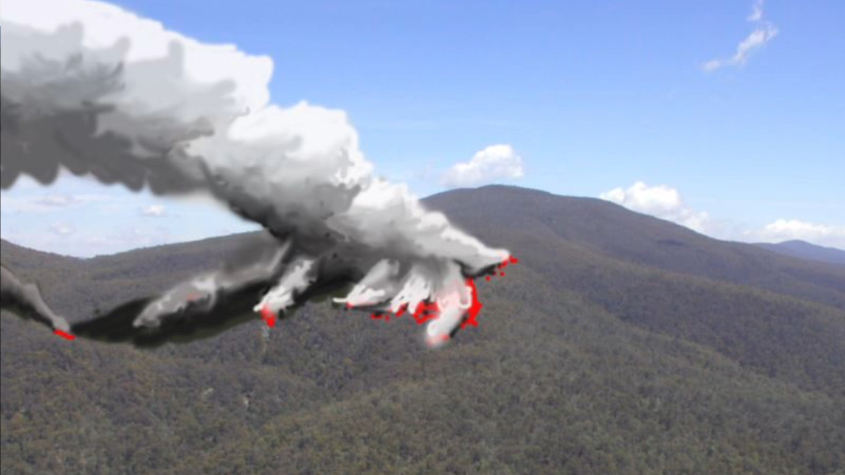
VLS
  2003 fires 20030118
  Video explaining VLS for fire crews.

Slide 8
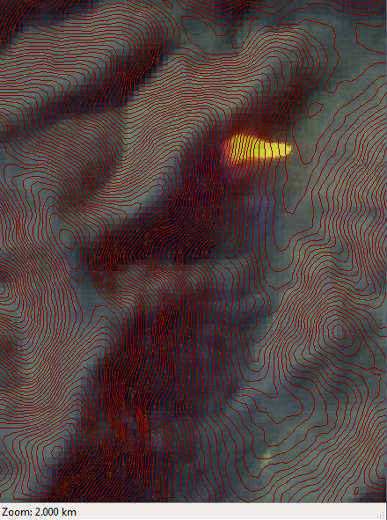
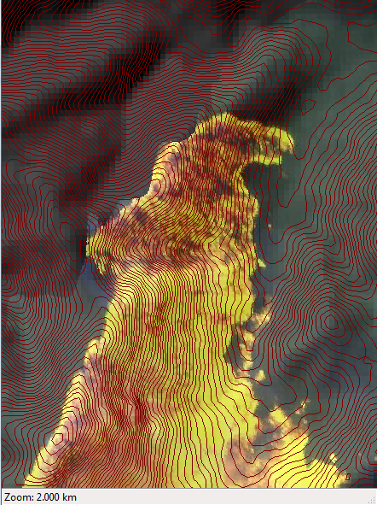
A field example (using linescans)
50 minutes later
Wind direction
Working under the IAP, crew lit a burn-out which quickly entered a VLS generator with spectacular consequences. [NSWRFS]

Slide 9
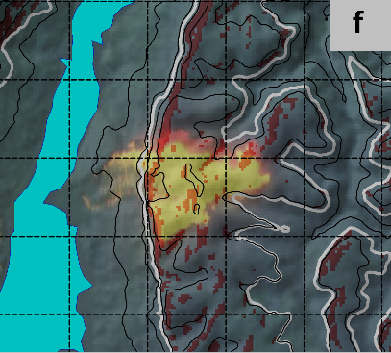

The Green Wattle Creek Fire in the southern Blue Mountains started on 27 November 20019 by dry lightning. It burnt along the Tonalli Tableland and spotted across the stored water in Lake Burragorang (Figure 3). At this point it ran upslope to a cliff-line.
The subject of a science paper being written up describing the “Second-Order VLS Model”.

Slide 10

The new 2nd Order VLS correctly shows that VLS can occur in unexpected places. This produces critical safety awareness for fire crews.

Slide 11
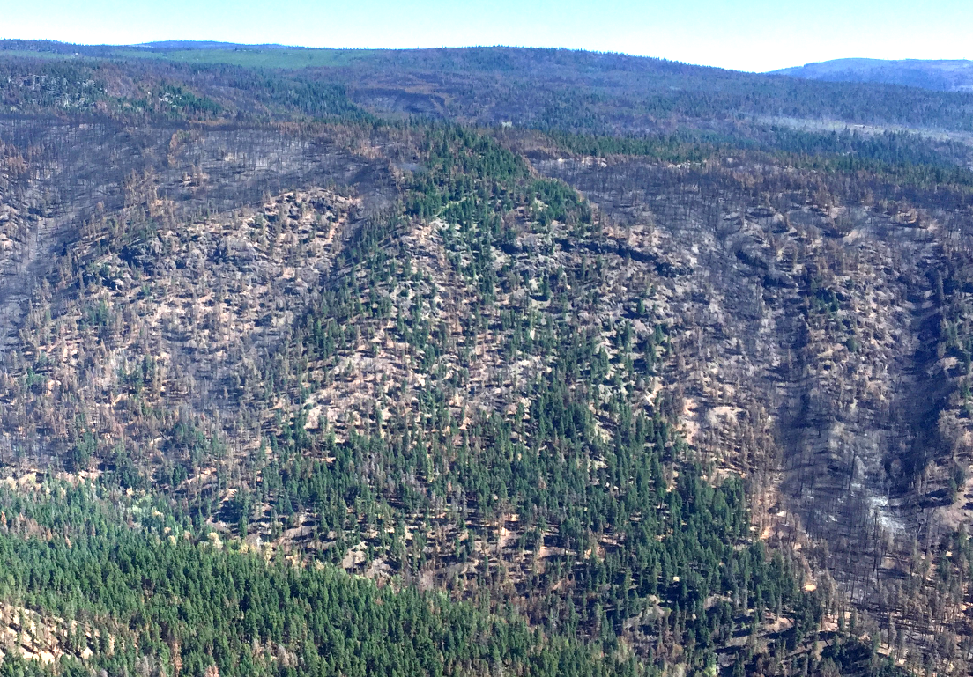
Eruptive growth
Elephant Hill
Fire 20170812
Multiple eruptive fire events carried hot fire up from the valley to the plateau, with spill-over on top. [McRae]

Slide 12
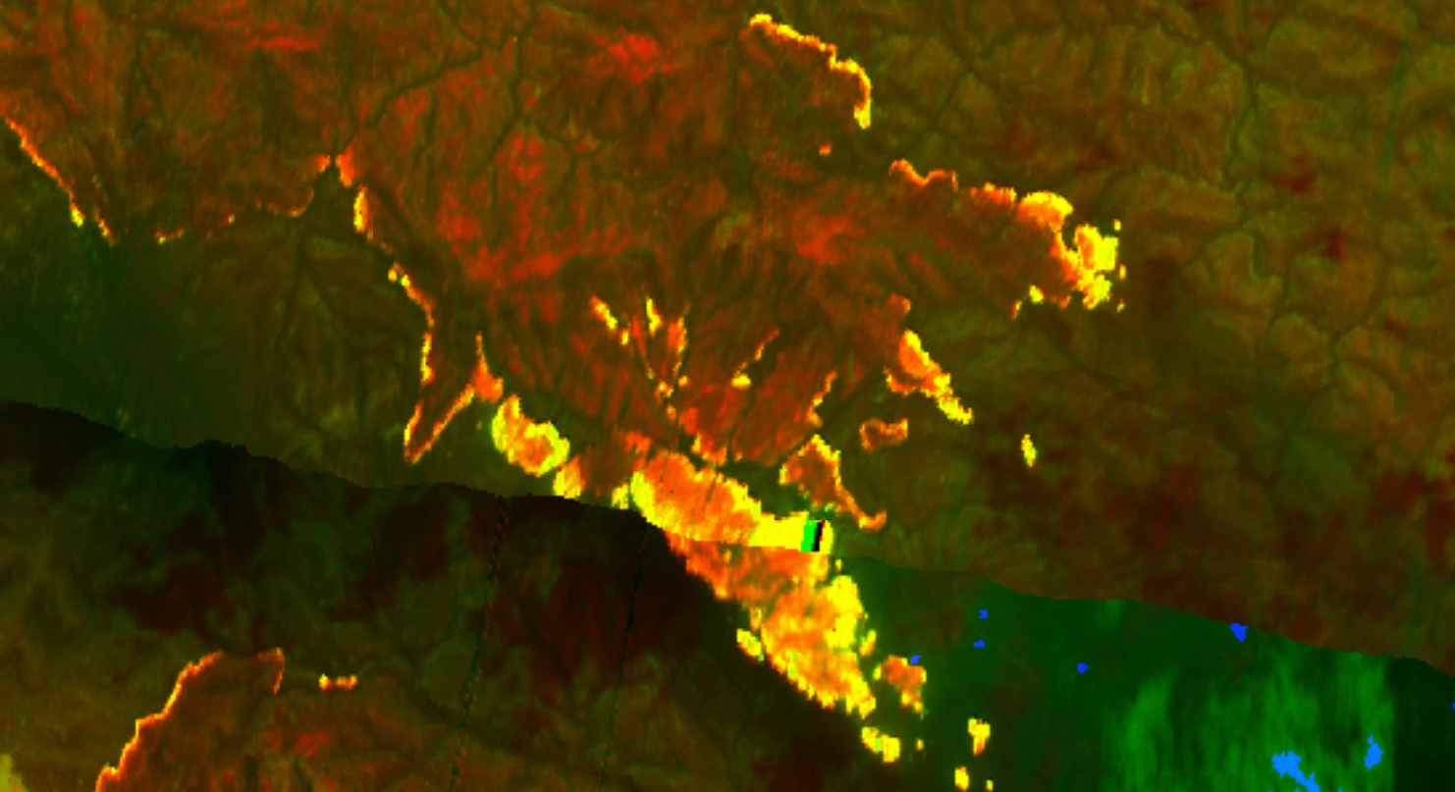
Dense spotting
  Wollemi Fire 20061122
  Dense spotting due to VLS formed deep flaming and then a pyroCb.
[NSWRFS]

Slide 13
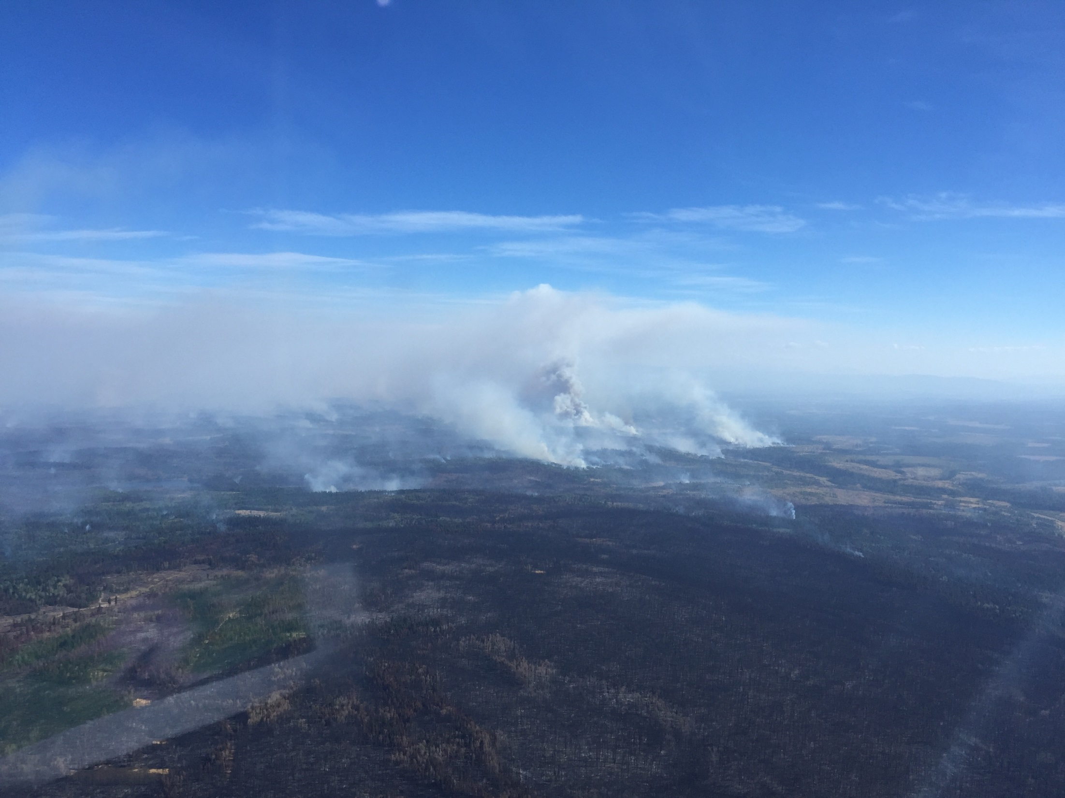
Interior Ignition
  Elephant Hill Fire 201708
Differential burning mosaic across the landscape contributing to a BUFE. Elephant Hill Fire, August 2017.
Photo: McRae.

Slide 14
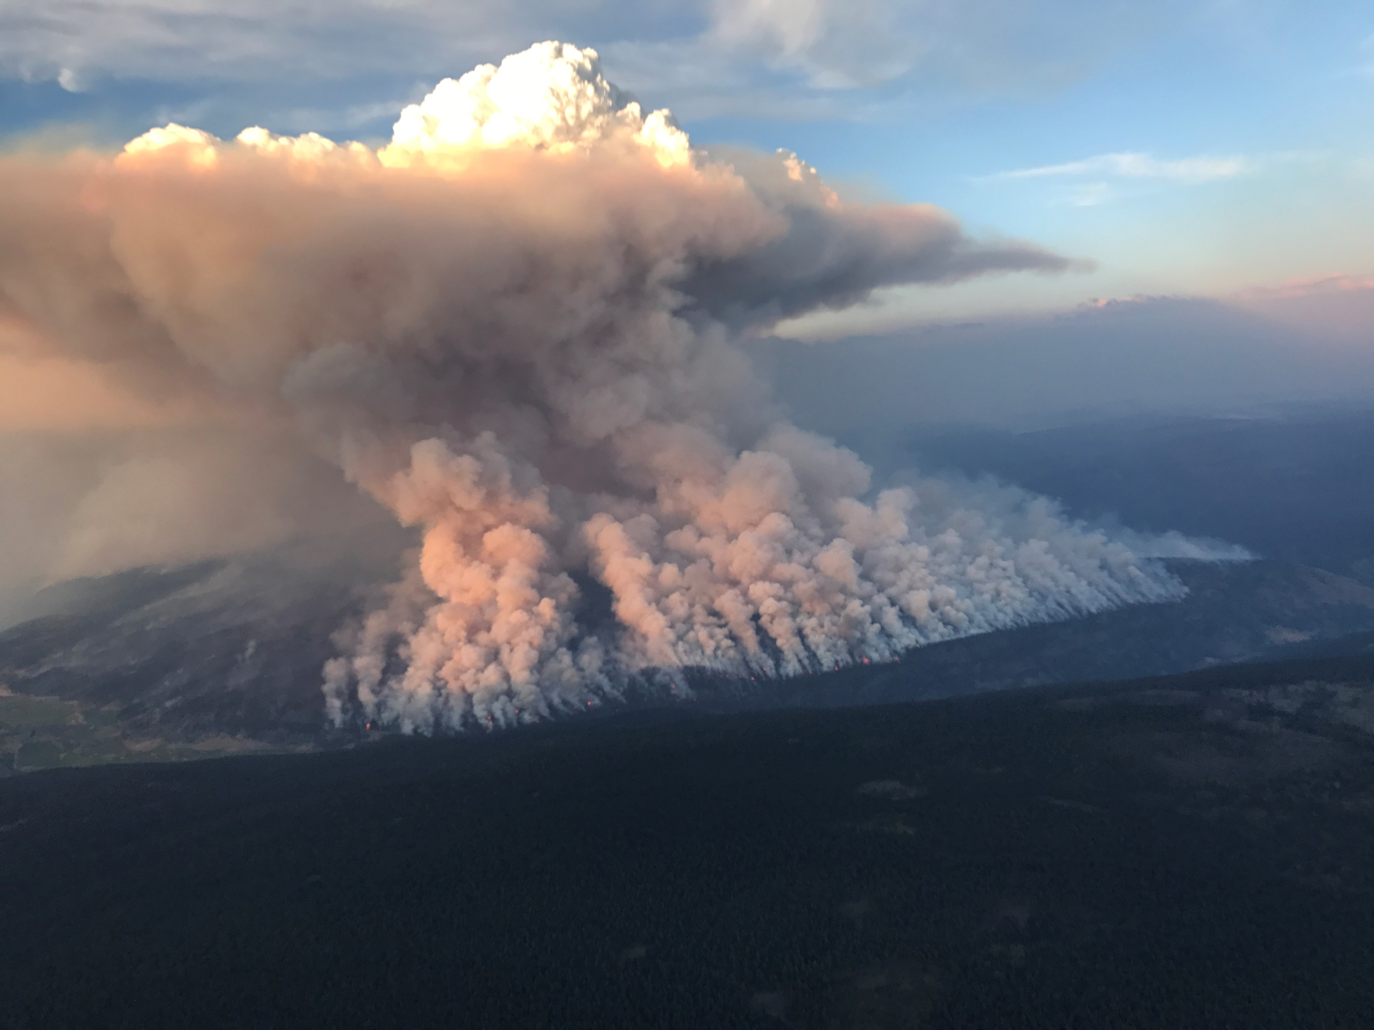
Inappropriate use of accelerant
  Actinoform ignition: Elephant Hill Fire (BC) August 2017.
Actinoform plume from a burn-out, Elephant Hill Fire, Clinton. [Paul Simakov-Ellims, ACTRFS]

