Slide 1
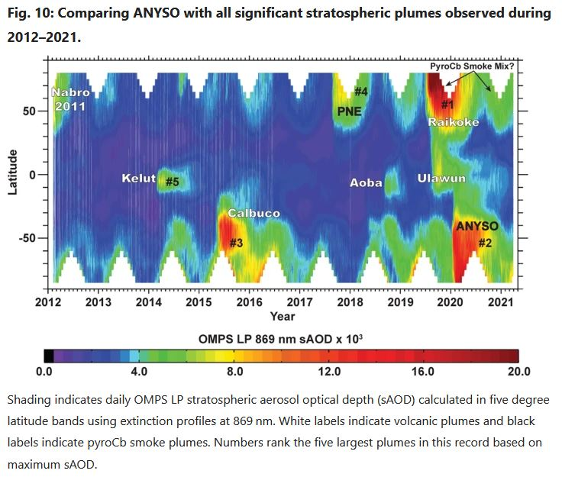

MANAGING EXTREME WILDFIRES
A virtual PDP Workshop for the 2021 AFAC Conference.
Rick McRae, Jason Sharples
UNSW Bushfire Research Group.
Graphic: Nature.

Slide 2
INSTABILITY

Slide 3
Instability/DPD/Cap
Weather balloon (radiosonde) flights provide data on the vertical profile of the atmosphere up to the UTLS.

Slide 4
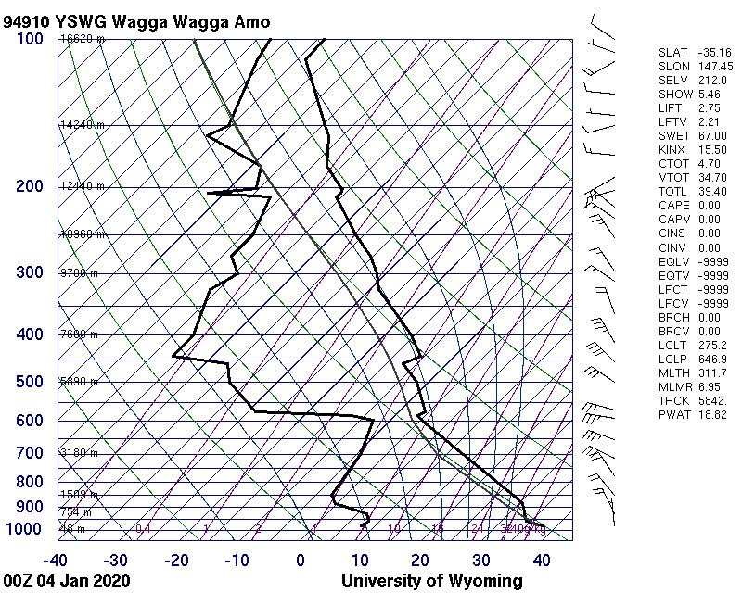
Key aspect for BUFE development:
  Purple = Convective cap
  Orange = dew point depression near the cap
  Blue = LCL = cloud base height

Slide 5
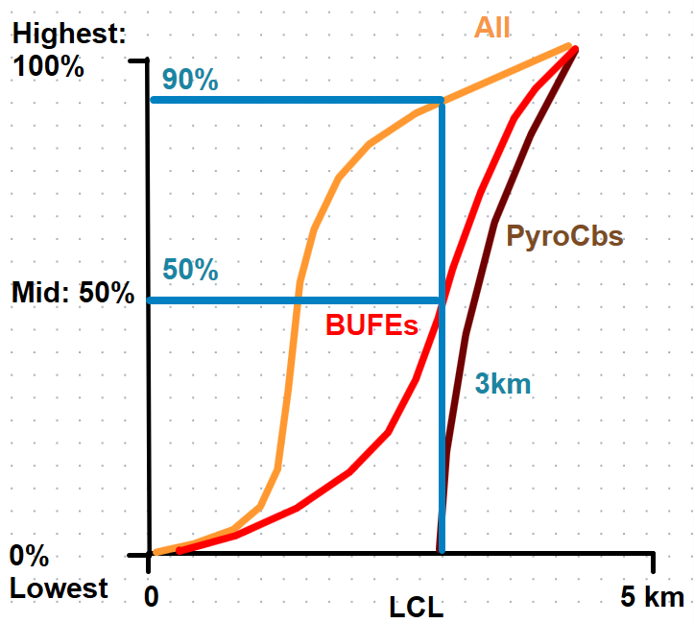
Percentile plots

Slide 6
BUFE Trend 1
50% of BUFEs occur at or above the 90%ile for all days
(3km, equivalent to 20% RH).

Slide 7
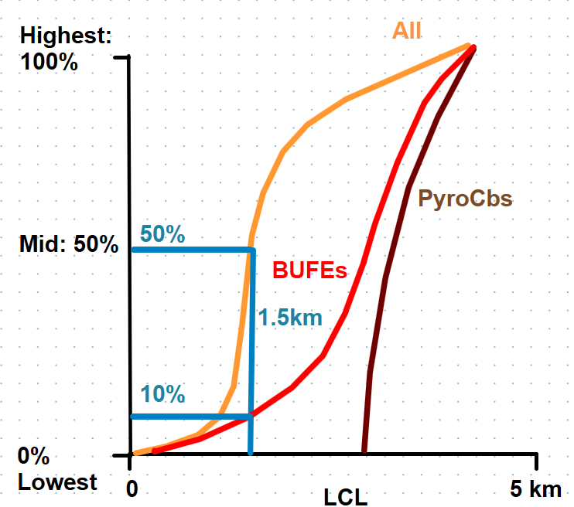
BUFE Trend 2
The 10%ile for BUFEs, 1.5km (equivalent to 40% RH), is the 50%ile for all days.

Slide 8
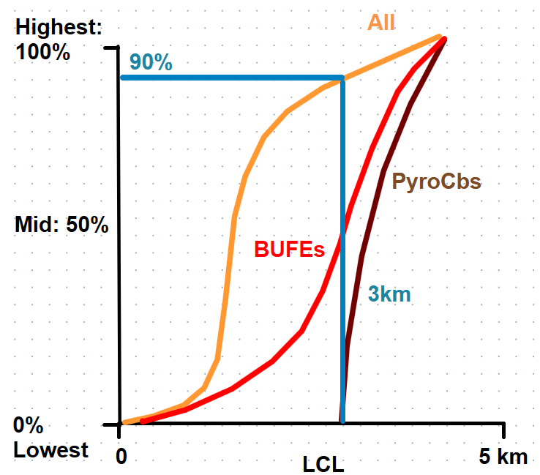
PyroCb Trend 1
PyroCbs occur at or above the 90%ile for all days (3km or 20% RH).
PyroCbs mostly occur with low RH and high cloud base.

Slide 9
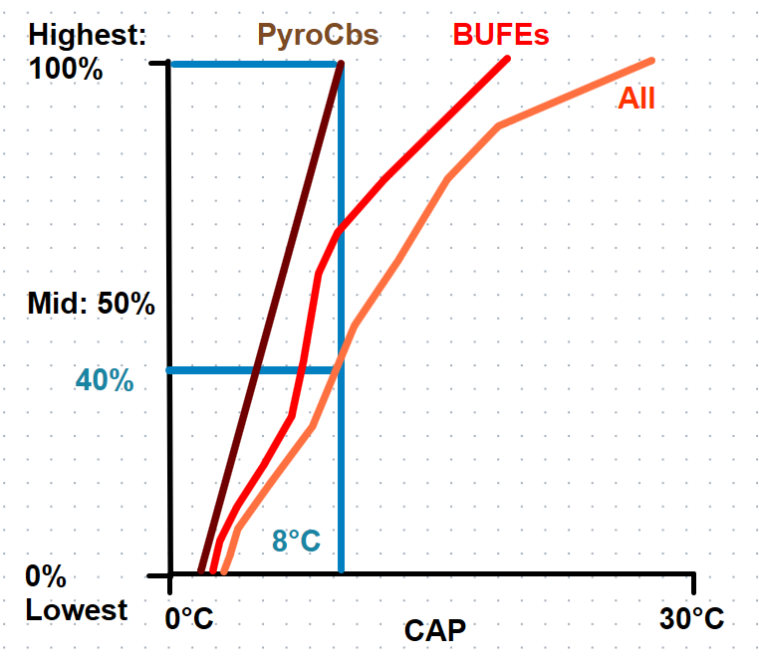
PyroCb Trend 2
All pyroCbs occur below the 40%ile CAP.
There is little difference for BUFEs.

Slide 10
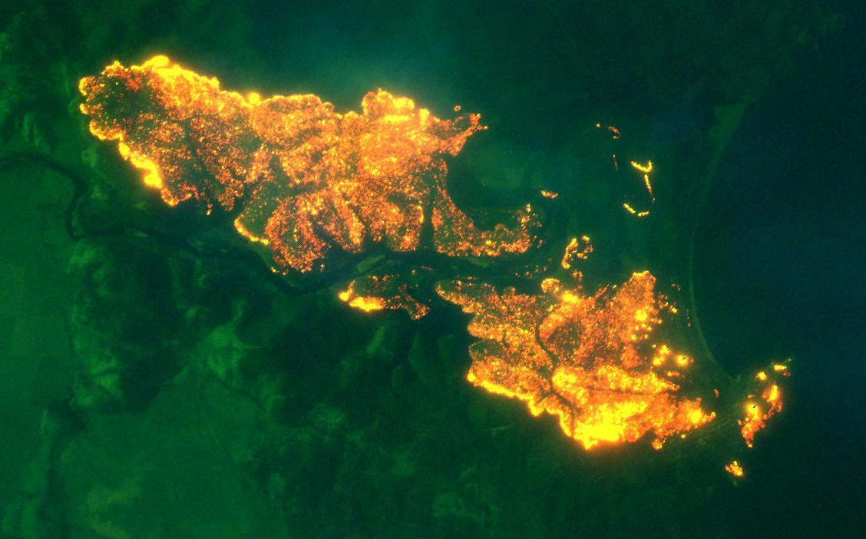
Isentropic drawdown (ID)
Types of foehn wind
Role of ID
  Tathra Fire 20180323
  Northern blocks during BS
[NSWRFS]

Slide 11

Foehn winds, and especially isentropic drawdown, can drive BUFE development on a large scale.

Slide 12
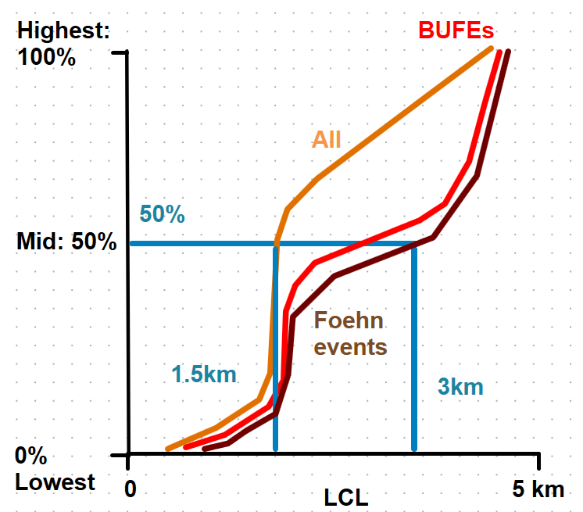
Foehn Trend 1
The median LCL height for both foehn BUFEs and foehn events (3km) is double that for all days(1.5km).

Slide 13
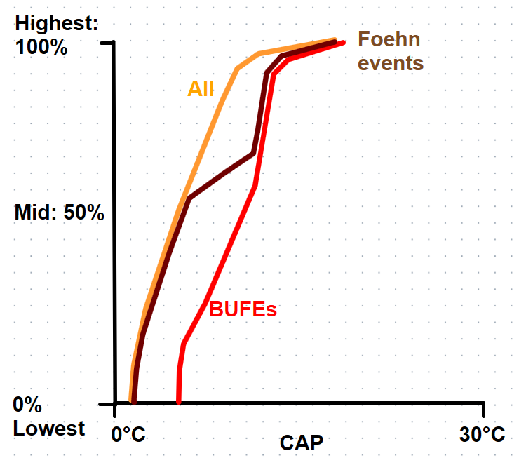
Foehn Trend 2
There is a tendency for foehn BUFEs and, to a lesser extent, foehn winds to occur under stronger CAPs.

Slide 14
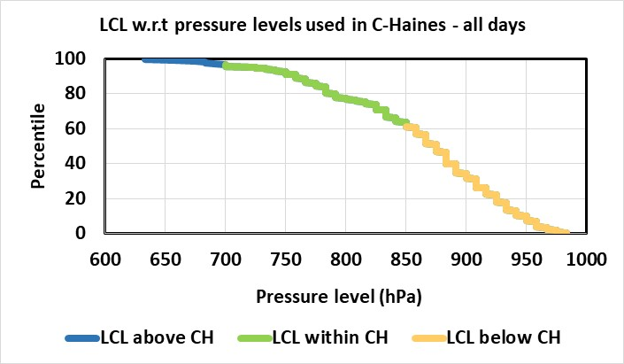
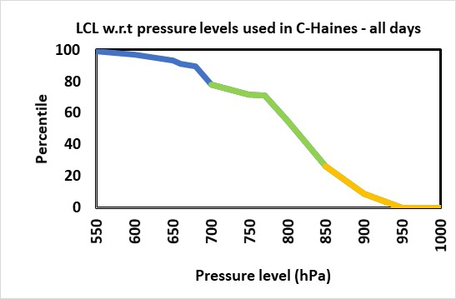
Haines Indices?
Work underway shows that, during BS:
  5% of CH values were correctly based on data from below the LCL.
  60% of CH values were based on data from above the LCL.
  35% of CH values were based on data from either side of the LCL.
CH can either indicate FDR or instability, not both.
BUT both can indicate a BUFE potential.
Note: The LCL values used here are estimated from surface T and DP, as might be done in the field on a bad fire day. On the right are values for measured change points in the T trace.
Data: University of Wisconsin, Analysis: McRae

Slide 15
Caveat
Technically, Mid-level C-Haines should only be used on a fire day when the RH is less than 12%!
However on bad fire days it “works” for RH up to 25% if there is a DPD in place near the LCL.

Slide 16
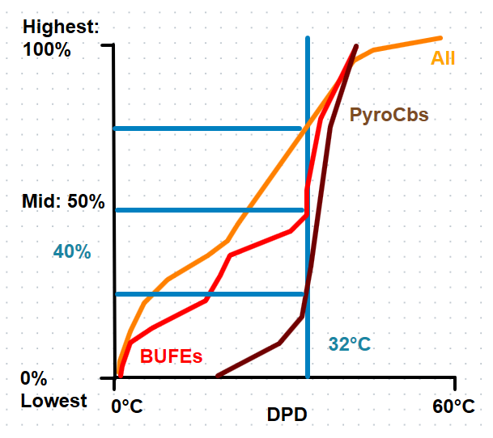
C-Haines Trend
A DPD of 32°C is exceeded by:
  25% of all days
  50% of BUFEs
  75% of pyroCbs

Slide 17
The role of the convective cap must be understood.

Slide 18
High country plumes can bounce back off a convective cap and drive unexpected fire runs.
Brian Potter: The Drumskin Effect.

Slide 19
The role of dew point depression near the LCL must be understood.

Slide 20
The role of the LCL must be understood.

Slide 21
Caution is required if using C-Haines as an index for instability.

Slide 22
An old learning worth repeating:
The instability of the atmosphere above the LCL must be understood.

Slide 23
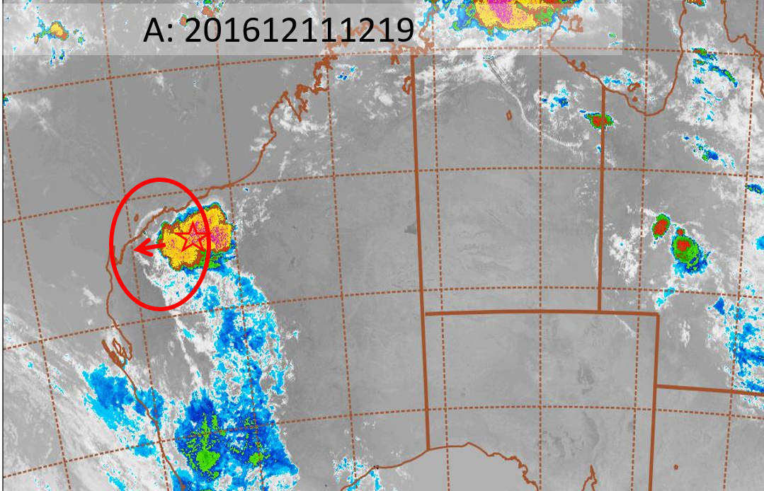
Undular Bores
These synoptic-scale outflows from storm systems act to reduce the convective cap and can help trigger a BUFE, Cb, or pyroCb.
Undular bores from storms cells, 11 Dec 2016. [H8 imagery, US Naval Research Laboratory, Monterey]

