Slide 1
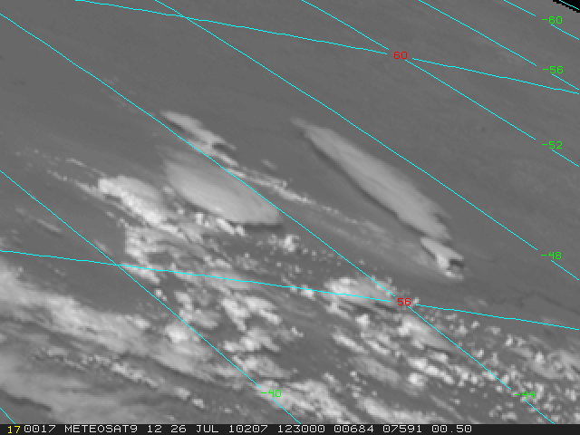

MANAGING EXTREME WILDFIRES
A virtual PDP Workshop for the 2021 AFAC Conference.
Rick McRae, Jason Sharples
UNSW Bushfire Research Group.
26 July 2010, W Russia. Image: Dan Lindsey & EUMETSAT

Slide 2
PYROCBs

Slide 3
PyroCbs
Extreme upwards manifestations of violent pyroconvection above a BUFE.
Hazards: Lightning ignitions downwind; cancellation of aerial fire-fighting.
Global monitoring for climate change & atmospheric dynamics.

Slide 4
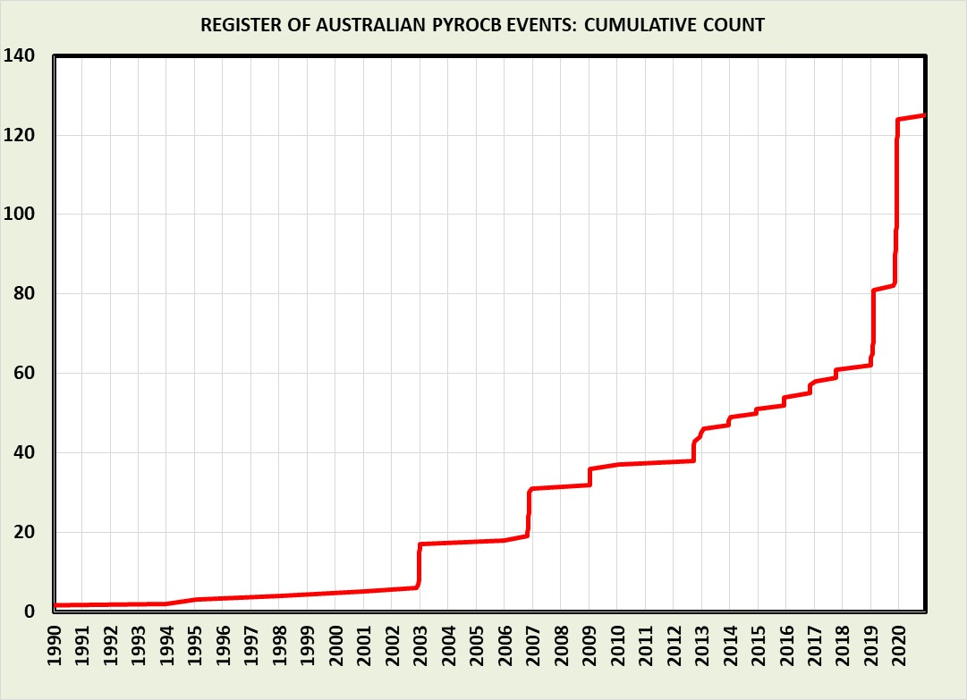
PyroCbs
f
Massive escalation of national trends:
a = E Aust
b = WA
c = E Vic
d = Black Summer (includes ANYSO)
e = WA
f = WA.
e
d
c
b
a
Data: PyroCb Group (esp. Fromm, Servranckx, McRae),
Analysis : McRae

Slide 5
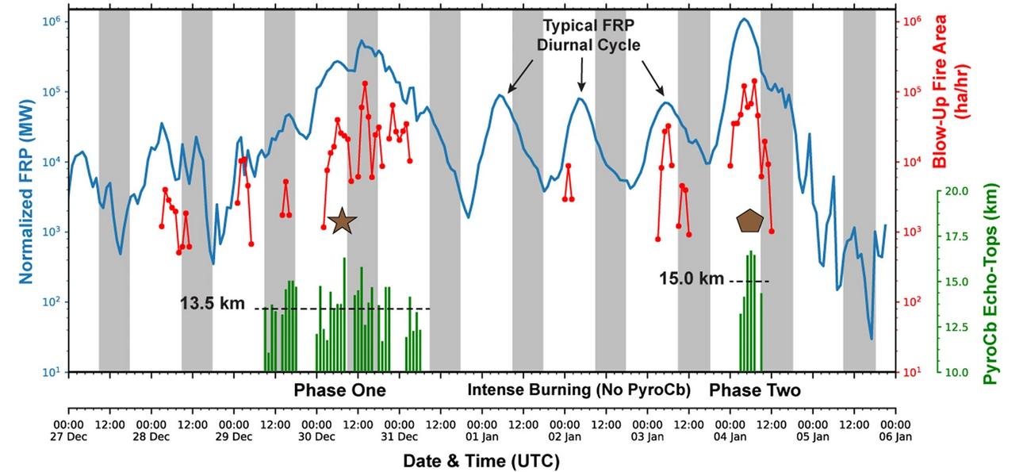
PyroCbs are a good indicator of the total power and energy setting for a fire.
Afternoon of 4 Jan 2020: 100,000 ha burnt per hour releasing a million MegaWatts of power.
Now remember your fire training and learning about kiloWatts per metre.
Graphic: Peterson, et al. 2021, Nature.

Slide 6
REMEMBER
A pyroCb is a clear sign that matters on the fire ground are as bad as they can get.
We do not manage pyroCbs, we survive them.
We watch for things like lightning.
The real focus is on the BUFEs.

Slide 7
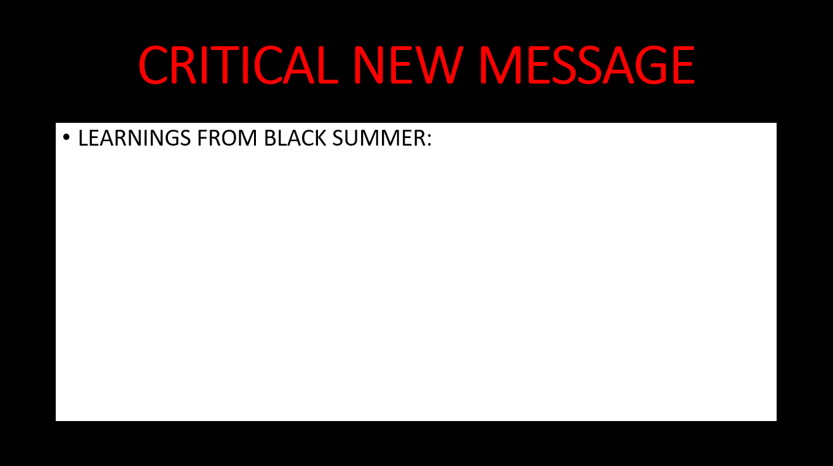
Climate change is producing exponential growth in the frequencies of BUFEs and pyroCbs.

