Slide 1
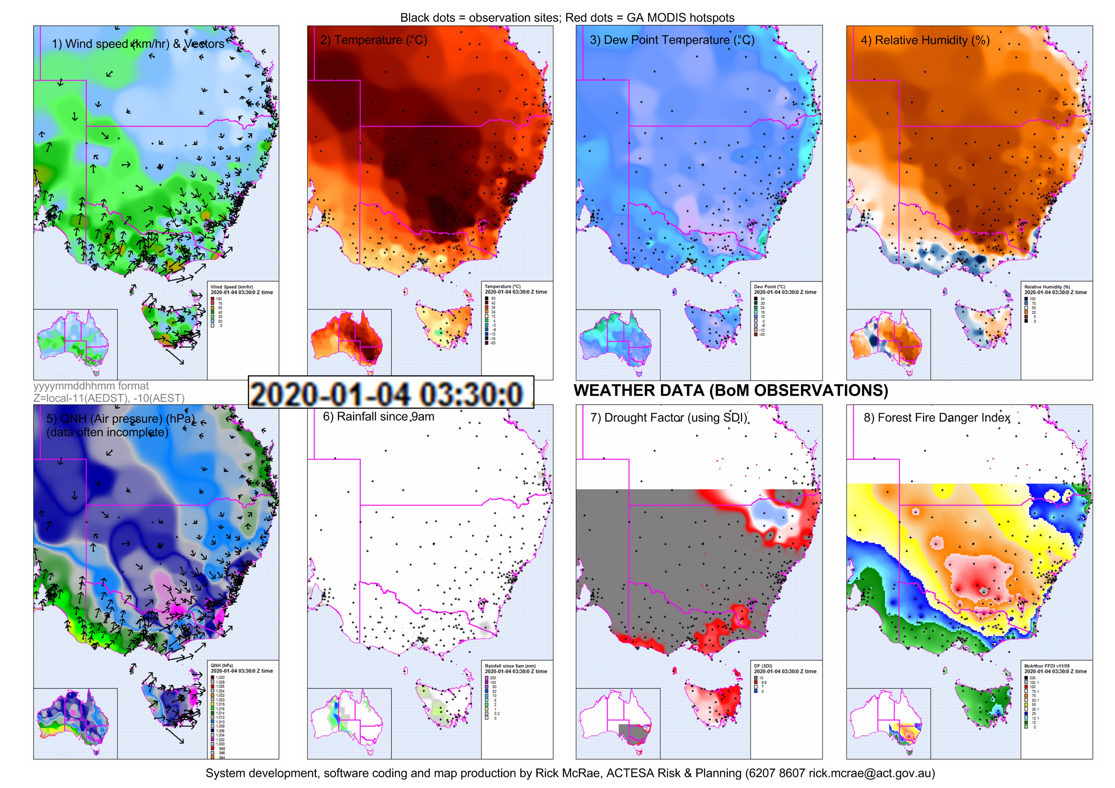

MANAGING EXTREME WILDFIRES
A virtual PDP Workshop for the 2021 AFAC Conference.
Rick McRae, Jason Sharples
UNSW Bushfire Research Group.
Animation: JAXA, NICT, BoM

Slide 2
DATA

Slide 3
There are a set of classes of data required for management of extreme wildfires:
  Fire weather (trad.)
  Fire fuel (trad.)
  Terrain (trad.)
  Profile weather - stability
  Terrain indices – esp. VLS-prone lands
  Fire & plume
  Science-oriented datasets

Slide 4
Data sources
WEATHER: BoM registered user pages or agency portals. Field data.
FUEL: Agency fuel state reports.
Satellite based fuel index portals.
Drought index portals.
TERRAIN: Field data. Remote-sensing data. Terrain index portals.
PROFILE: BoM & fire agency radiosonde data. NWP estimates.
FIRE: Airborne (fire agency) and space (portals) remote sensing fire data. BoM radar. Photography.
SCIENCE: Value-added datasets from the above, especially remote sensing.

Slide 5
Fire weather, fuel & terrain data
You should all be on top of these!
You need to know what goes on in between BUFEs.
Use your agency’s ratified data sources.

Slide 6
Profile weather data
This comes from weather balloon flights or NWP runs.
Source examples:
http://weather.uwyo.edu/upperair/sounding.html
http://reg.bom.gov.au/aviation/observations/aerological-diagrams/
Fire agency balloon flight data dissemination channels (e.g. email list).

Slide 7
Terrain index data
http://www.highfirerisk.com.au/maps/index.htm
Discussed in detail in another session.

Slide 8
Fire data
Operational data
Summary data – public summaries, etc.
Remote sensing: weather radar, satellites, cameras, etc.

Slide 9
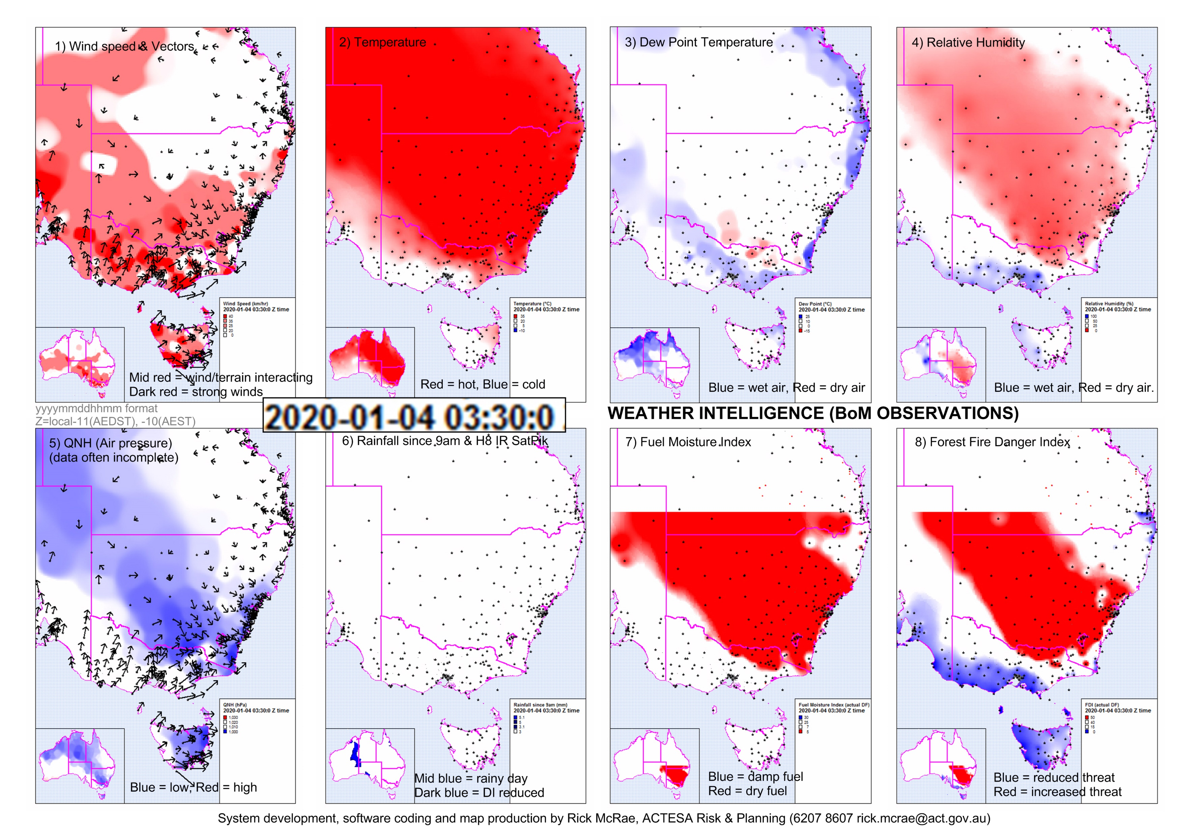
Science-oriented data
The goal is to ingest & archive real-time data flows in a coordinated way to support real-time work and also post-fire analyses.
Questions:
  Time stamp formats? (UTC or local, DTG or date/time format)
  Raw data, value-added information, intelligence products?
  Coronial sensitivities?
  Custodianship?
  Copyright?
Information (left) – Intell (right: red mostly = bad for firies)
WSp, T, Dp, Rh, QNH, Rf, DF, FFDI)

Slide 10
Satellite imagery
PLATFORMS:
  Himawari 8 AHI data – 0.5km to 2 km, 10 minute repeat.
  Terra/Aqua MODIS data – 0.25km to 1 km, 4 passes per day.
  Sentinel 2 data – 10m to 60m , every three days.
  LandSat data – 15m to 60m, every 16 days.
BANDS:
  Visible bands
  Near InfraRed bands – fire temperature
  InfraRed bands – cloud tops
  Water Vapour bands – mid-tropospheric moisture.
ISSUES:
  Parallax
  Clouds and/or dense smoke
CALIOP/CALIPSO – atmospheric aersol LIDAR – two passes per day.
Future plans – Low Earth Orbits.

Slide 11
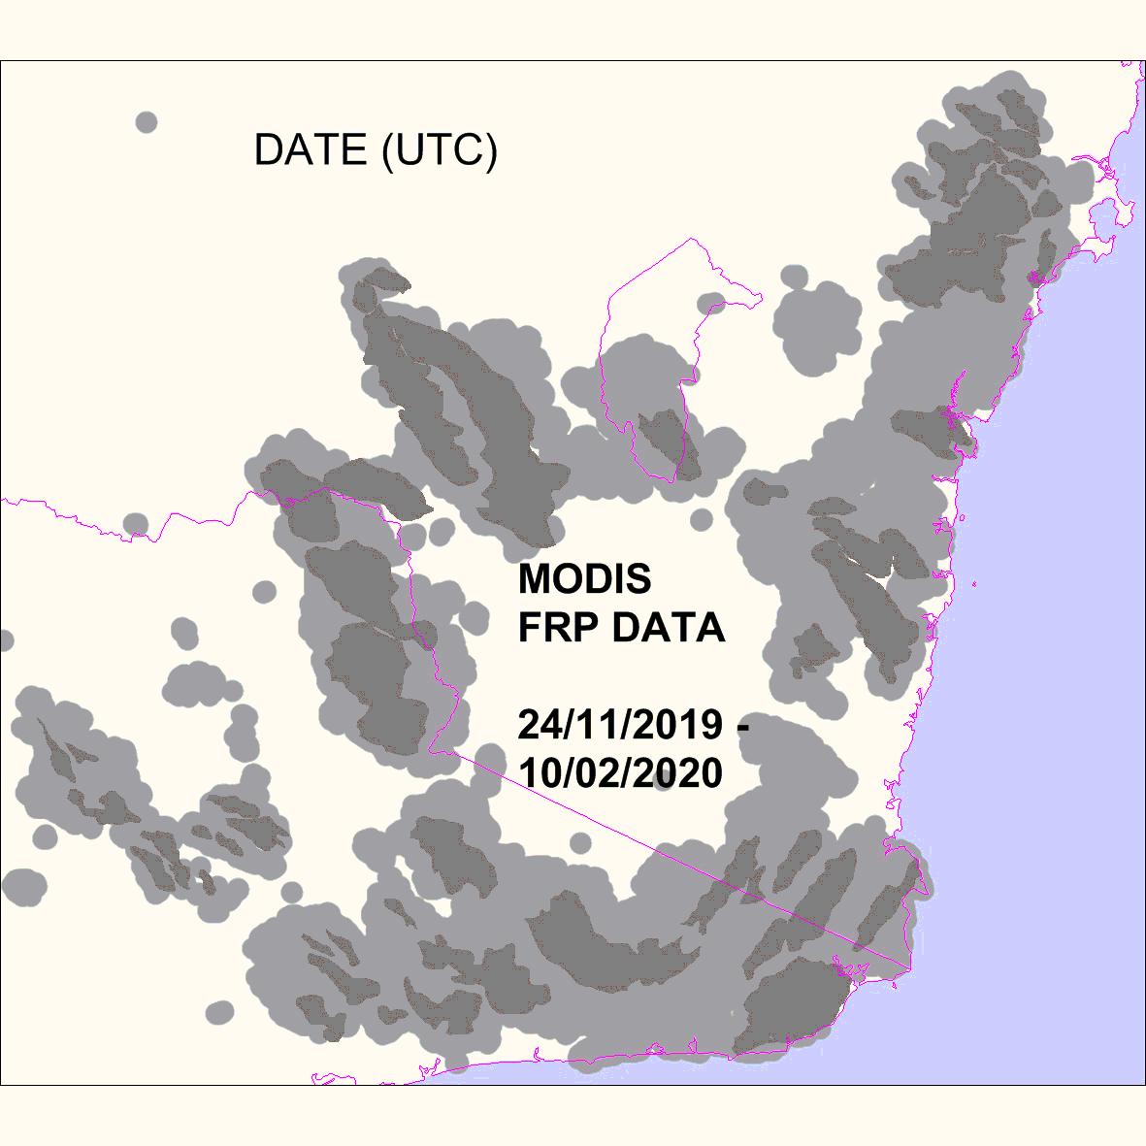
Hotspots
Algorithm derived fire pixels.
Note the pulses at regional scales.

Slide 12
Terrain analysis
Elevation/Slope/Aspect = normal dataset used. But:
  MSER = lightning ignitions
  Wind regime
  VLS – 1st order & 2nd order models
  Ruggedness: large fires in rugged terrain are not put out – catch then when they leave.

Slide 13
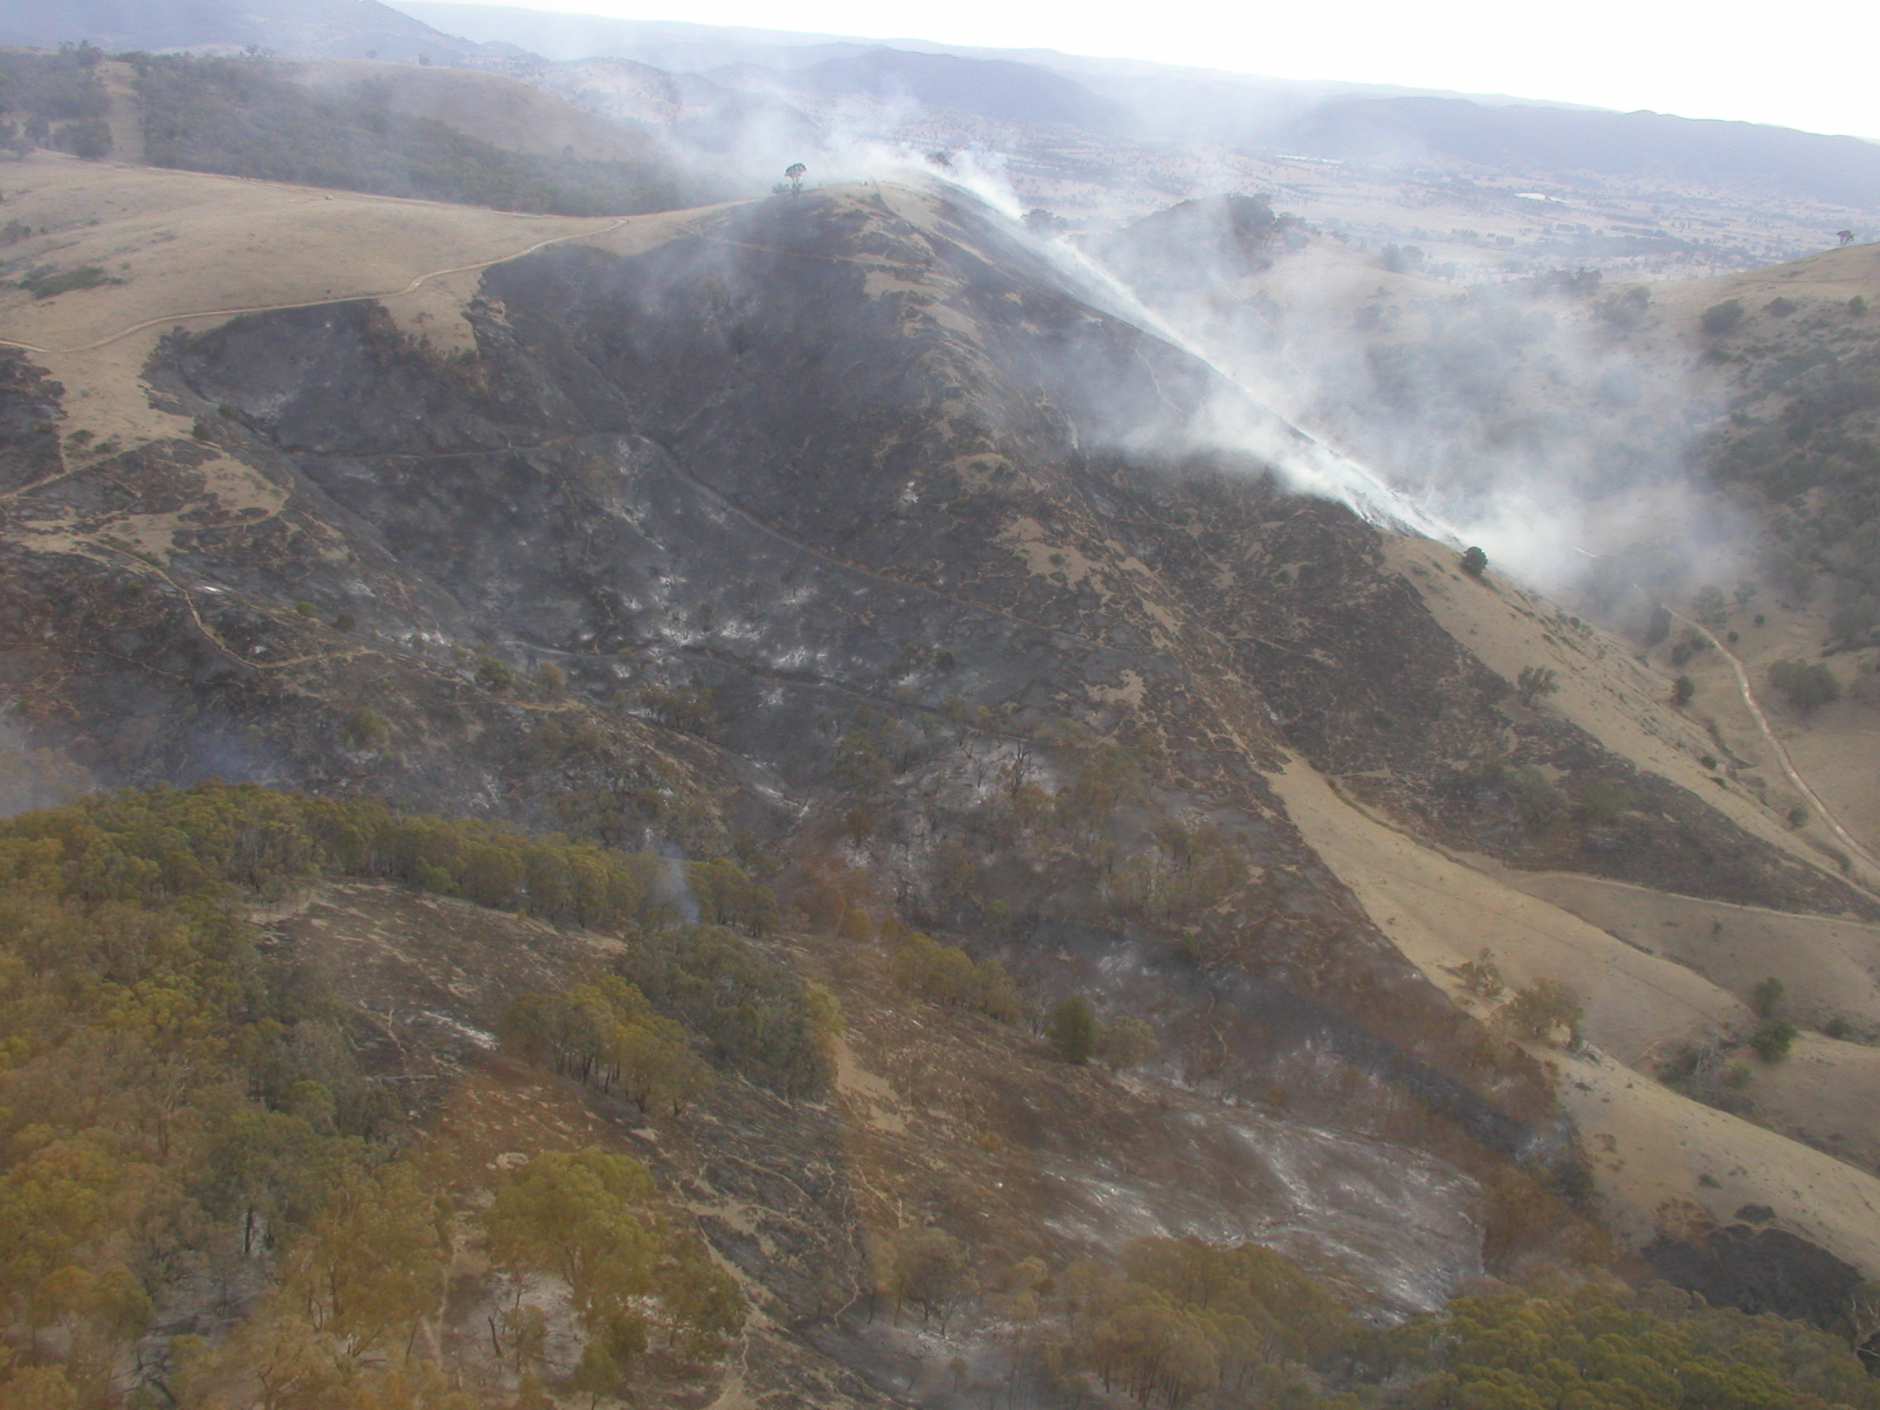
Vegetation data
Vegetation type – ability to support a BUFE.
Role of fuel load.
---END ---
Billo Road Fire, NSW, 20061211. VLS in grass? [McRae]

