Slide 1
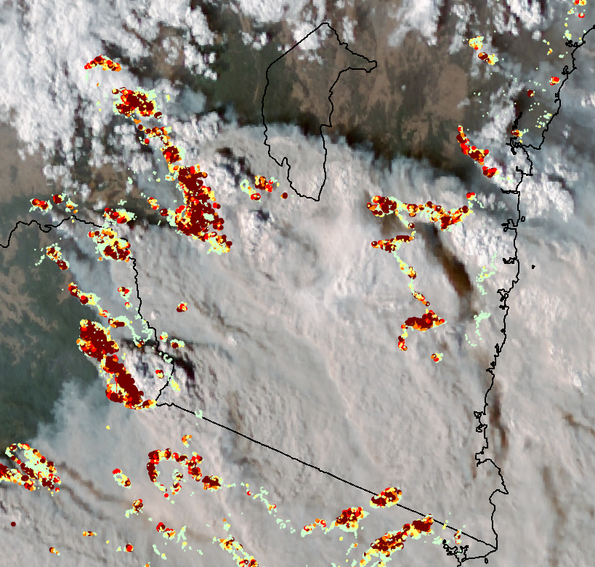

MANAGING EXTREME WILDFIRES
A virtual PDP Workshop for the 2021 AFAC Conference.
Rick McRae, Jason Sharples
UNSW Bushfire Research Group.
VIIRS hotspots & H8 imagery. Data: NASA, JAXA

Slide 2
MAPPING

Slide 3
BUFE mapping
Not just fire perimeter mapping: flaming area geometry + smouldering area + spotting
Intelligence objectives: perimeter mapping vs BUFE detection
Does it reflect predictions?

Slide 4
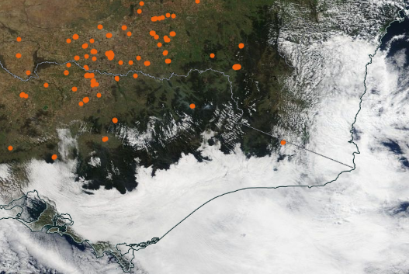
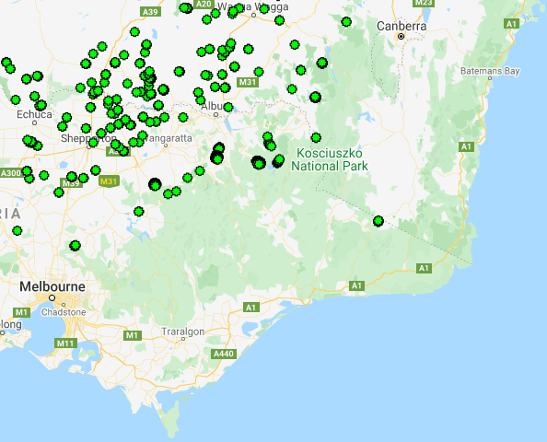
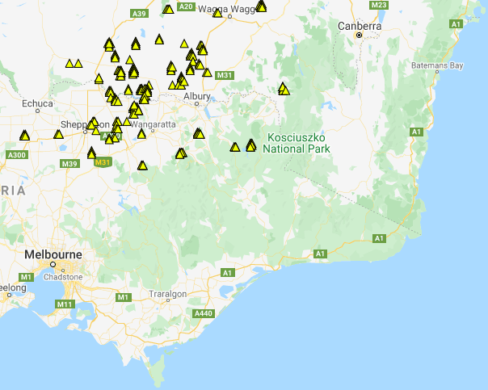
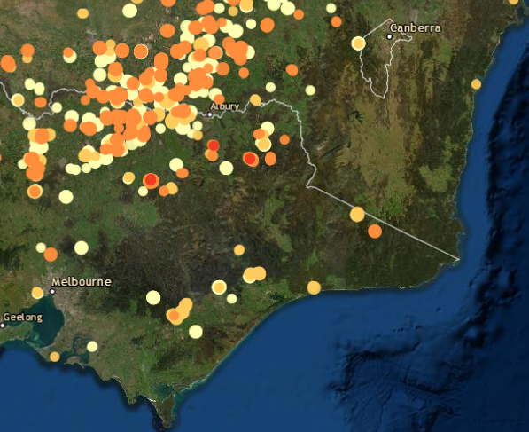
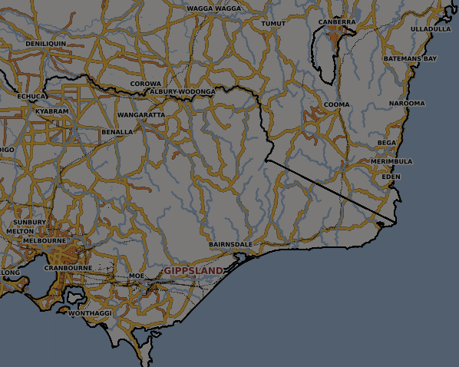
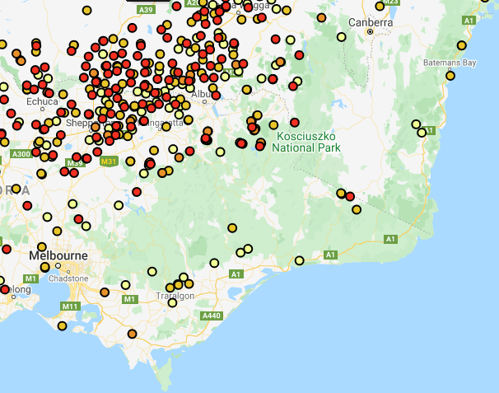
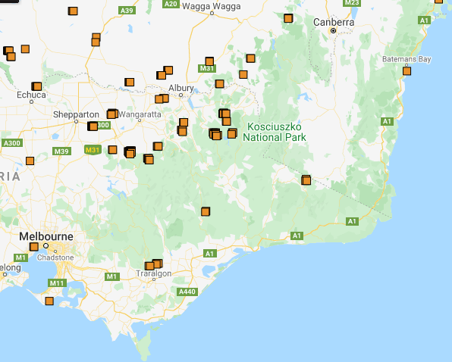
Hotspots
MODIS
VIIRS
H8
NASA FIRMS/ WorldView
DEA
FireWatch
NAFI
From top left: WorldView MODIS,
LandGate VIIRS,
LandGate H8,
GA DEA hotspots,
LandGate NOAA,
LandGate MODIS.
Bottom left: NAFI masked out in this area.

Slide 5
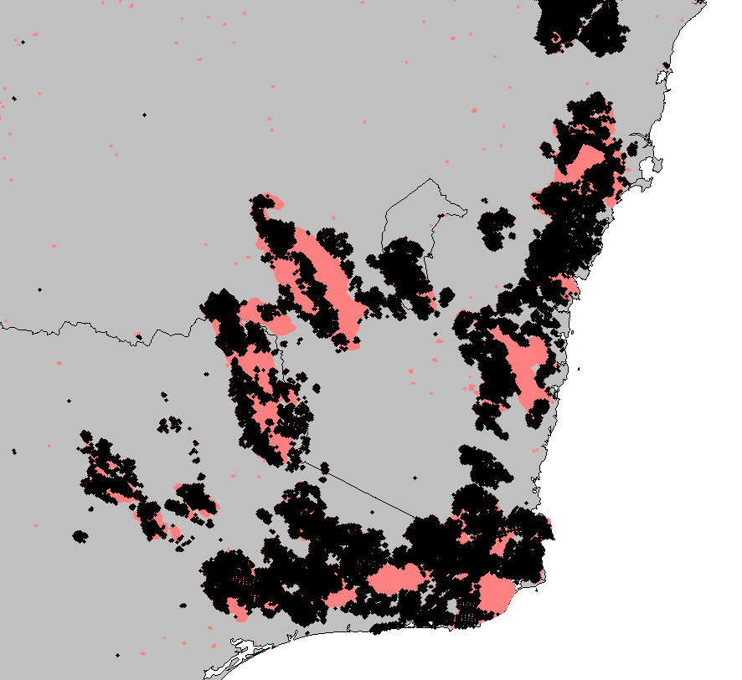
Lack of hotspots
Diagnostic for BUFE
Compare to burn area imagery
Satellite imagery, NDBI
Radar
Satellite data
Fire agency data
Black = MODIS hotspots
Red = Area burnt in BUFEs

Slide 6
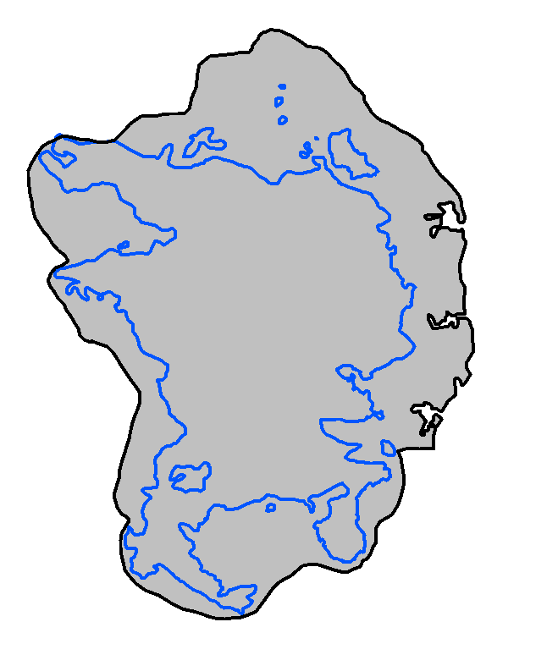
Perimeter mapping
Map an isochrone to track a fire’s progress.

Slide 7
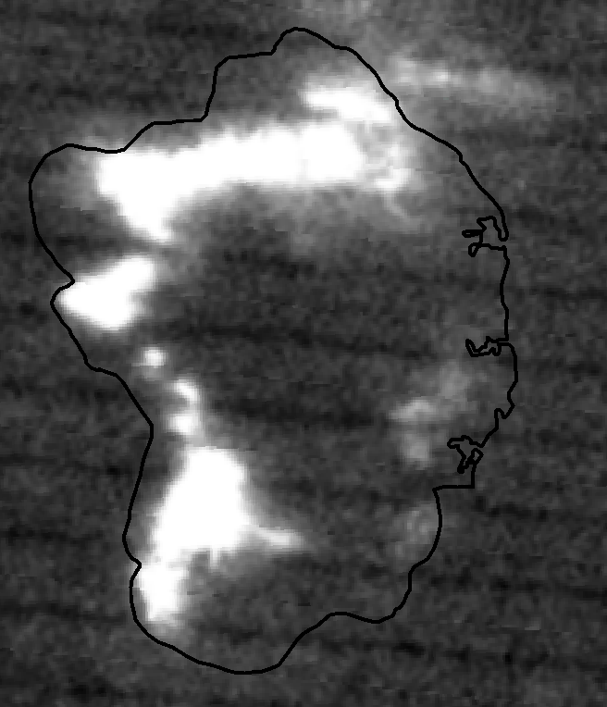
Satellite imagery
Careful interpretation required – a lot of the glow here is reflected off cloud.

Slide 8
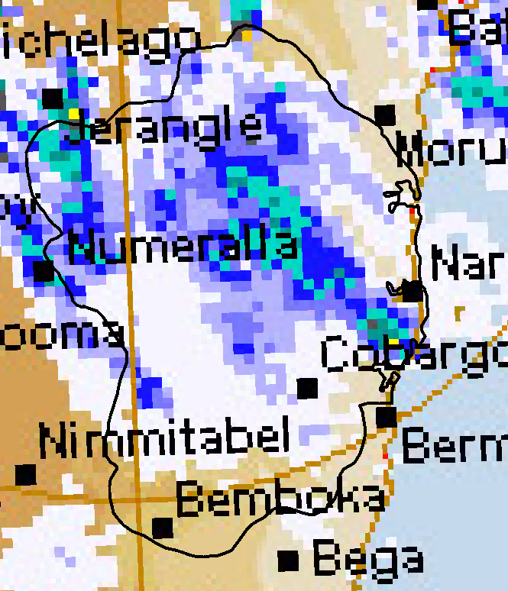
Radar
Plume base detection & movement
BUFE detection
Doppler - vorticity

Slide 9
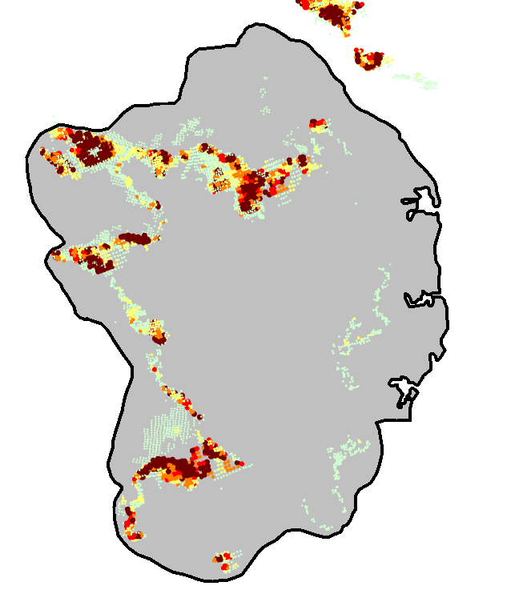
Hotspots
MODIS -> VIIRS
FRP mapping:
  Variations in intensity
  Linefire
  Deep flaming
  BUFE detection

Slide 10
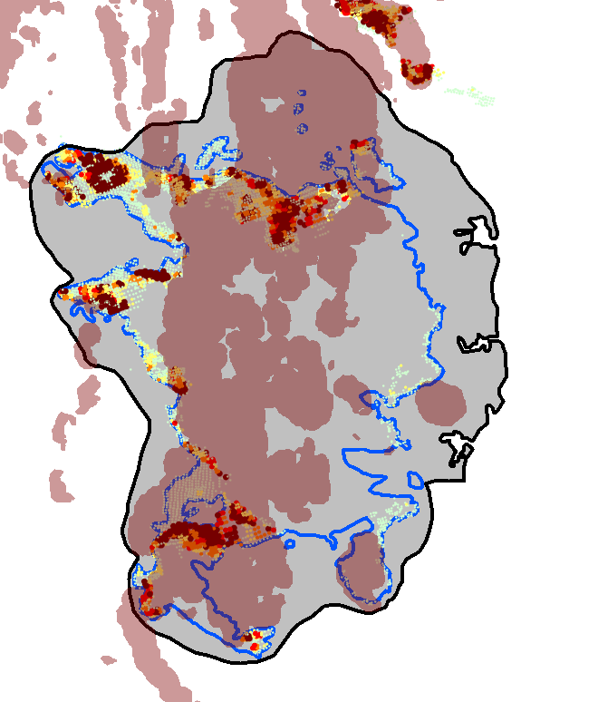
Terrain
Association of fire activity with terrain indices.
Brown back colour – rugged landscapes
Explains some intense fire activity
BUFE detection - VLS
Shows areas where suppression should not be attempted.

Slide 11
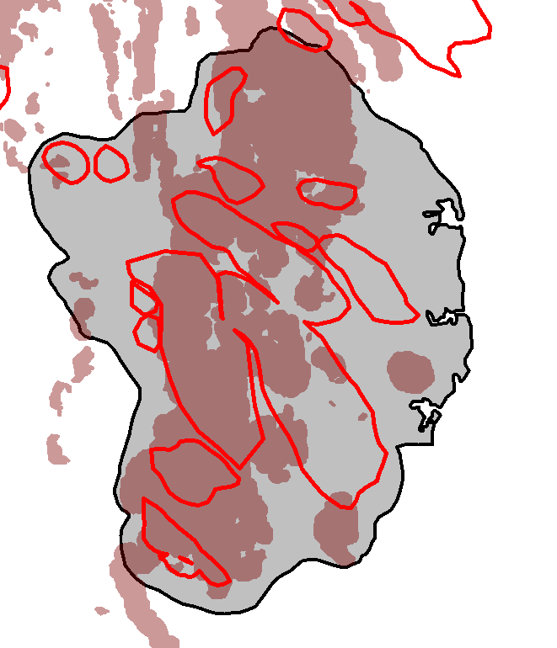
BUFEs
Mapping of BUFEs after-the-fact.
Validates deductions in real-time.
Important for science later.

