Slide 1
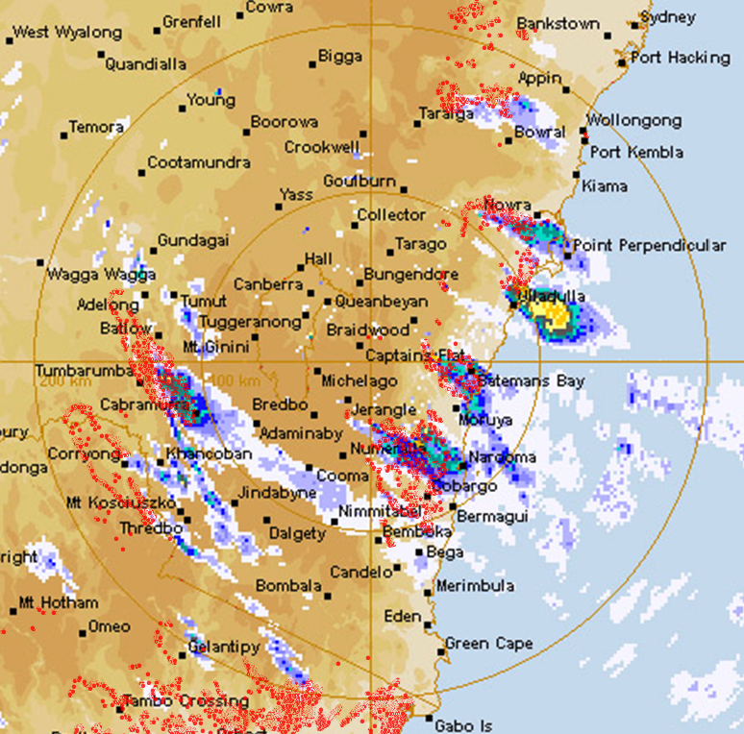
MANAGING EXTREME WILDFIRES
A virtual PDP Workshop for the 2021 AFAC Conference.
Rick McRae, Jason Sharples
UNSW Bushfire Research Group.
Radar: BoM; VIIRS hotspots: NASA FIRMS

Slide 2
Operational Tools
OPERATIONAL TOOLS

Slide 3
Fire Danger
In the simplest of concepts,
FDI equals
wind speed
times cloud base height
divided by stream depth

Slide 4
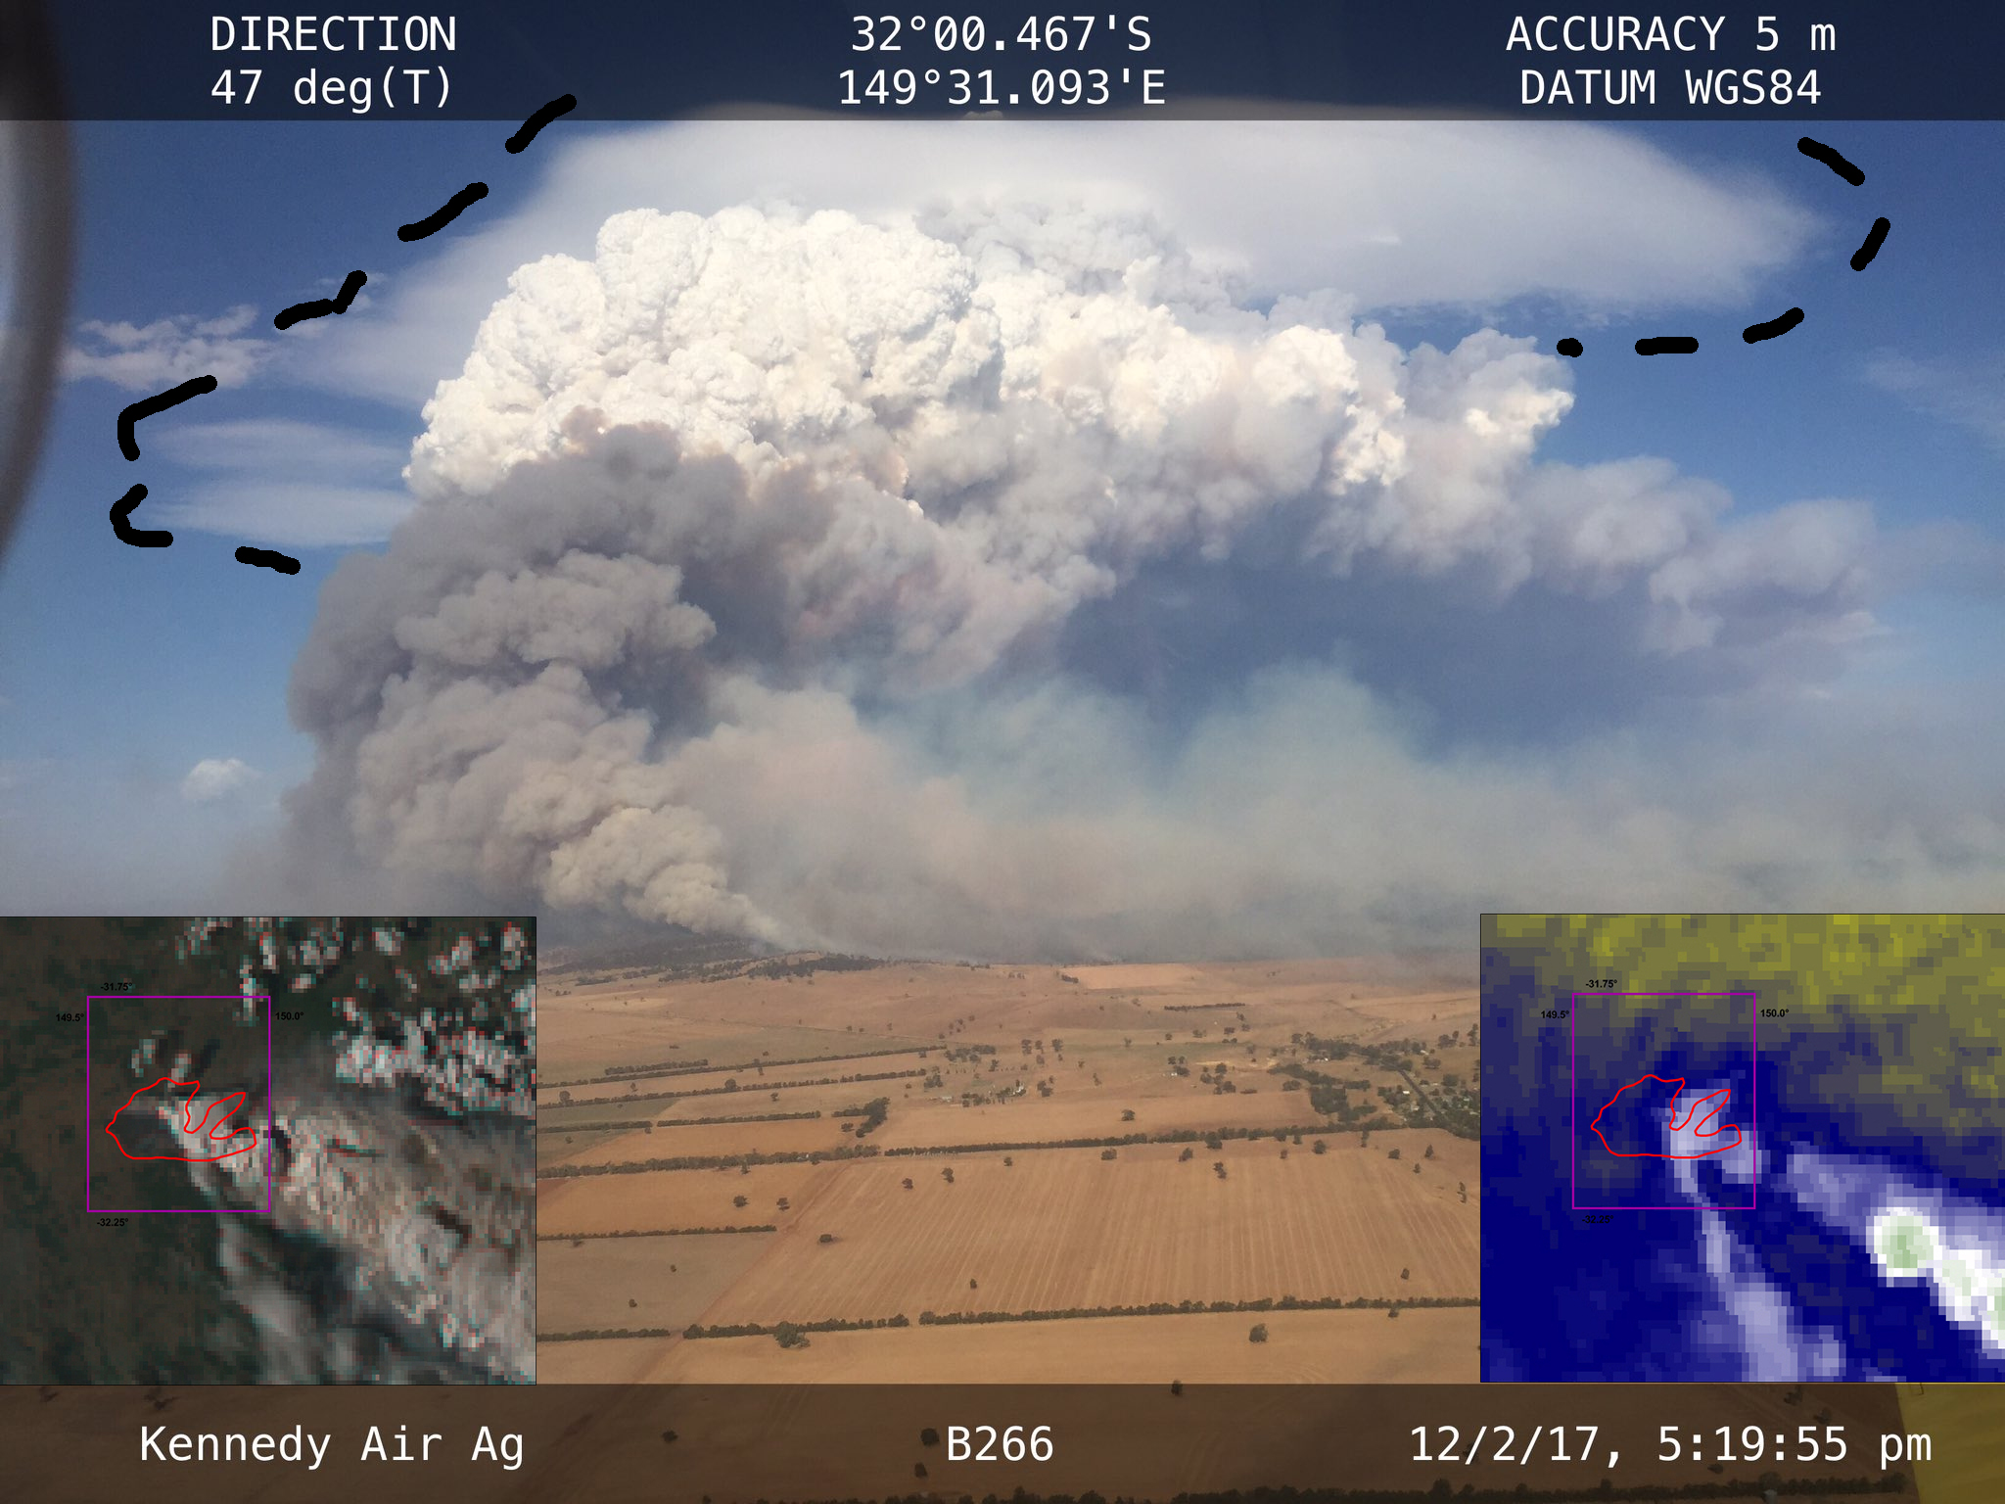
Watchouts
Black smoke column - VLS
Lenticularis – gravity waves
Wind direction changes (trad.)
Fire enters VLS-prone landscape
Bow waves (see picture)
Sudden drying - foehn wind
Fire near trenches…

Slide 5
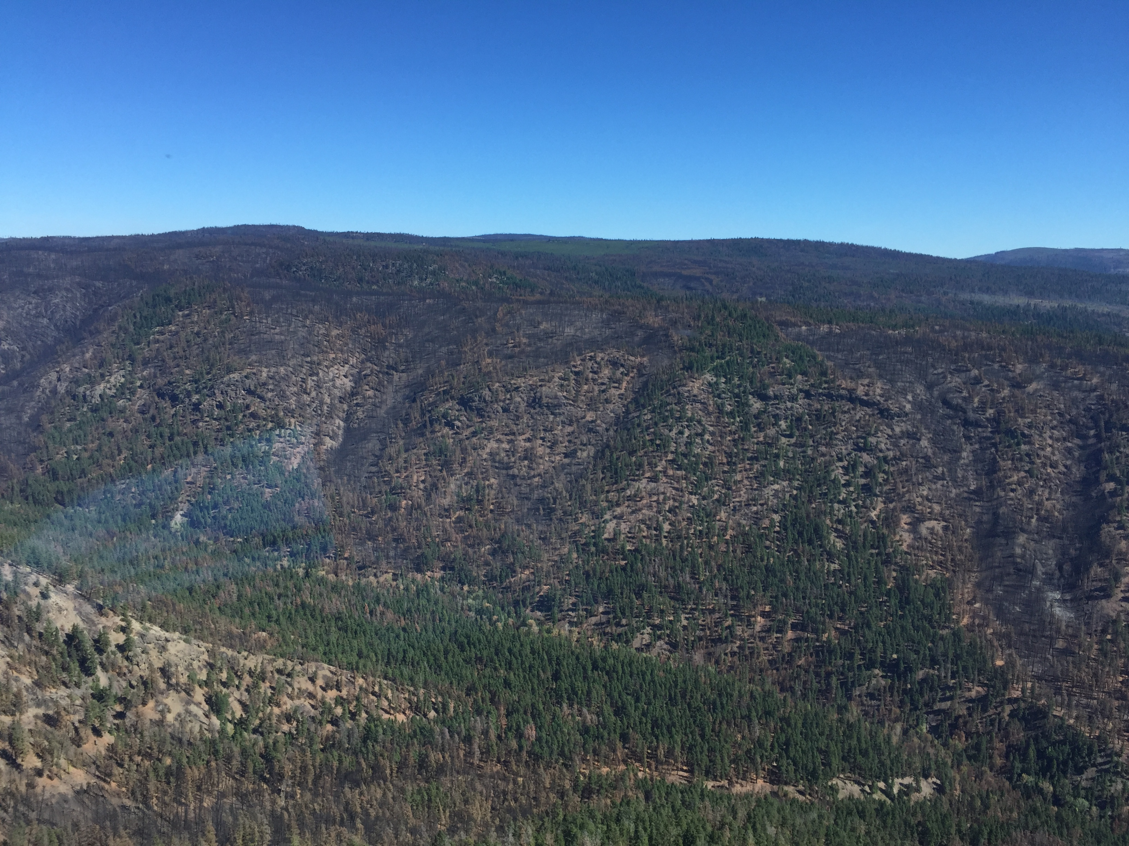
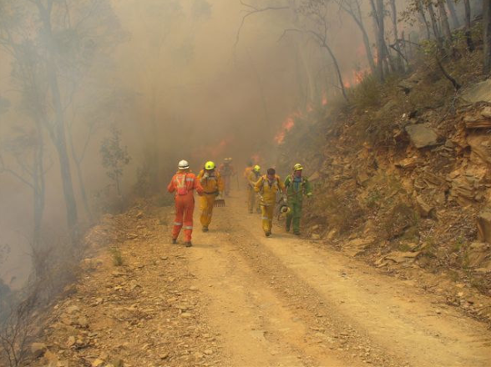
Eruptive growth
Fire entering the bottom of a trench can undergo eruptive spread, putting crews at risk and allowing fire to escalate. Above: Burn-over near Mansfield, 16 Dec 2006; joint Vic/NZ Investigation Report. Right: Elephant Hill Fire, BC, 2017, showing trenches; photo: McRae.

Slide 6
But…
Do your crew leaders understand these terms and concepts?
Their safety may depend on this.
What about your Ops Os? Div Cons? Sector Leaders?
Training and awareness are key operational tools.

Slide 7
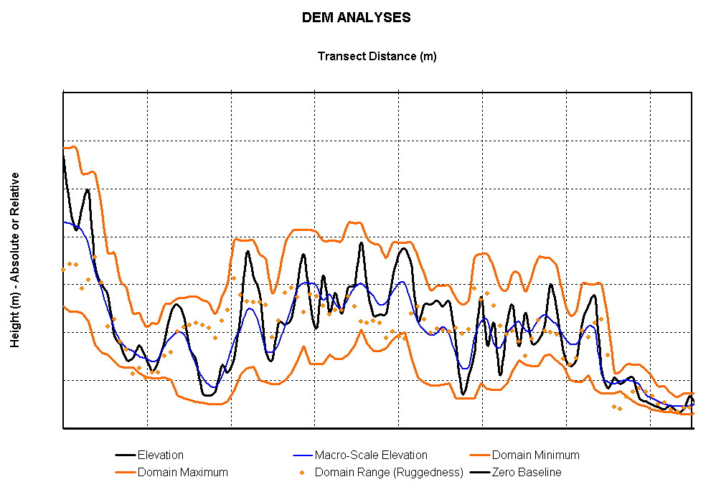
Terrain tools
http://www.highfirerisk.com.au/maps/index.htm
RED ARROW: The difference between Domain Maximum and Elevation indicates the wind regime.
Lightning ignitions occur where the black and blue lines cross.
Rugged landscape are where the orange dots are above this level →
BLUE ARROW: The difference between Elevation and Domain Minimum indicates the drainage (soil moisture) regime.

Slide 8
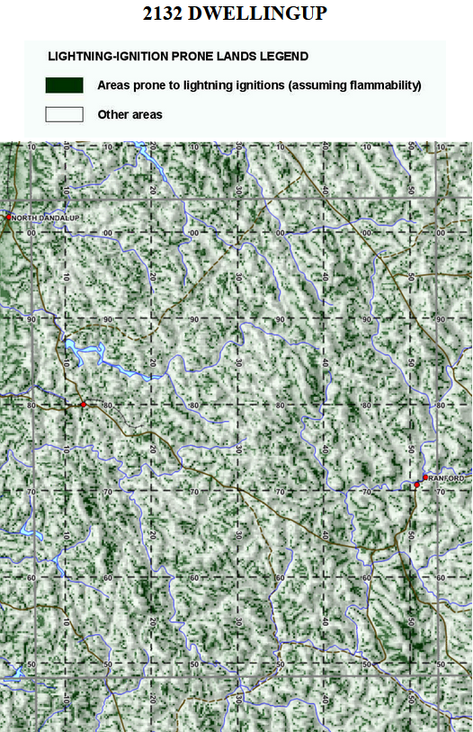
Lightning ignition prone areas
The site gives maps of areas prone to lightning ignitions.

Slide 9
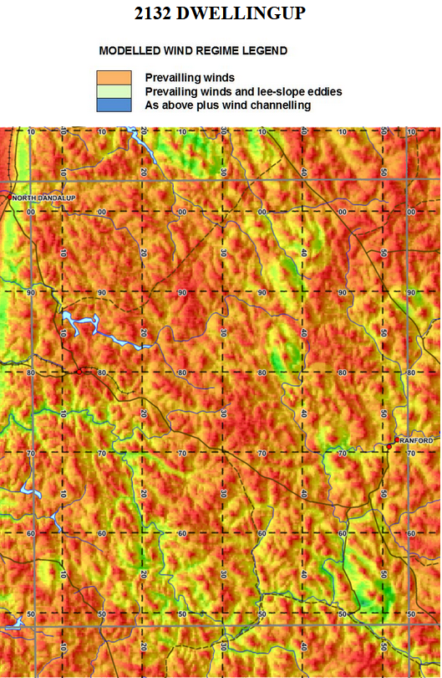
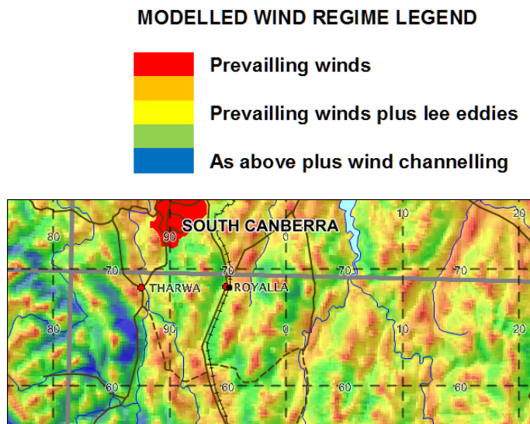
Wind regime
The site gives wind regime maps.
In the lower image, the blue band around a hill shows that it is often isolated from surrounding areas for fire spread.

Slide 10
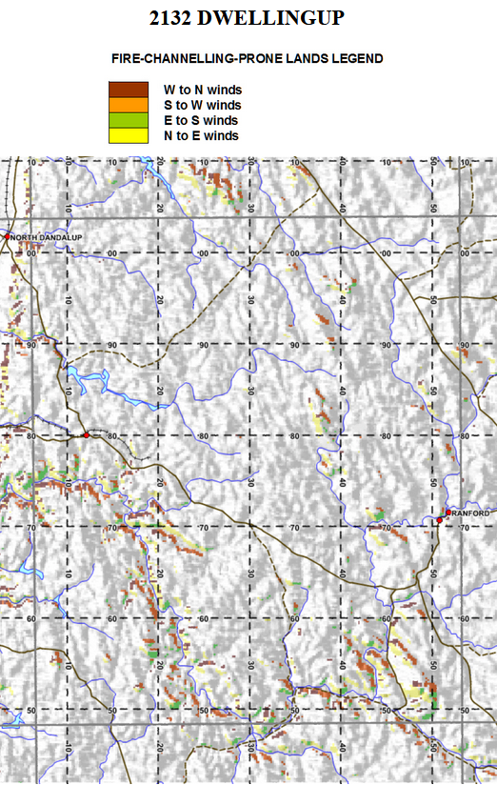
VLS-prone lands
VLS generator maps are available. The colour used indicates the wind direction (plus or minus 40°) for which it is likely to be active when the speed exceeds 25 km/hr.
New model and new tools are being produced.

Slide 11
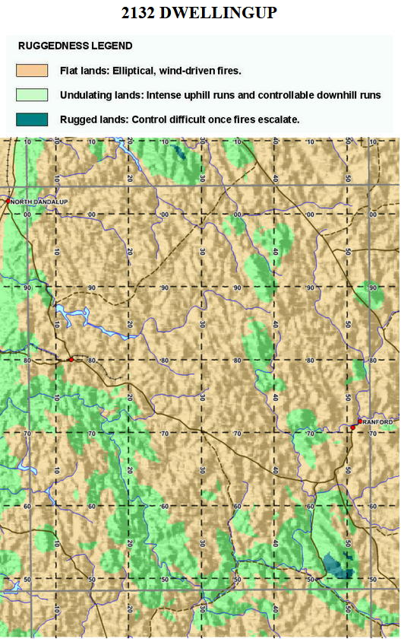
Ruggedness
Rugged landscapes interact strongly with the weather.
No escalated fire in rugged landscapes has been extinguished, except when it rains or it leaves the rugged landscape.

Slide 12
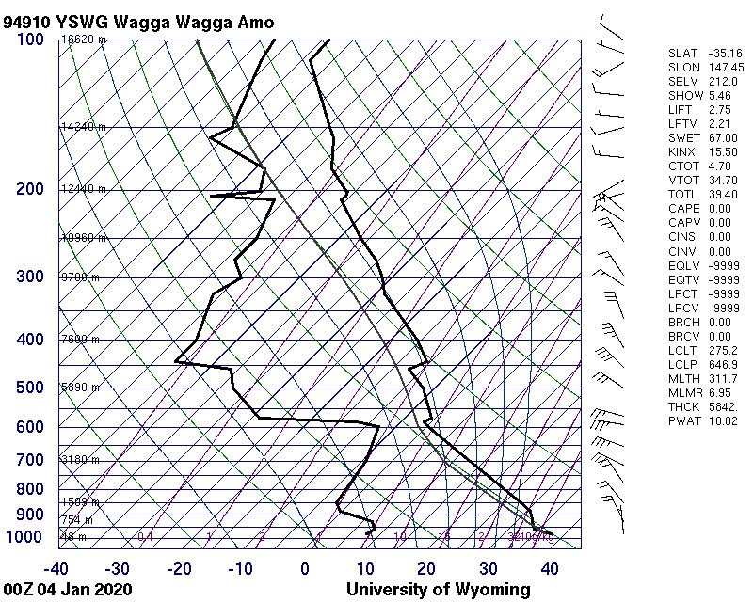
Radiosondes
Profile moisture
Instability - cap
Dry air to mix down
LCL – cloud base
Profile winds, wind shear
Fire Danger (part)

Slide 13
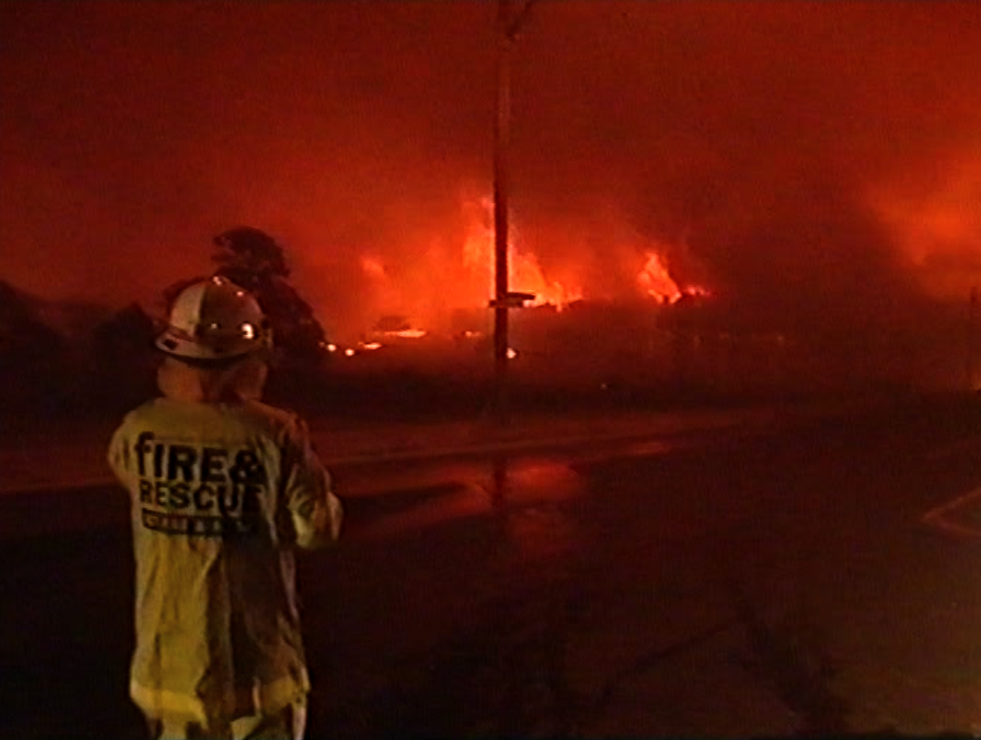
Spotting
Ember sources: VLS, ember storms, drip torches
FMC below 5%
For VLS: wind speed over 25km/hr.
Still from news video, 18 January 2003: Richard Moran, Nine News.

Slide 14
Threat footprints
If a BUFE occurs or is expected to occur shortly, the goal is not a detailed threat map.
The goal is a large rectangle aligned with the steering wind.
We still lack guidance on how large it should be, but 15km through to 60km long have been inferred from case studies.

Slide 15
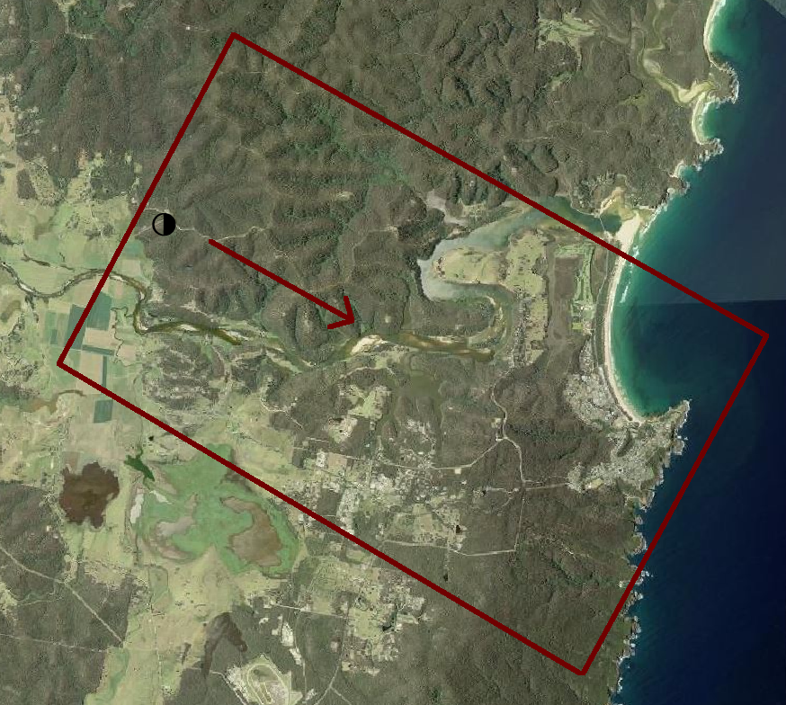
A fire ignites in a VLS-prone area with a NW wind.
The threat footprint might look like this.
The threat is classed as “instant” and is not considered to evolve as in a normal fire situation.
It needs to consider wind strength and directional consistency.
Image: NSW Govt Six Map.

Slide 16

BUFE threat footprints are getting larger, with compound runs over 50km no longer unusual.

Slide 17
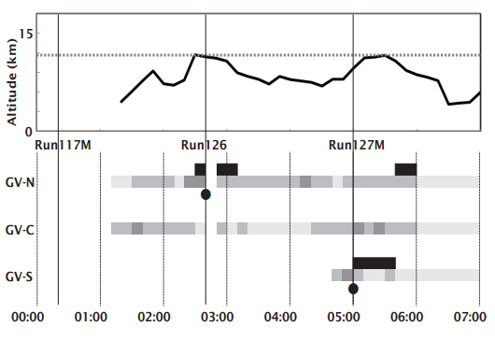
A proposal
We know that when BUFEs blow-up, the FRP and rate of burning of area go up.
So does radar echotop.
Can we ask BoM to provide echotops as a real-time monitoring tool for detecting BUFEs in their early stages?
Time series of echotops and low level radar reflectivity for the 2011 Grose Valley Fire. Black dots are VLS events seen in NSWRFS linescans. From: McRae, et al., Nat. Hazards Earth Syst. Sci., 15, 417–428, 2015.

Slide 18
Next:
BUFO

