Slide 1
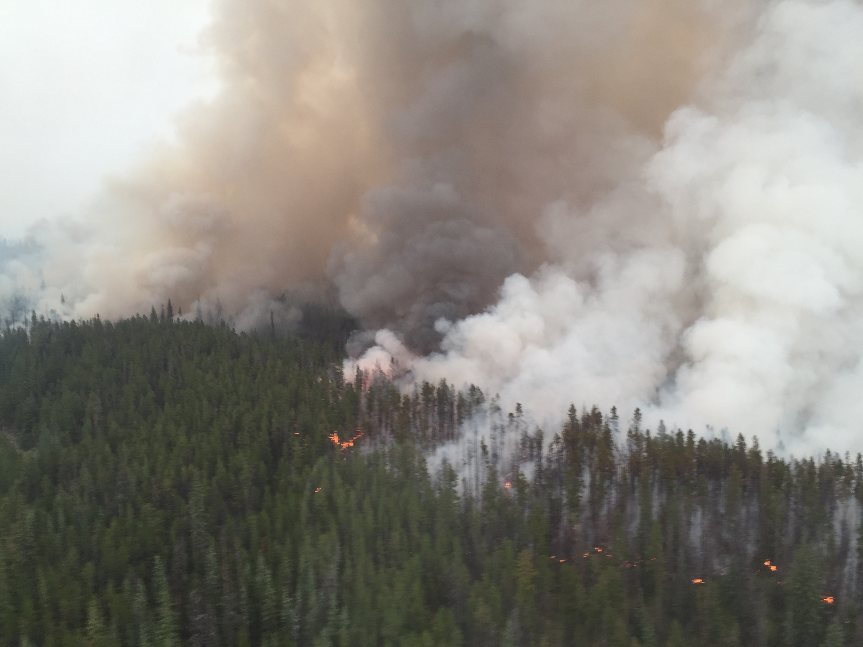

MANAGING EXTREME WILDFIRES
A virtual PDP Workshop for the 2021 AFAC Conference.
Rick McRae, Jason Sharples
UNSW Bushfire Research Group.
Chezacut Fire, BC, August 2017. Photo: McRae
Notes:
Welcome to the next on-line instalment of the Managing Extreme Wildfires Workshop, part of the 2021 AFAC Conference, and part of AFAC’s Professional Development Program.

Slide 2
BUFO
Notes:
Here we will be talking about the BUFO predictive model for Blow-Up Fire Events.

Slide 3
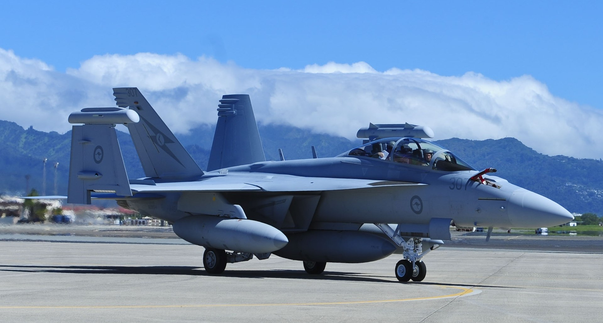
BUFO
The first predictive model for BUFEs.
Uses a range of data: weather, terrain, fire.
Multiple paths to a prediction.
Allows lead-times for warnings.
Allows a Bayesian decision tree intelligence approach.

Slide 4
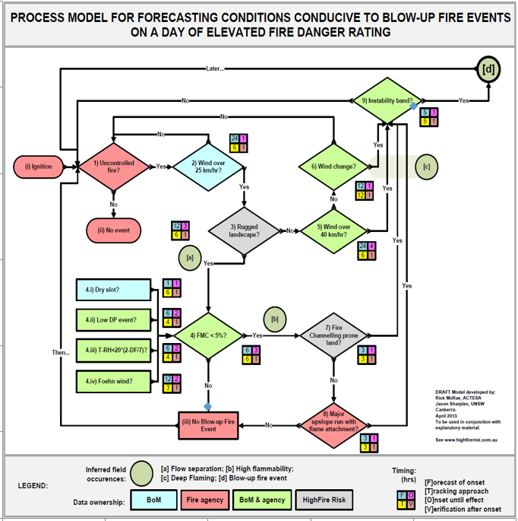
Flowchart
Start at the beginning. Uncontrolled fire on a day of elevated fire danger (?>35).
Loop through (on a schedule) until fire is extinguished or a prediction is reached.

Slide 5
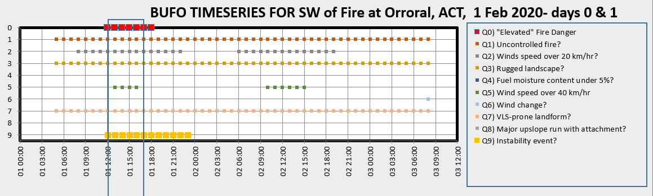
Spreadsheet examples
BoM data, HFR data, ESA data.
One column per hour.
Outline = window of threat: dry fuel, windy on a VLS-prone landform, unstable atmosphere.
Data: BoM, ACTRFS, HighFireRisk
Analysis : McRae

Slide 6
BUFO2
Switch from case-studies of past fires to population statistics of Black Summer.
BUFEs now includes both unstable events and foehn events.
Explicitly addresses (1) pyroCb potential and (2) outflow winds recoiling from LCL.

Slide 7
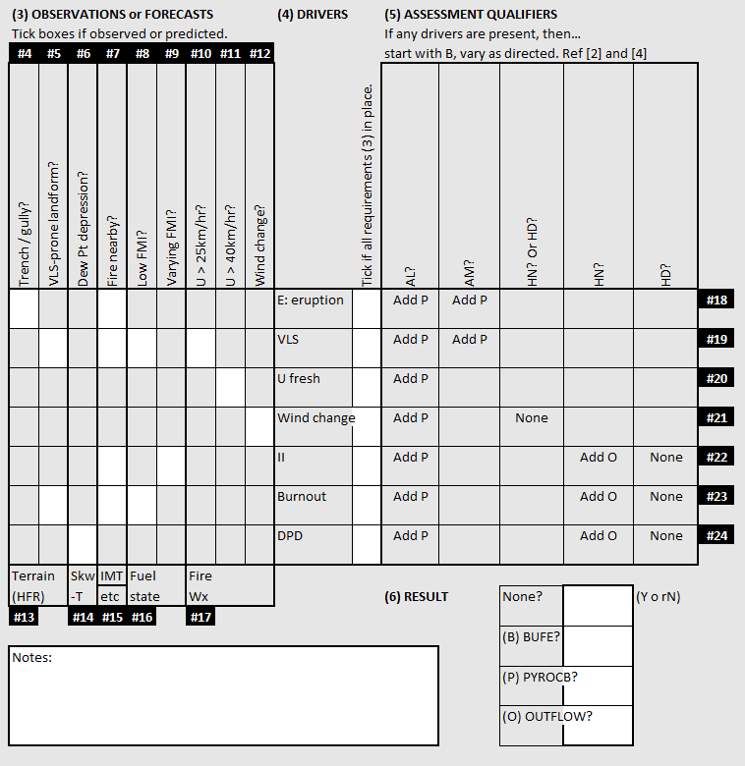
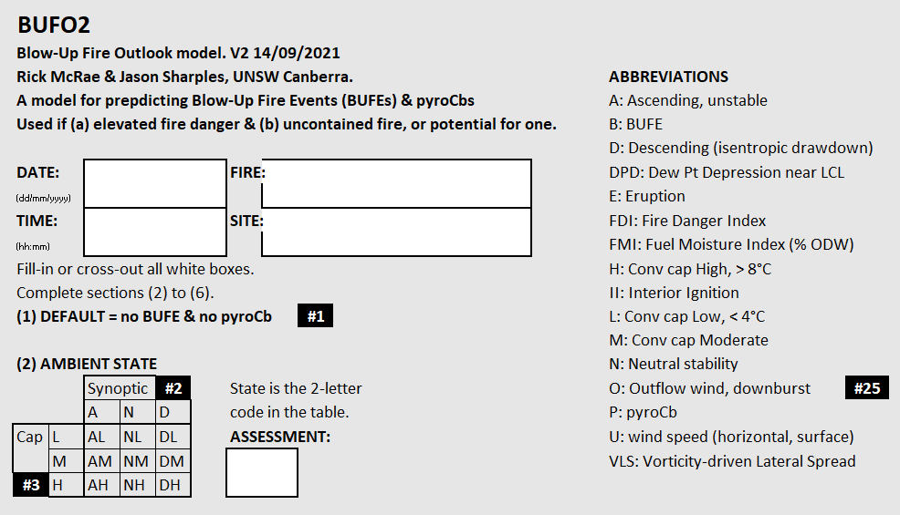
Worksheet
Specific events indicated by tags, e.g. #25
(1) DEFAULT = no BUFE, no outflow & no pyroCb

Slide 8
(2) Ambient state
How is the atmosphere above the fire configured?
Synoptic state = [A]scending air; [N[eutral air; [D]escending air.
Cap = [L]ow (up to 4°C); [M]edium (4 to 8°C); [H]igh (over 8°C)
1 Feb 2020
Yaouk Peak Fire
16:00
Generic
AL

Slide 9
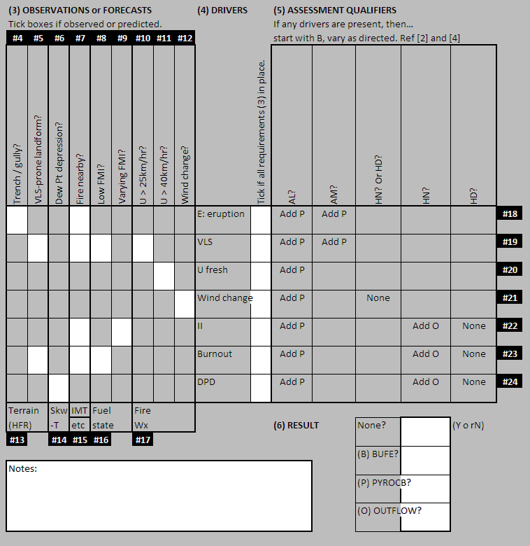
(3) Observations or forecasts
What do recent observations or current forecast suggest might be in play around the fireground?
Trench / gully? => eruptive growth
VLS-prone landform? => VLS potential
Dew Pt depression? => mixing down of dry air
Fire nearby? => Fire in the feedback loop
Low FMI? => easy spotting
Varying FMI? => unburnt areas can ignite later
U > 25km/hr? => lee-slope eddy winds
U > 40km/hr? => strong winds
Wind change? => Ooops
O
P
P
P
P
P
O
O
P
O
P
P
P
P

Slide 10
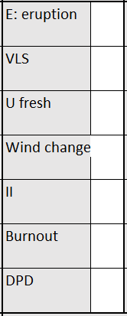
(4) Drivers
O
Are any of the seven causes of deep flaming possible?
Any [Yes] assessment does a preliminary change to the default state (which is no BUFE + no pyroCb) to [Yes] for BUFE.
P
O
O
O
P
P

Slide 11
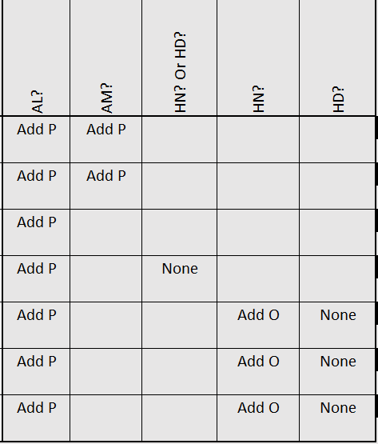
(5) Assessment qualifiers
How does the ambient state (AL) alter the result of any drivers being present?

Slide 12
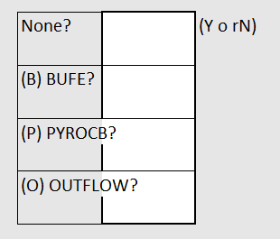
(6) Result
The key part.
Data from observations or forecasts is turned into information about the drivers of events, which is them turned into intelligence about what the IAP has to address.
No
Yes
Yes
No

Slide 13
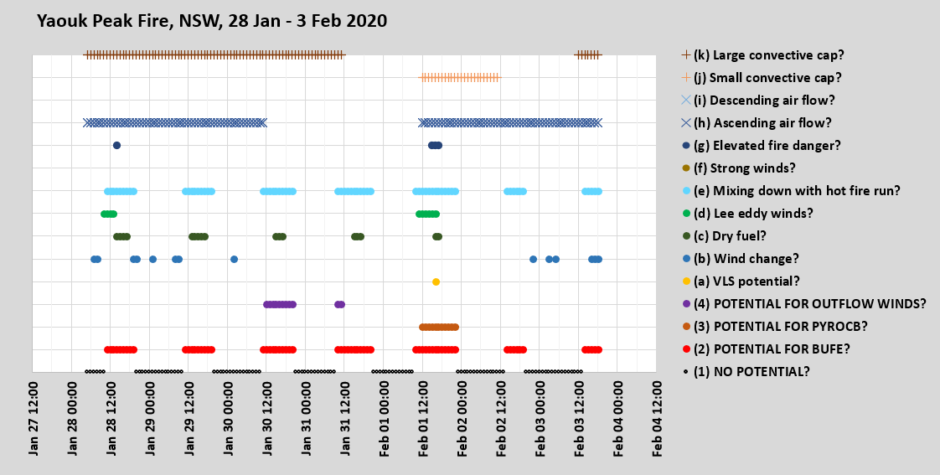
Spreadsheet examples

Slide 14
Yaouk Peak Fire, 16:00 Feb 01 2020
Ambient state = AL
Observations or forecasts: VLS + fire nearby + low FMI +
U > 25km/hr
Drivers = VLS, Burnout & DPD
Assessment qualifiers for AL = Add P
Result = BUFE predicted & PyroCb predicted.

Slide 15
Boundary conditions
What needs to be in place for BUFO/BUFO2 to be valid?
  Elevated FFDI. Perhaps above 40?
  An uncontrolled fire (as the fire is an input). It can be run without the fire to produce a BUFO Alert.
  And…

Slide 16
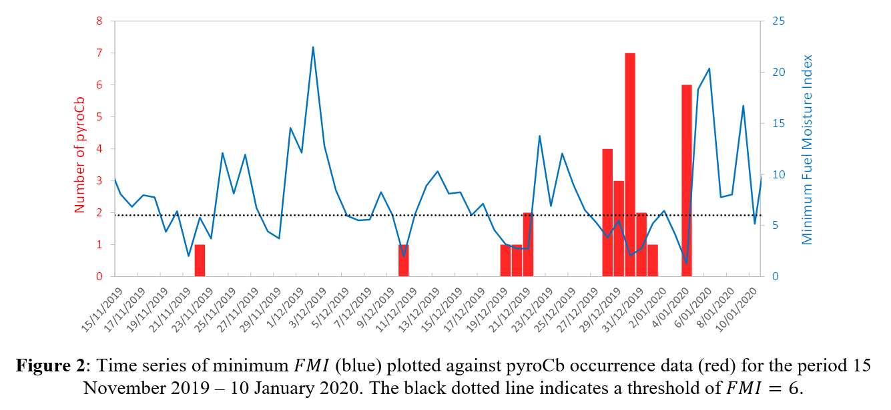
Dry fuel
FDI = wind speed divided by FMC.
Low FMC is needed for easy spotting to form deep flaming.
PyroCbs form when FMC is low (& other things are in place).

Slide 17
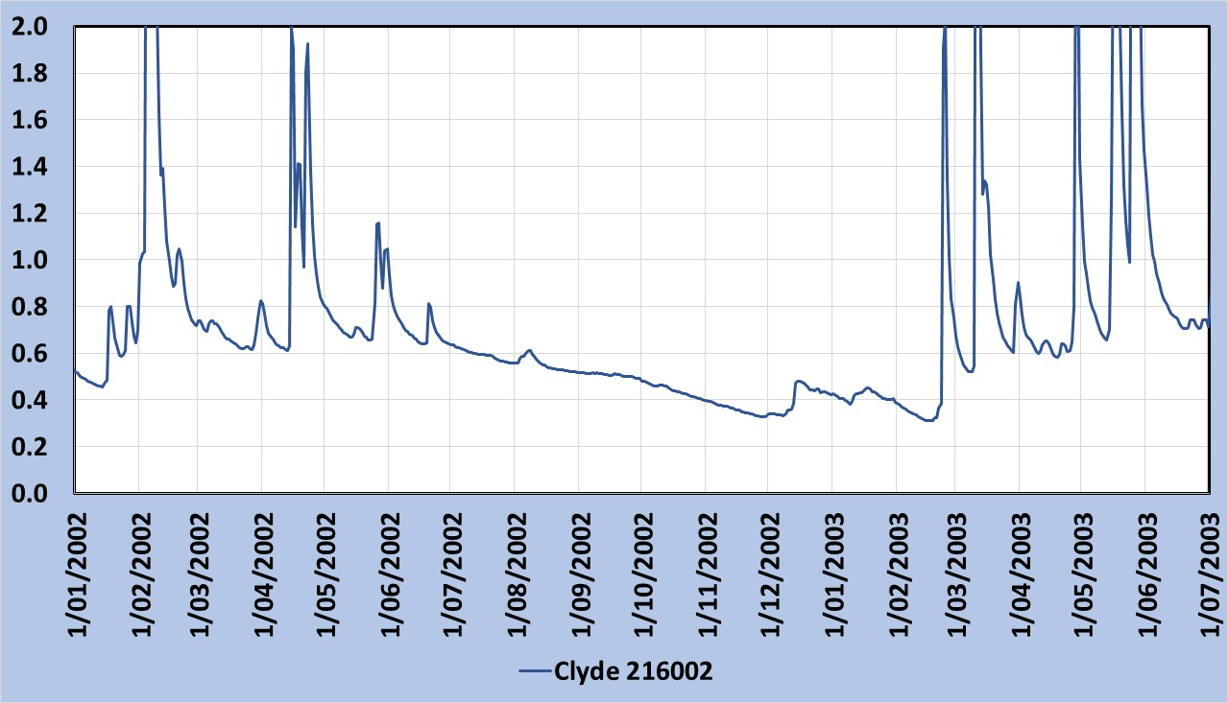
Drying stream flows
Blue box = rain, surface run-off. Concave curve. No bushfire potential.
Green box = surface drying. Limited bushfire potential.
Brown box = sub-surface soil drying. Large bushfire potential.
Red box = deep soil drying, flow may stop. Convex curve. Potential for landscape fire or BUFE.
Data: BoM

Slide 18
Landscape dryness
If scale is considered, then DF is an inverse function of stream flow depth.
DF capped at 10 early in dry spell – no further increase allowed.
Stream flows can continue decline past that point in a way that forecasts potential for BUFEs.

Slide 19
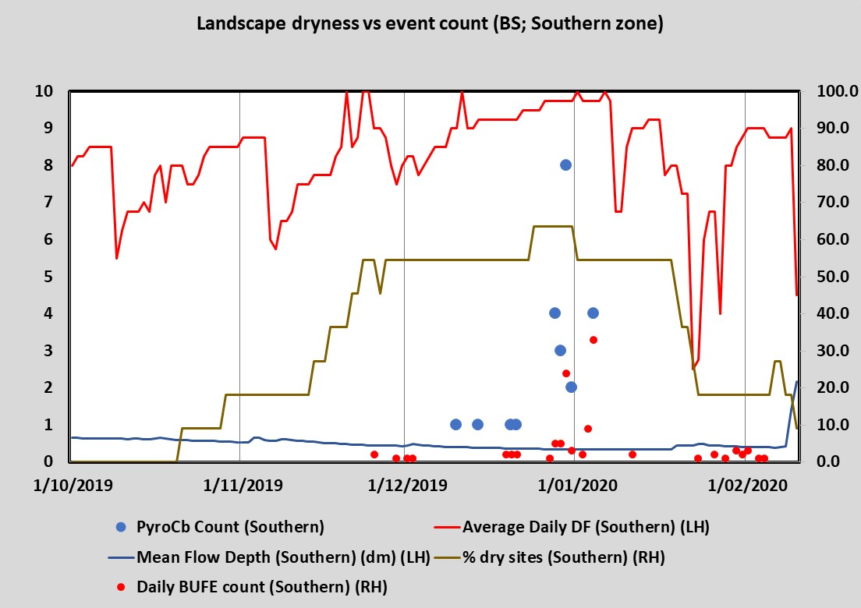
A new boundary conditions for BUFO2 = drying stream flows in region.
Data: BoM; McRae

Slide 20
Next: IMPLEMENTATION

