Slide 1
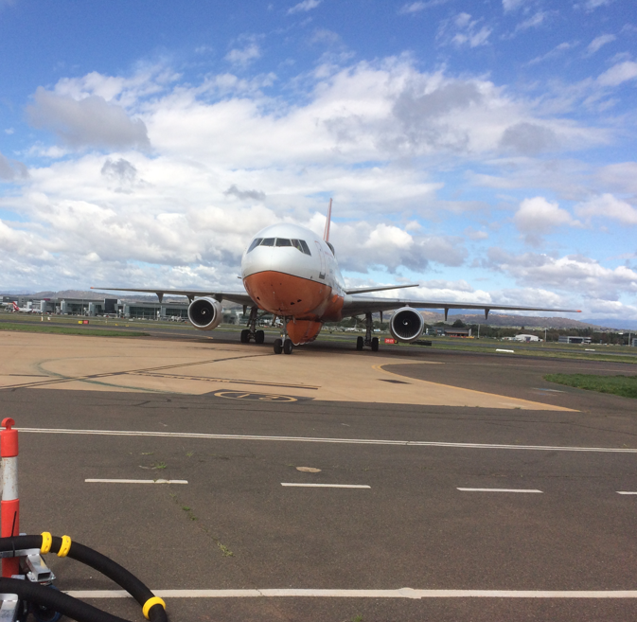

MANAGING EXTREME WILDFIRES
A virtual PDP Workshop for the 2021 AFAC Conference.
Rick McRae, Jason Sharples
UNSW Bushfire Research Group.
Not all sandpits have the cool toys… Photo: McRae
Notes:
Welcome to the next on-line instalment of the Managing Extreme Wildfires Workshop, part of the 2021 AFAC Conference, and part of AFAC’s Professional Development Program.

Slide 2
IMPLEMENTATION
Notes:
Here we will be discussing practical aspects of implementing what we have learned about these events. There will be a focus on Incident Management Teams and how to handle the technical issues in an Incident Action Plan..

Slide 3
Step 1 - analysis
Step 2 - prediction
Step 3 - decisions
Step 4 - IAP
Step 5 - communication

Slide 4
Step 1 - Analysis
Who does the work?
  Fire services: FBAns? IMTs? State Ops?
  AFAC Predictive Services?
  BoM – super-computer job?
  NHRC?
  Academic consortium?

Slide 5
A word about fuel
While we know that fuel is needed, and flashy fuels do not support BUFEs, there is no explicit role for fuel load.
Therefore BUFO is not aligned with AFDRS.
BUFO is aligned with FDI, as a boundary condition and with its core elements (wind, FMI & stream depth).
Whereas steady-state fire behaviour goes up as FDI times fuel load goes up, and this is a core of AFDRS, this relationship has not been demonstrated for BUFEs.
AFDRS cannot in principle predict a BUFE or a pyroCb. On a bad fire day, when all the ducks line-up, it may appear to do predict well, as could other tools.

Slide 6
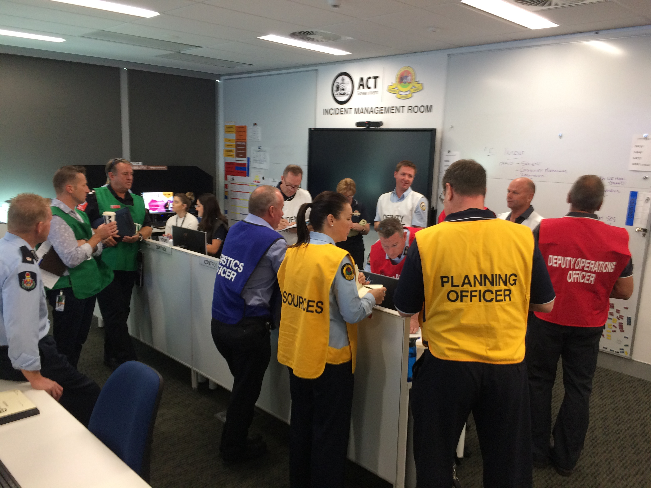
How are predictions managed?
Reflects who does them
National protocols
Common web platform / web protocols
Analyst push vs operations pull?
IMT Briefing, Canberra. Photo: McRae

Slide 7
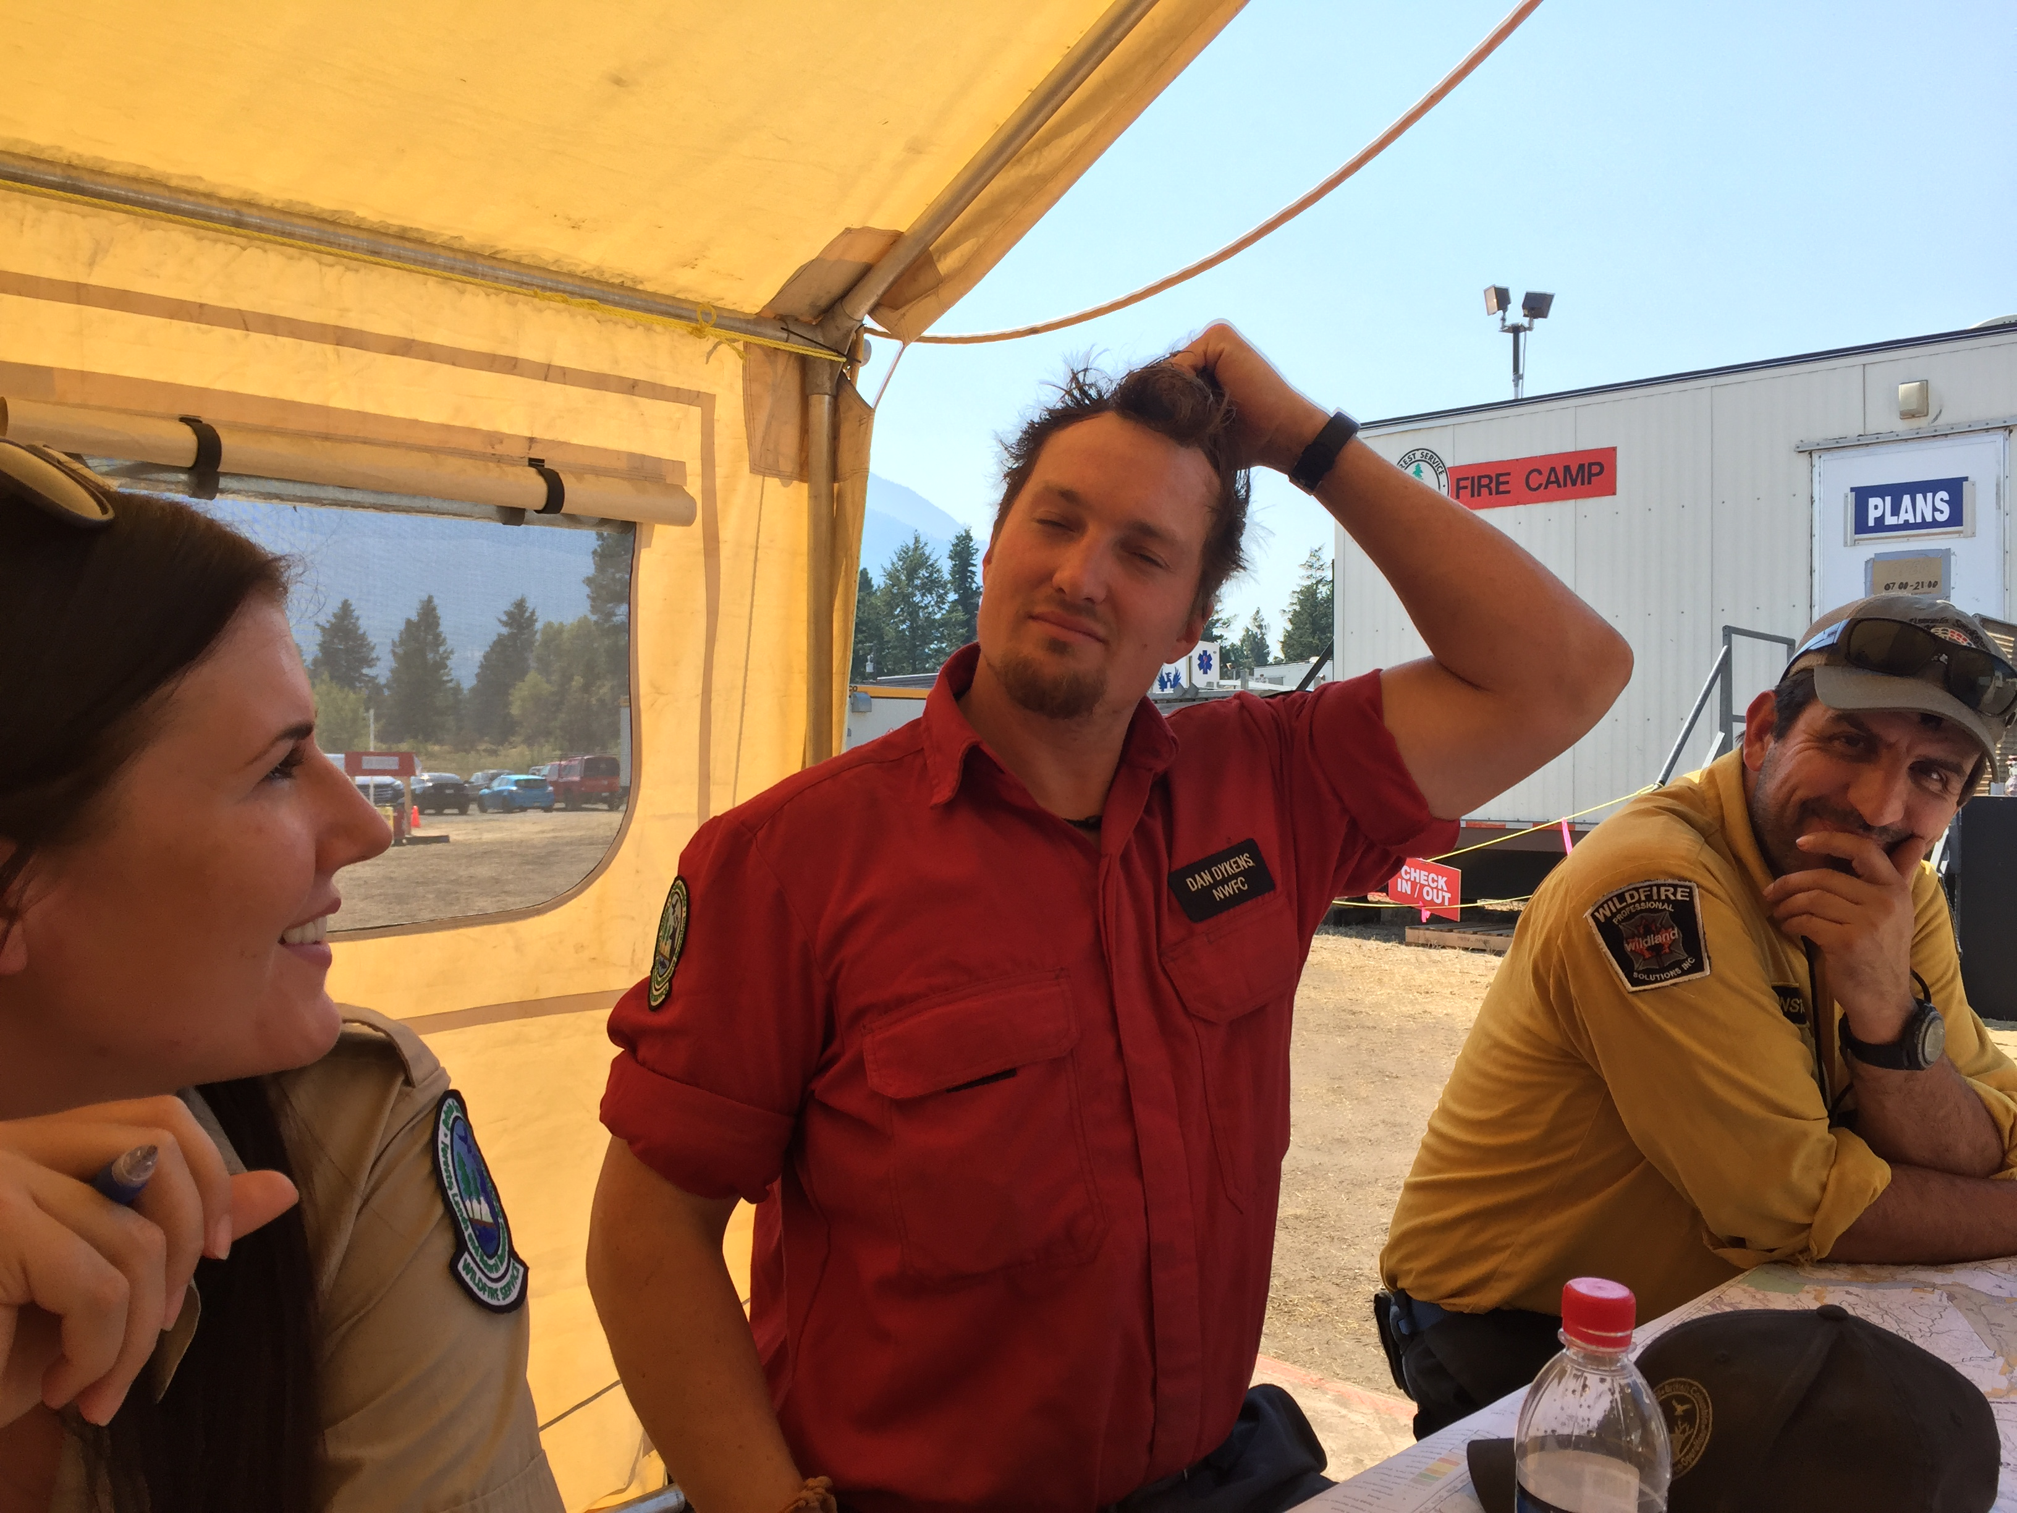
Decisions
Incident Controller needs Intelligence Products to support correct & timely decision making.
Data – information – intelligence: how do we make this an Intelligence Product?
Who in the IMT understands the technical aspects? Is this a problem?
“The FBAN anticipates VLS in Sector Alpha at 3pm. Plans agrees. Ops, we will remove all units from there until end of shift. The next IAP will use an update from FBAN due at 4pm”
Planning Meeting, Elephant Hill Fire, BC. Photo: McRae

Slide 8
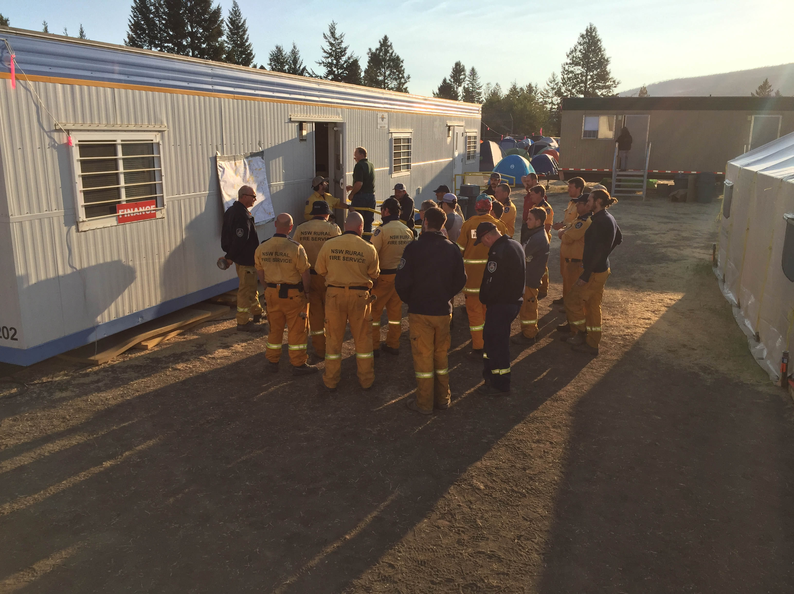
IAP
How do we make an IAP that includes these processes and their risks?
Ops briefing for Aussies, eh, Clinton, BC. Photo: McRae

Slide 9
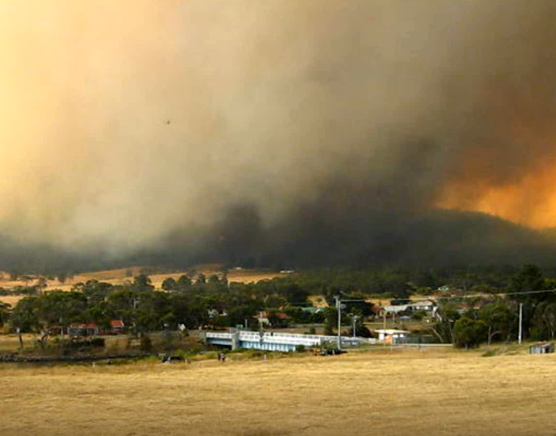
Public messaging?
TECHNICAL:
If, as predicted, the fire reaches the vorticity-driven lateral spread prone ridgeline tomorrow while the CAPE is still extreme and the fuel moisture content is 3%, then we expect an ember storm to reach the town. In this situation houses in the town will be under threat, not just those in the bushfire-prone area.
Dense spotting is expected to close the highway around this time. All residents should consider evacuating.
Terminology
Correct conveyance of threat
PUBLIC MESSAGING:
We expect that when the fire burns onto the ridge tomorrow it will quickly become far more intense and put the entire town in grave danger. We expect the fire to shut the highway around this time. All residents should consider evacuating before 9am tomorrow, following fire service directions.
Dunalley, Tas, coming under threat from VLS, Jan 2013.
[Photographer unknown]

Slide 10
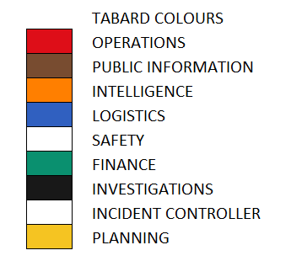
Who in the IMT is able to process an alert?
Planning Officer
Intelligence Officer
Situation Unit Leader / FBAN
Operations Officer
Div Cons/ Sector Leaders
Safety Officer
Incident Controller
Public Information Officer

Slide 11

The seven known causes of deep flaming must be understood and considered by IMTs; as must the foehn effect.

