Slide 1
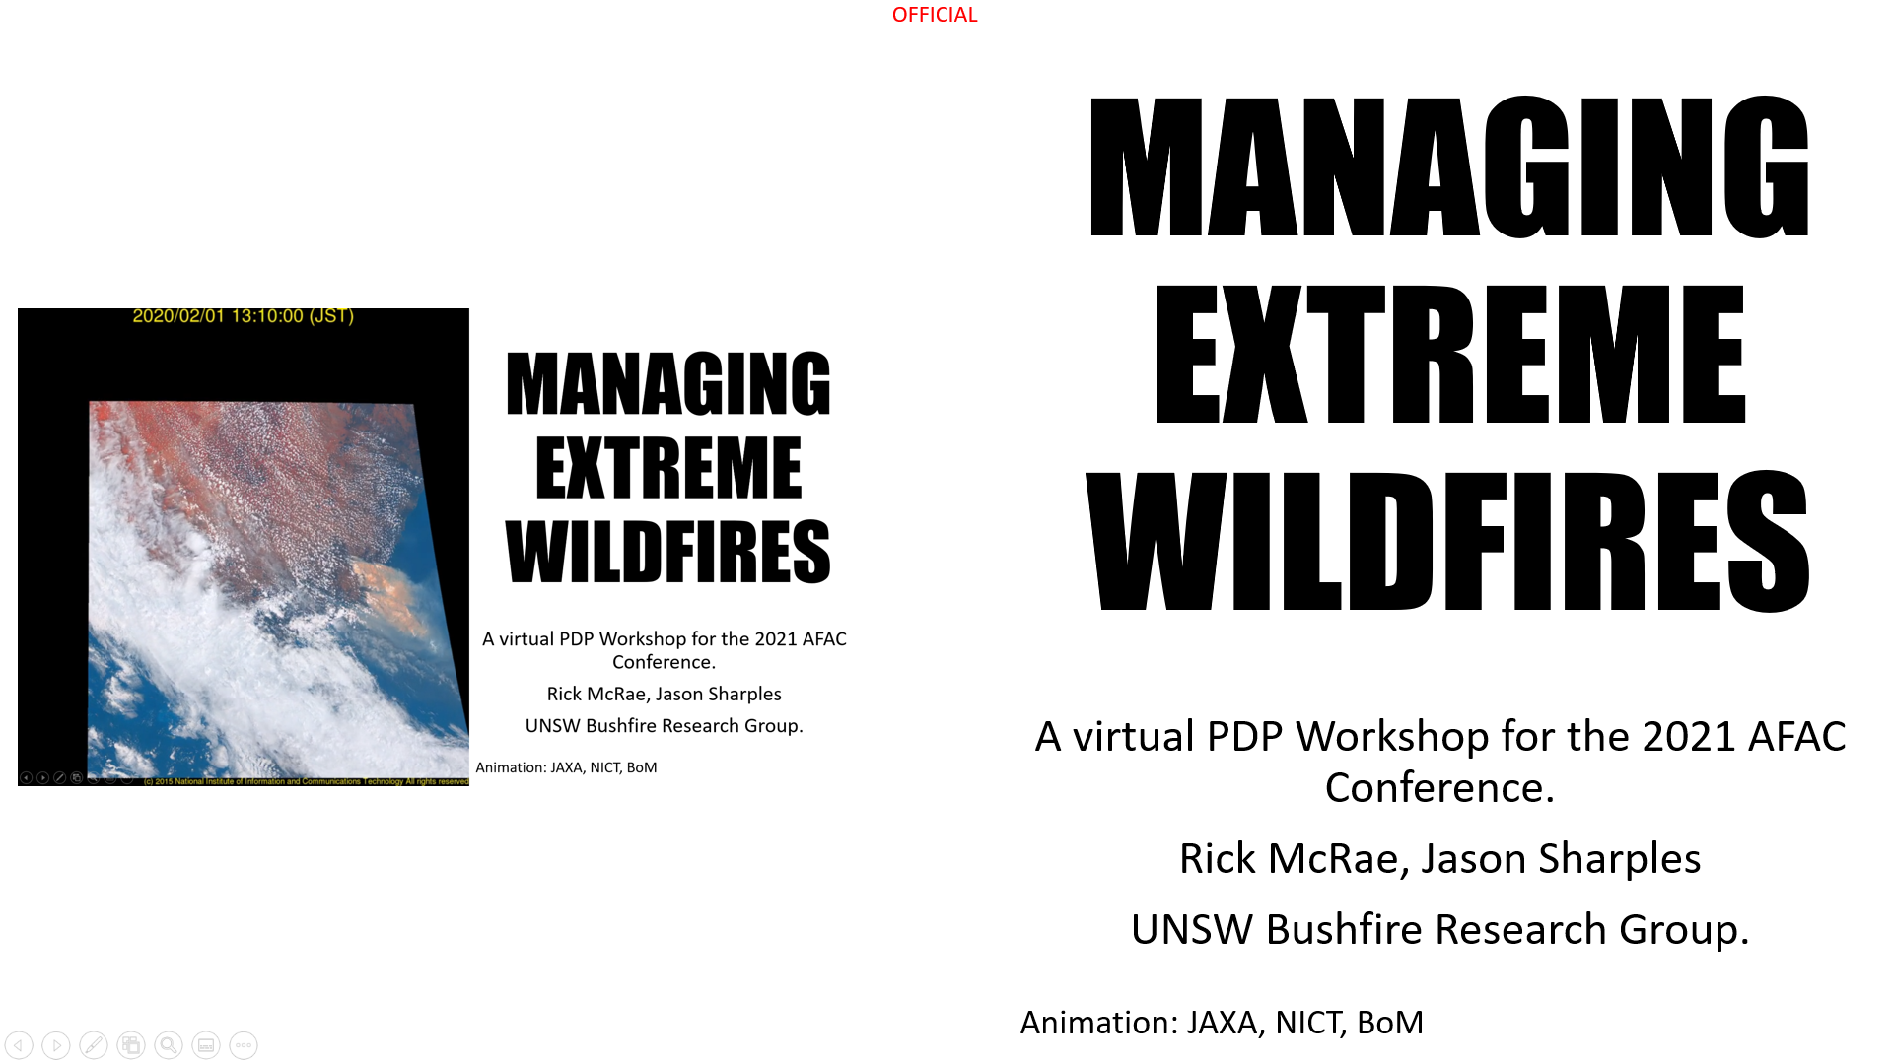
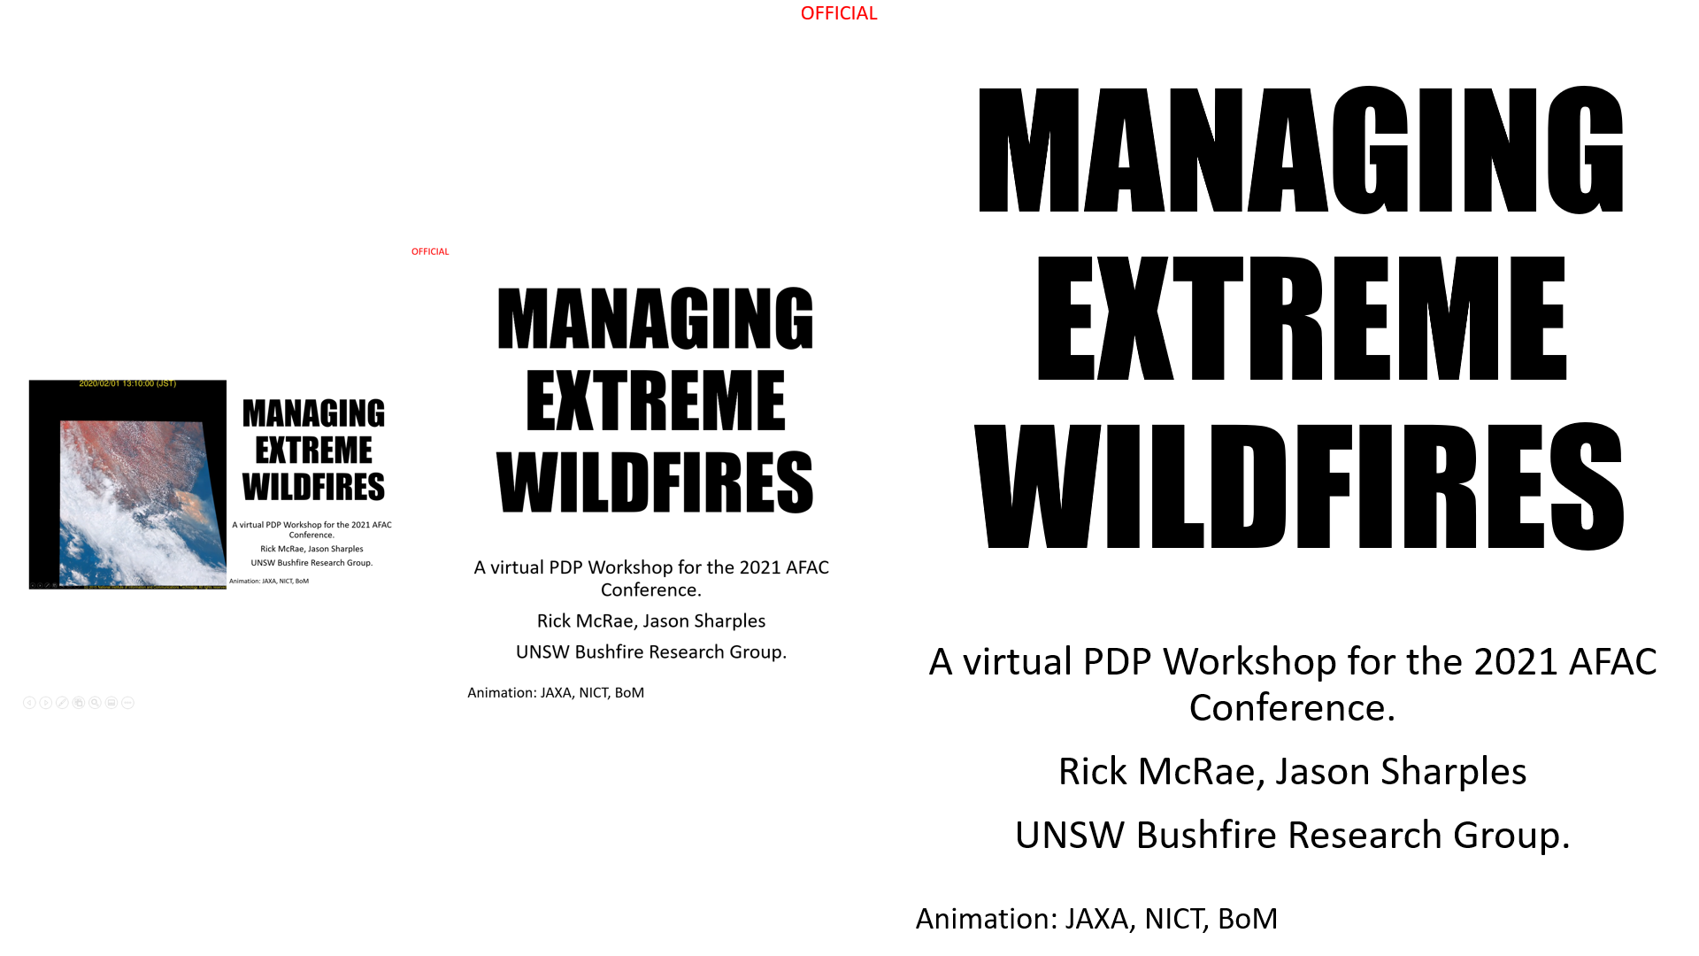
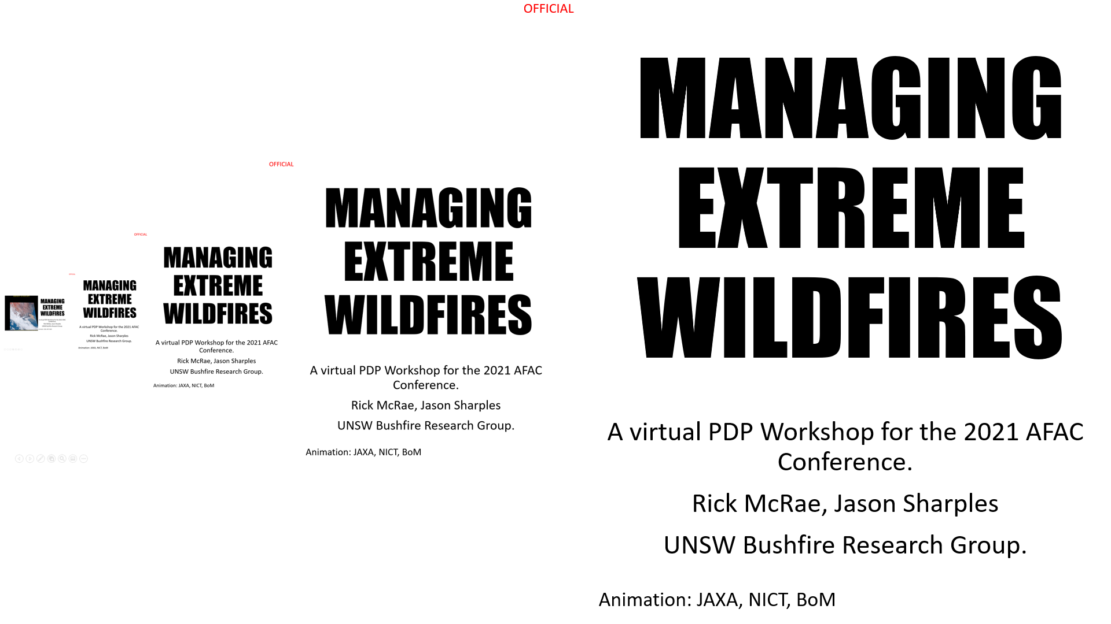

MANAGING EXTREME WILDFIRES
FEEDBACK IS GOOD!
A virtual PDP Workshop for the 2021 AFAC Conference.
Rick McRae, Jason Sharples
UNSW Bushfire Research Group.
Animation: JAXA, NICT, BoM

Slide 2
TAKE-AWAYS

Slide 3
Support for science?
No science = no learning
Acquire and deploy data collection technology.
If the unexpected occurs – record it.
Support scientific studies.
Consider alternate hypotheses.

Slide 4
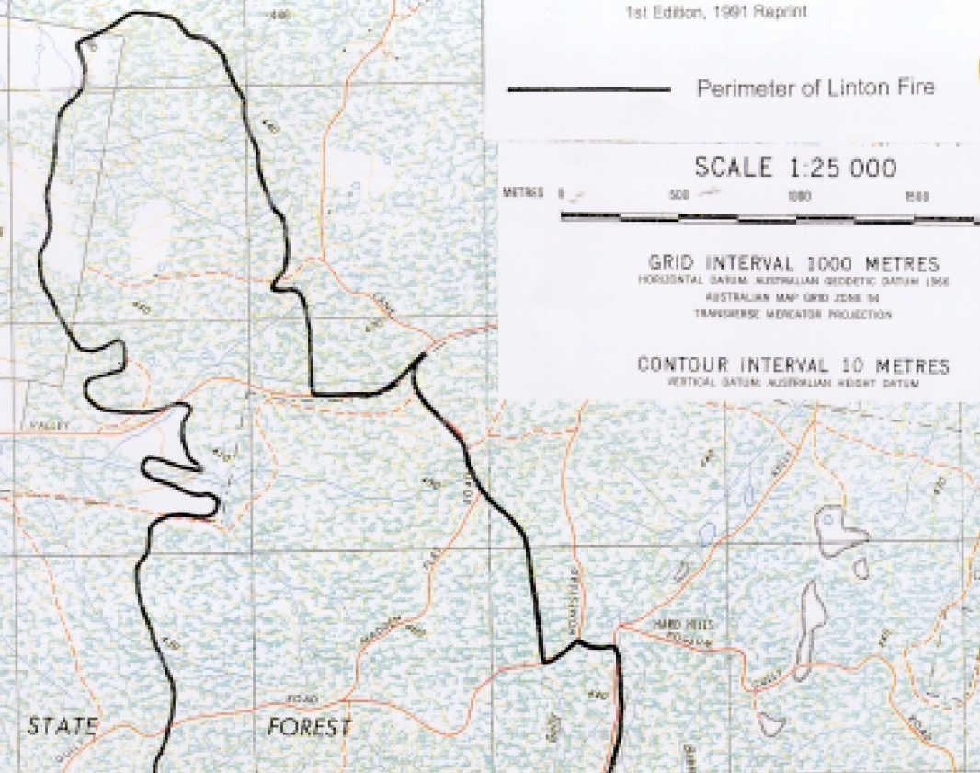
“Before the fire crossed the Pittong-Snake Valley Road it was burning on the lee-slope of the ridge to the north. Although the surface fire on the lee-slope involved the coalescence of spot fires (possibly upslope under the influence of an eddy wind)… speed of the fire and the flame heights was very much reduced. The relatively mild behaviour of the surface fire as it approached the bottom of the slope might have influenced fire fighters to consider it was possible to hold the fire on the Pittong-Snake Valley Road.”
From “Report of the Investigation and Inquests into a Wildfire and the Deaths of Five Firefighters at Linton on 2 December 1998”, State Coroners Office, Victoria.

Slide 5
Lots of new science in the pipeline…
BUFO2 predictive model for BUFEs.
How forests are likely to recover from BS fires – in terms of fire danger.
Use of hydrology and fuel moisture to anticipate BUFE risks.
VLS above cliff-lines.
Changes in fire seasonality with climate change.
The 2nd-order VLS model.
A single global fire danger index.

Slide 6
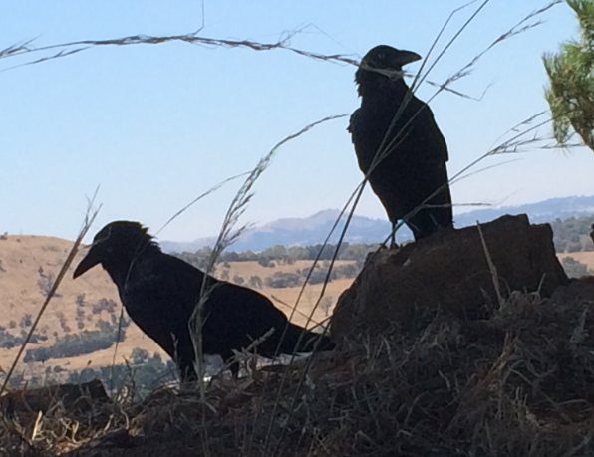
CC adaptation?
Rapid escalation of risks
Continuing process – no “new normal”
Potential for far
worse to happen
No Black Swans, just ubiquitous
Ravens and Cane Toads.

Slide 7
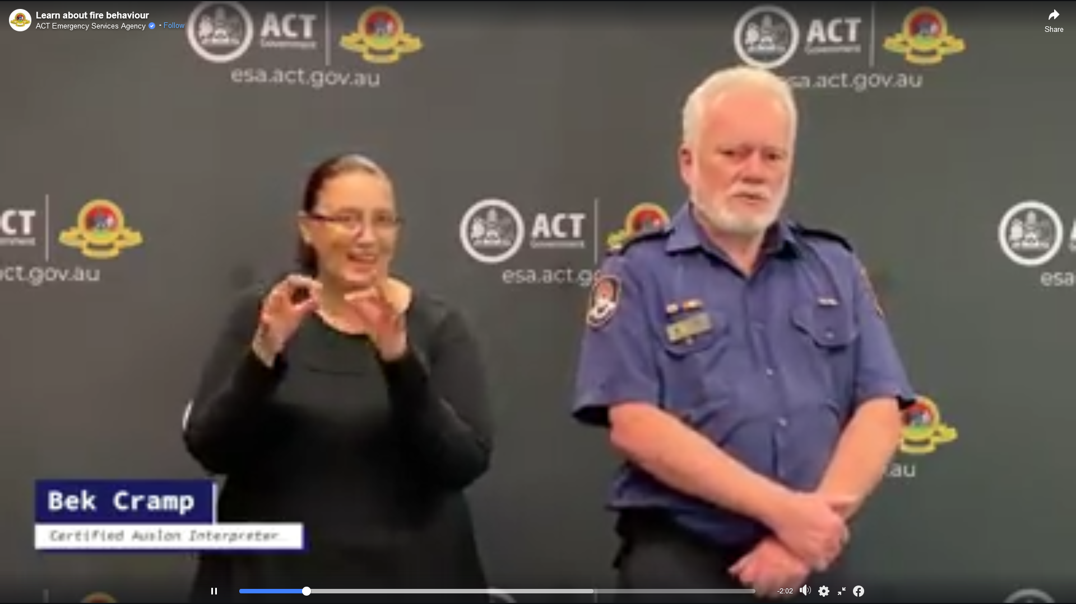
THINGS TO REMEMBER
What canopy intercept class do you use for SDI?
What average annual rainfall do you use for KBDI?
Why do you use KBDI anyway?
When will your burnt forests return to flammability?
Have you factored CC into HRB planning?
Do all IMT unit leaders understand the weird stuff?
What about your Public Information
Cell staff? (including the AUSLAN folks)>>>>>>>
Have you pondered how to
brief-up on the weird stuff?
Image: ACTESA

Slide 8
New terms to learn
Older ones:
Pyrocumulonimbus - pyroCb
Pyrotornadogensis
VLS
Isentropic drawdown
Newer ones:
Sustained outbreak
Super outbreak
Smoke-induced stratospheric anticyclones

Slide 9

There is little explicit role for fuel load in BUFE occurrence. One year-since-last-fire only is effective. Drought-stricken grasslands may not be able to carry BUFEs.

Slide 10
Increasing drying out of streamflows on a regional scale is a useful portent of BUFE occurence.

Slide 11
Sea breezes are now, due to climate change, able to push BUFEs inland for considerable distances.

Slide 12
BUFEs, on a district-scale, go through cycles of activity allowing switching between defensive and offensive IAPs.

Slide 13
Because of climate change, BUFEs and pyroCbs now occur in extended clusters, called Sustained Outbreaks.
We have seen one Super Outbreak.

Slide 14
The new 2nd Order VLS correctly shows that VLS can occur in unexpected places. This produces critical safety awareness for fire crews.

Slide 15
The role of the convective cap must be understood.

Slide 16
High country plumes can bounce back off a convective cap and drive unexpected fire runs.
Brian Potter: The Drumskin Effect.

Slide 17
The role of dew point depression near the LCL must be understood.

Slide 18
The role of the LCL must be understood.

Slide 19
An old learning worth repeating:
The instability of the atmosphere above the LCL must be understood.

Slide 20
Foehn winds, and especially isentropic drawdown, can drive BUFE development on a large scale.

Slide 21
Climate change is producing exponential growth in the frequencies of BUFEs and pyroCbs.

Slide 22
BUFE threat footprints are getting larger, with compound runs over 50km no longer unusual.

Slide 23
The seven known causes of deep flaming must be understood and considered by IMTs.

Slide 24
Next
So we will convene, on-line, on Friday for the interactive review and discussion workshop.
It is up to your agency to decide how extreme wildfires will be managed. We have given you the tools and understanding to build a better system.
If this workshop has been successful then it will have given you the understanding to drive those decisions in a way that keep everyone safer in the face of future outbreaks.
See you then.

