Slide 1

MANAGING EXTREME WILDFIRES
A virtual PDP Workshop for the 2021 AFAC Conference.
Rick McRae, Jason Sharples
UNSW Bushfire Research Group.
Animation: JAXA, NICT, BoM

Slide 2
INDEX
Introduction and core concepts
Climate change
Black Summer
Deep flaming
Instability
PyroCbs
Data
Mapping
Blow-Up Fire Outlook (BUFO) model
Operational tools
Operational implementation
Take-Aways

Slide 3
INTRODUCTION

Slide 4
Objective
This one day virtual workshop will show senior bushfire management personnel the lessons from recent fire activity and the science from it. Improved procedures for incident management will be indicated.
Attendees will be shown how to be better prepared for future extreme wildfire activity.

Slide 5
Blue text is something that will be explained shortly.
Red text is that explanation.

Slide 6
Definitions
It is vitally important that terms used are fully defined and used in the correct contexts.
Adjectives are ambiguous!
Extreme Wildfires
Blow-Up Fire Events
Deep Flaming

Slide 7
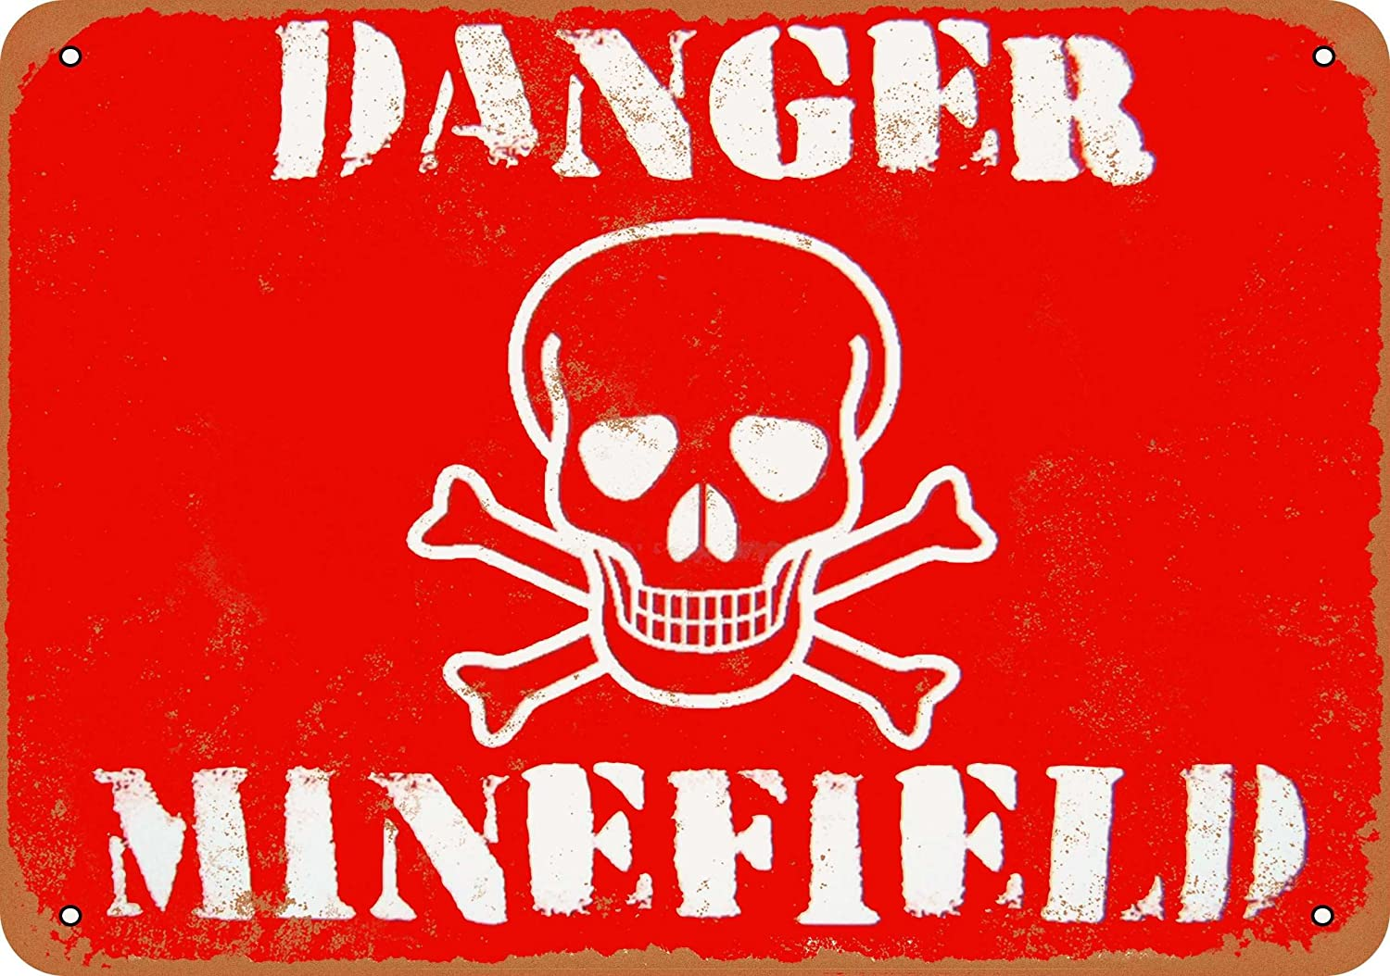
Ever used these out of context?
EXTREME
BAD
WORST
SEVERE
MASSIVE
UNPRECEDENTED
ELEVATED
VIOLENT
EXTREMELY BAD
EXCEPTIONAL
Image: amazon.com

Slide 8
Extreme wildfires
An extreme wildfire is one that, on one or more occasions, develops a blow-up fire event.
Sharples, J.J., Cary, G.J., Fox-Hughes, P. et al. (2016). Natural hazards in Australia: extreme bushfire. Climatic Change, DOI 10.1007/s10584-016-1811-1

Slide 9
Two species of fire
There are now two species of fire in Australia.
Steady-state fire behaviour
Dynamic fire behaviour

Slide 10
Blow-Up Fire Events
A blow-up fire event occurs when a fire couples with the atmosphere above.
Without this coupling, it is a steady-state fire – if you know the fuel, the terrain, and the weather then you know the fire’s behaviour.
After coupling feedbacks develop, it becomes a dynamic fire. You also need to know the stability and the fire.
Deep flaming occurs and triggers the coupling.

Slide 11
Deep Flaming
Deep flaming is where a fire’s perimeter becomes deeper (or thicker) than the normal flaming depth due to fuel burn-out times.
There are 7 known causes of deep flaming, discussed later.

Slide 12
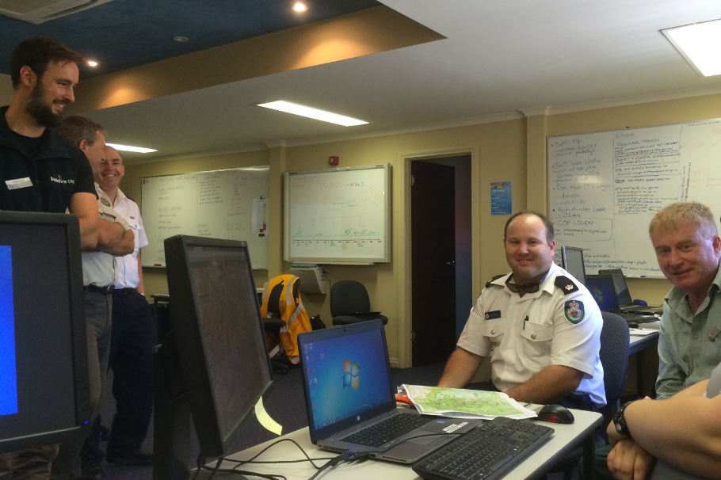
DISCUSSION
Who has been in an IMT for a BUFE?
What lessons were learned?
Interstate Planning Section staff, Launceston, Feb 2016. Photo: McRae

Slide 13
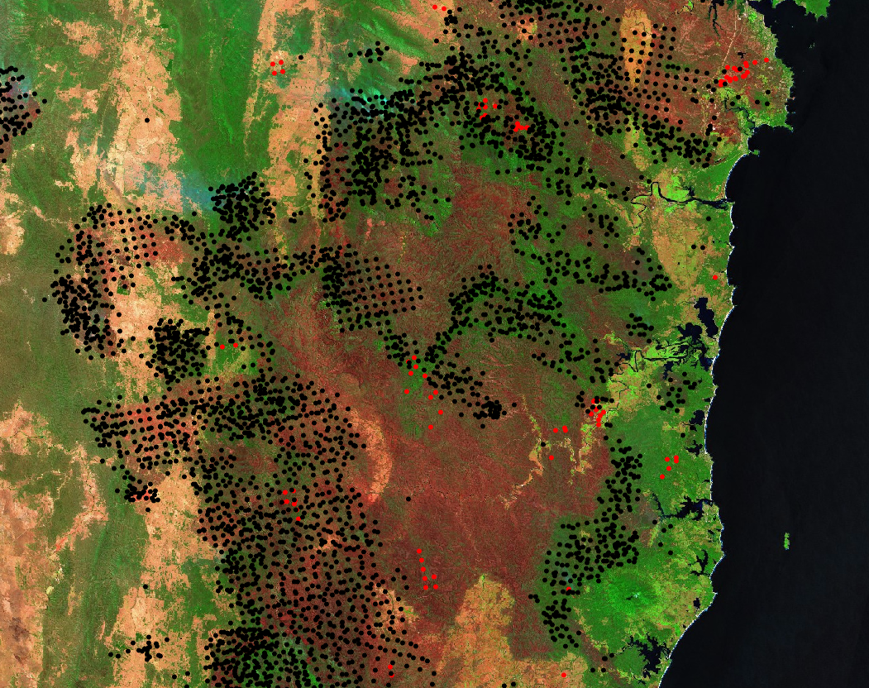
Discuss this…
Sentinel 2 image (ESA) showing BS hotspots (black dots) and previous 12 months’ hotspots (red dots). Remember that the brown areas are BUFEs with no hotspots.

Slide 14
Ideas…
HRB too small to impact on BS.
Recent HRBs sometimes reduce fire intensity.
Recent HRBs sometimes have no impact at all.

Slide 15

There is little explicit role for fuel load in BUFE occurrence. One year-since-last-fire only is effective. Drought-stricken grasslands may not be able to carry BUFEs.

Slide 16
CLIMATE CHANGE

Slide 17
Increasing drying out of streamflows on a regional scale is a useful portent of BUFE occurence.

Slide 18
Sea breezes are now, due to climate change, able to push BUFEs inland for considerable distances.

Slide 19
CLIMATE CHANGE DISCUSSION
What impacts has CC had on your operational area?
How have you or your agency adapted?
Is more change currently needed?

Slide 20
BLACK SUMMER

Slide 21
DISCUSSION
What were your relevant experiences during BS?

Slide 22
BUFEs, on a district-scale, go through cycles of activity allowing switching between defensive and offensive IAPs.

Slide 23
Discussion
What might be the difference between OFFENSIVE and DEFENSIVE IAPs?

Slide 24
Because of climate change, BUFEs and pyroCbs now occur in extended clusters, called Sustained Outbreaks.
We have seen one Super Outbreak.

Slide 25
DEEP FLAMING

Slide 26
The new 2nd Order VLS correctly shows that VLS can occur in unexpected places. This produces critical safety awareness for fire crews.

Slide 27
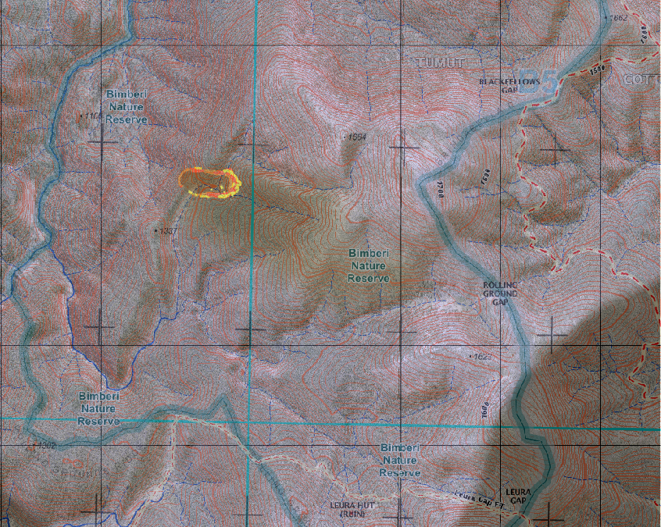
DISC-EX 1
This fire is running towards a major ridge. What are your concerns?

Slide 28
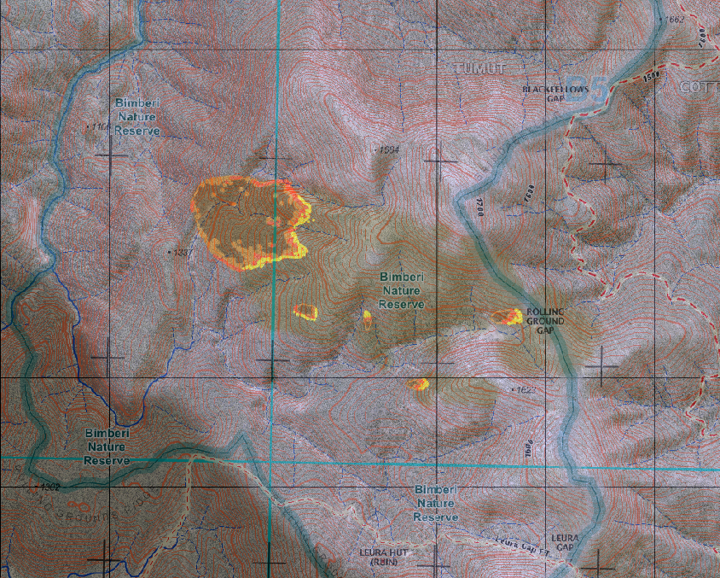
VLS in gully.
Spotting onto SW, S & W aspects.
Spotting onto next terrain block.

Slide 29
INSTABILITY

Slide 30
The role of the convective cap must be understood.

Slide 31
High country plumes can bounce back off a convective cap and drive unexpected fire runs.
Brian Potter: The Drumskin Effect.

Slide 32
The role of dew point depression near the LCL must be understood.

Slide 33
The role of the LCL must be understood.

Slide 34
An old learning worth repeating:
The instability of the atmosphere above the LCL must be understood.

Slide 35
Foehn winds, and especially isentropic drawdown, can drive BUFE development on a large scale.

Slide 36
PYROCBs

Slide 37
Climate change is producing exponential growth in the frequencies of BUFEs and pyroCbs.

Slide 38
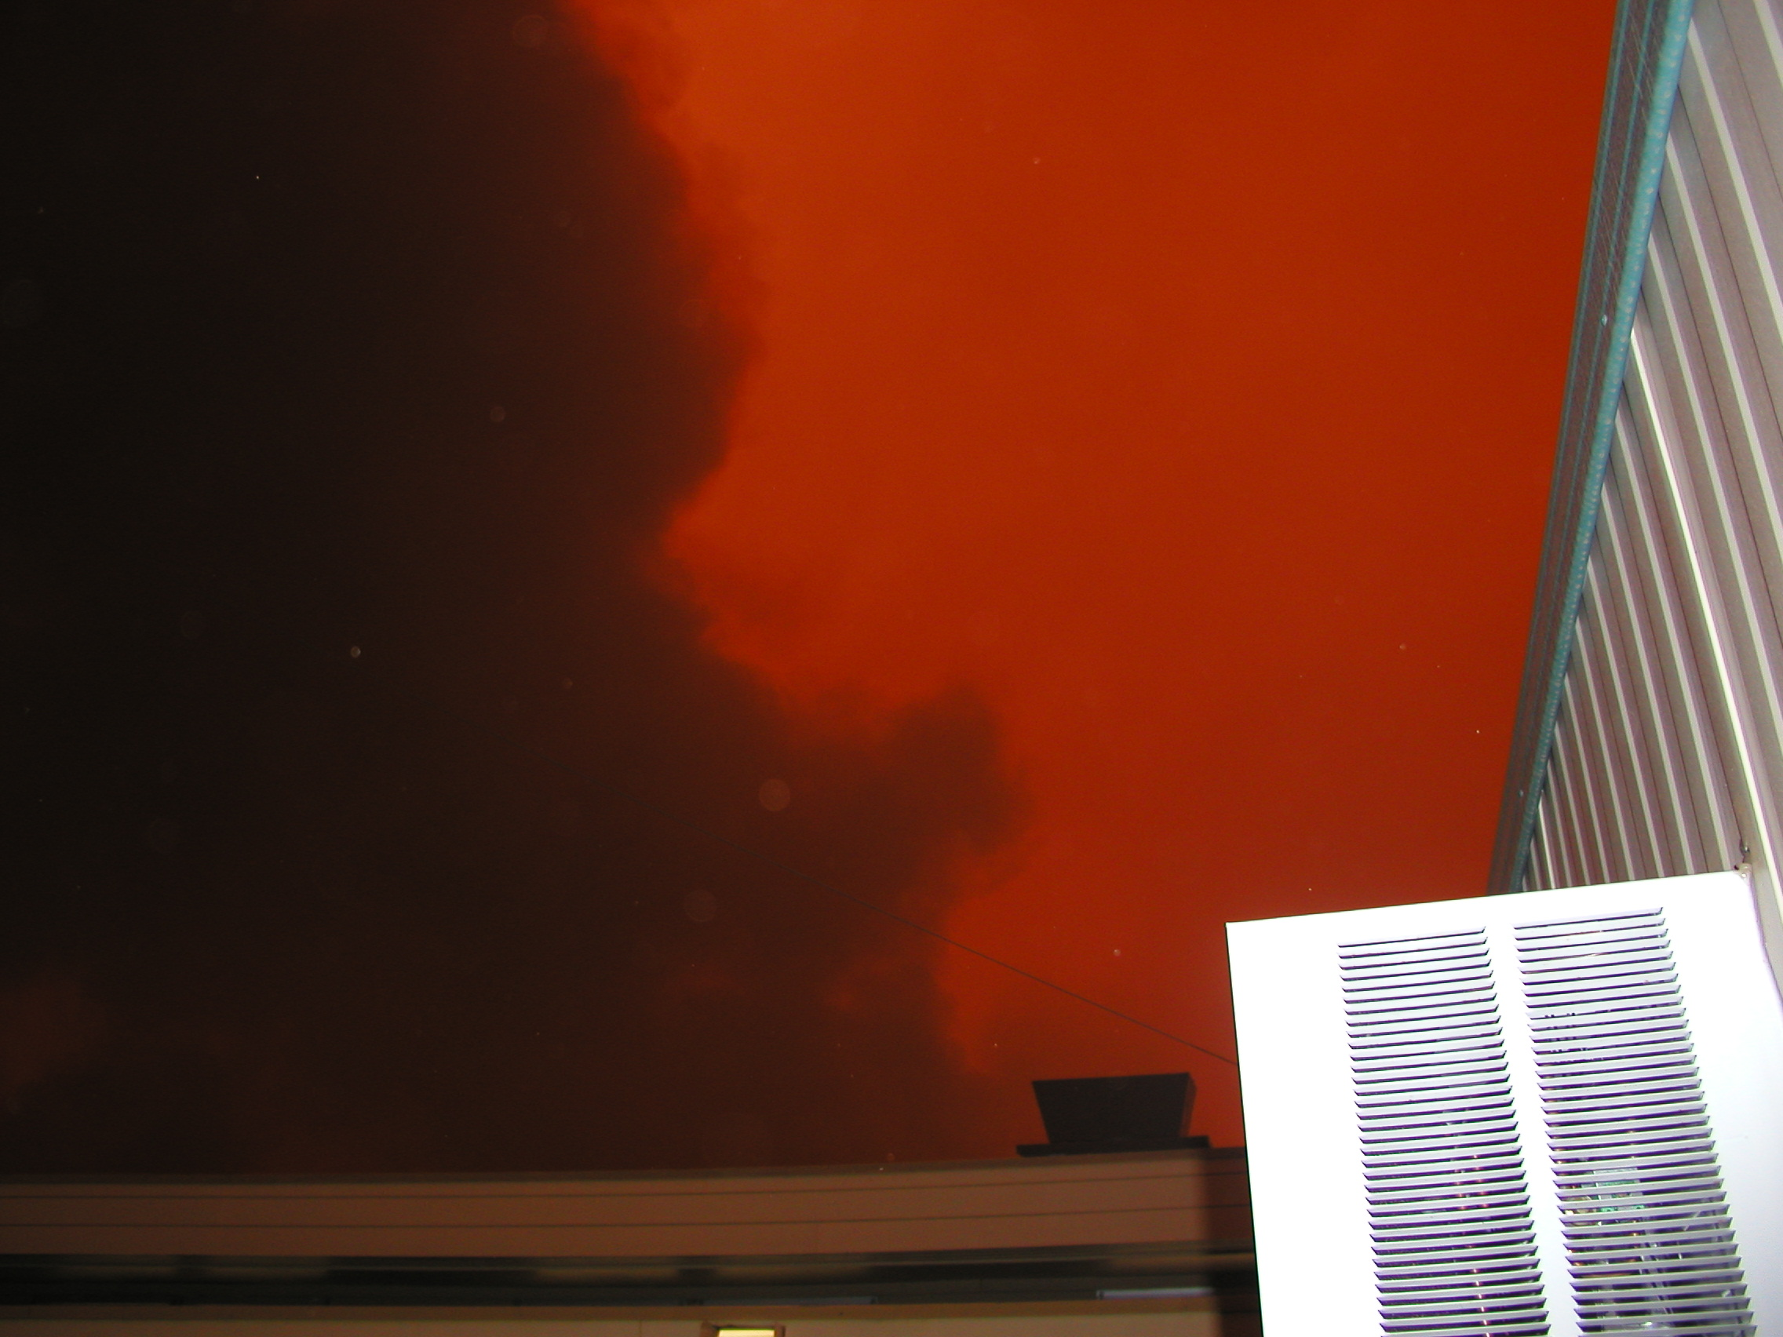
DISCUSSION
Have you encountered a pyroCb?
What happened?
Planning Unit office, 18 Jan 2003. Photo: McRae.

Slide 39
DATA

Slide 40


DISCUSSION
How important are these to you?
Satellites, linescans and radiosondes – data to Planning Units.
Air & ground observers – data to Ops and field controllers.
PLANNING
OPERATIONS

Slide 41
DISCUSSION
What are the most effective data sources that you use?

Slide 42
MAPPING

Slide 43
DISC-EX2
What do you task the Situation Leader to do if there is a chance of a BUFE?

Slide 44
Operational Tools
OPERATIONAL TOOLS

Slide 45
BUFE threat footprints are getting larger, with compound runs over 50km no longer unusual.

Slide 46
BUFO

Slide 47
IMPLEMENTATION

Slide 48
The seven known causes of deep flaming must be understood and considered by IMTs.

Slide 49
DISC-EX
At 1pm a truck crashes on the freeway near Bargo and starts a fire in the forest adjacent to the road easement.
Fire Wx:
  DF 10
  Wind speed 20km/hr, and rising, from WNW.
  Fuel Moisture Index 5% and likely to fall as the day heats up.
TASK 1: DO A SIZE-UP – map overleaf…

Slide 50
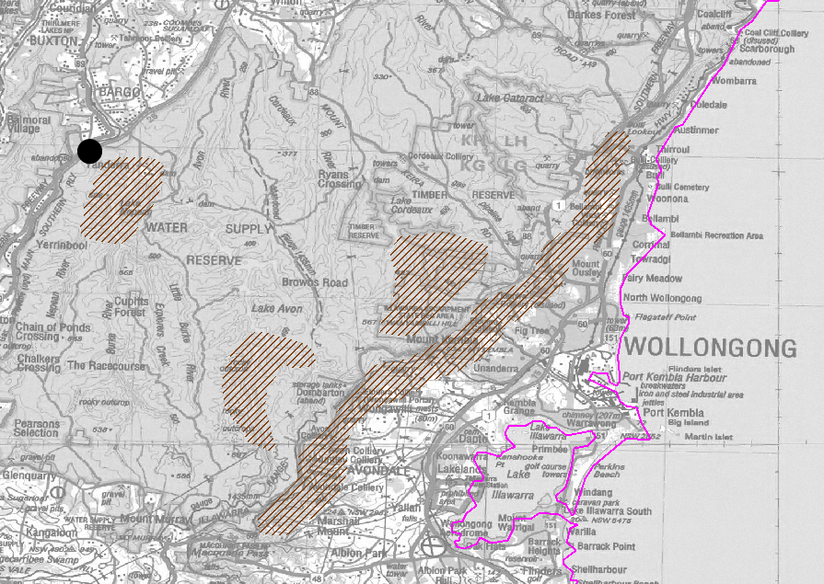
1:10pm
Black dot = P.O.O.
Hatching = VLS-prone lands for WNW winds.
10km

Slide 51
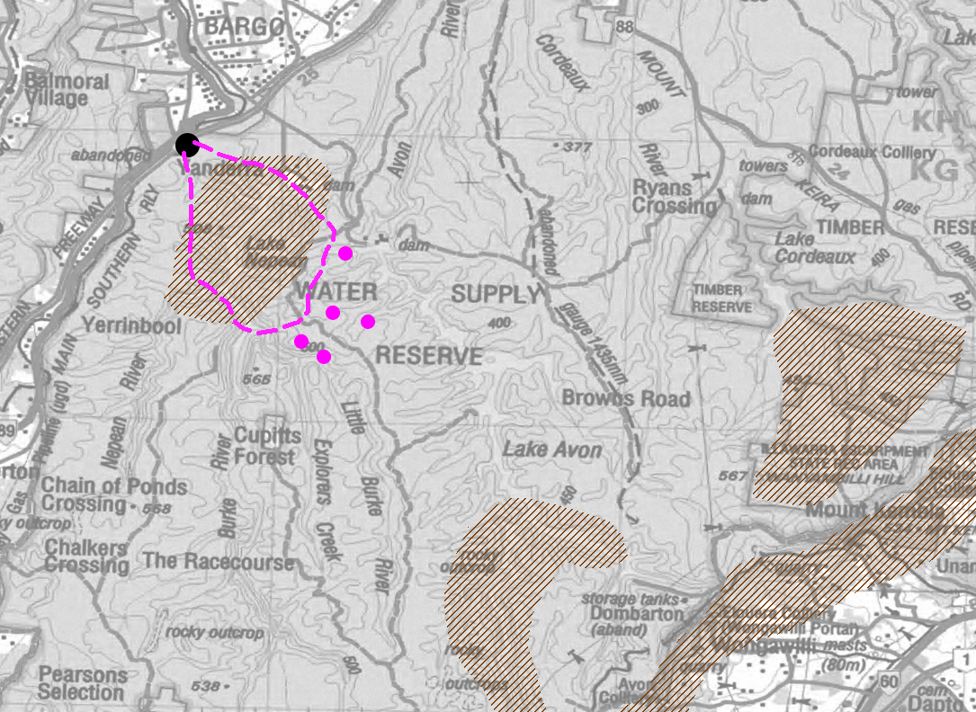
Time: 1:30pm
The fire crosses Lake Nepean as winds pick up.
Spotting is reported ahead of the fire and the next fire trail is crossed.
TASK 2:
DO A SIZE-UP
Dashed line = plotted fire perimeter at 1:20pm (from Air Observer out of nearby Camden Airport). Magenta dots = mapped spotfires.
10km

Slide 52
So, as Incident Controller, and while initial attack is underway and fully resourced, you tell the IMT to gather in 15 minutes to do an intelligence review.
TASK 3: WHAT DOES THE INCIDENT CONTROLLER NEED TO KNOW IF THERE IS A POTENTIAL FOR A BUFE TO FORM?
Time: 1:45pm

Slide 53
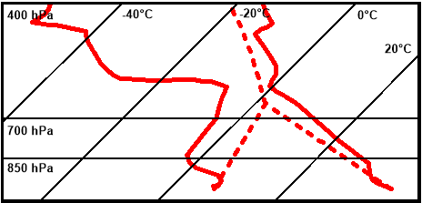
USE THE HANDOUT
TASK 4: You are Situation Unit leader and the Planning Officer has asked you to quickly run a BUFO2 assessment of the BUFE potential.
  MSLP shows [A]scending air mass.
  Nowra radiosonde (11a.m. that morning) shows [L]ow convective cap.
  HFR maps show VLS prone lands.
  Nowra radiosonde shows dew point depression around the LCL.
  There is an active fire.
  Field weather readings indicate very low FMC.
  Field weather readings show wind speed is at 25 km/hr.

Slide 54
TASK 5: What do the BUFO2 results suggest to the IC?

Slide 55
You are the Planning Officer: Sits O reports that BoM has advised that the wind is likely to back as the trough unexpectedly deepens near the coast.
A wind backing from WNW to WSW is expected after 4pm. This will still be a dry air mass.
It is due to the passage of the trough line, bringing with it a change in air mass: [D]escending with a [H]igh convective cap.
Time: 2:30pm.
TASK 6: What effect will this have on the fire and the response to it?

Slide 56
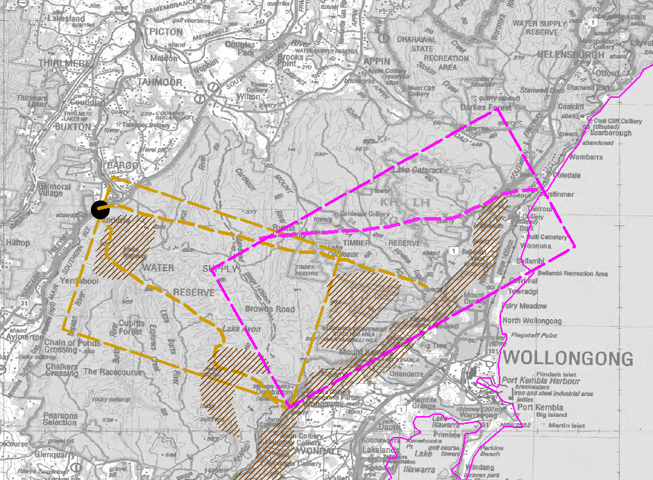
DISCUSS

Slide 57
TAKE-AWAYS

Slide 58
Support for science?
No science = no learning
Acquire and deploy data collection technology.
If the unexpected occurs – record it.
Support scientific studies.
Consider multiple hypotheses.

Slide 59
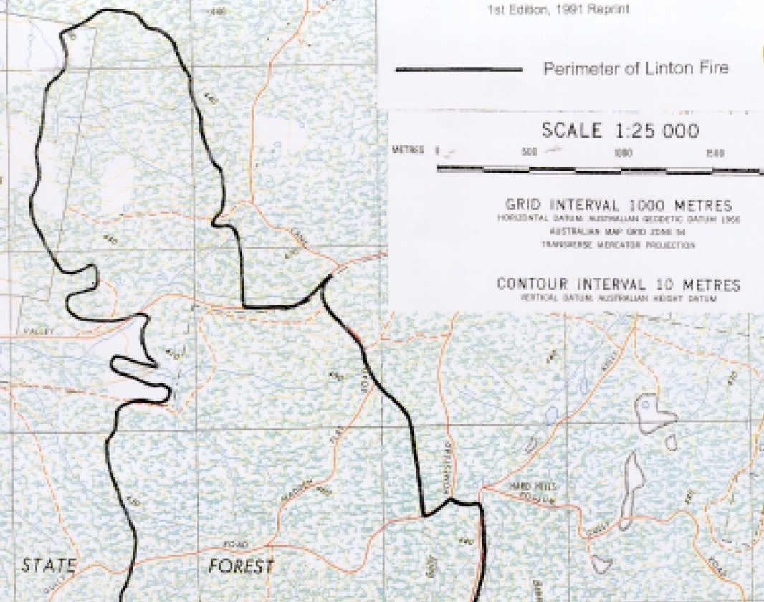
“Before the fire crossed the Pittong-Snake Valley Road it was burning on the lee-slope of the ridge to the north. Although the surface fire on the lee-slope involved the coalescence of spot fires (possibly upslope under the influence of an eddy wind)… speed of the fire and the flame heights was very much reduced. The relatively mild behaviour of the surface fire as it approached the bottom of the slope might have influenced fire fighters to consider it was possible to hold the fire on the Pittong-Snake Valley Road.”
From “Report of the Investigation and Inquests into a Wildfire and the Deaths of Five Firefighters at Linton on 2 December 1998”, State Coroners Office, Victoria.

Slide 60
Lots of new science in the pipeline…
BUFO2 predictive model for BUFEs.
How forests are likely to recover from BS fires – in terms of fire danger.
Use of hydrology to anticipate BUFE risks.
VLS above cliff-lines.
Changes in fire seasonality with climate change.
The 2nd-order VLS model.
A single global fire danger index.

Slide 61
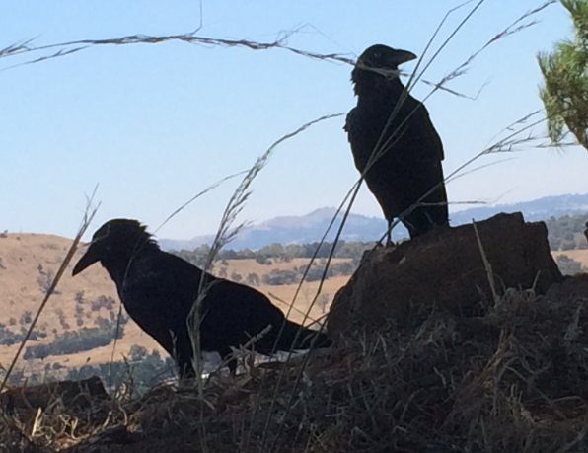
CC adaptation?
Rapid escalation of risks
Continuing process – no “new normal”
Potential for far
worse to happen
No Black Swans, just ubiquitous
Ravens and Cane Toads.

Slide 62
THINGS TO REMEMBER
What canopy intercept class do you use for SDI?
What average annual rainfall do you use for KBDI?
Why do you use KBDI anyway?
When will your burnt forests return to flammability?
Have you factored CC into HRB planning?
Do all IMT unit leaders understand the weird stuff?
Have you pondered how to brief-up on the weird stuff?

Slide 63
New terms to learn
Older ones:
Pyrocumulonimbus - pyroCb
Pyrotornadogensis
VLS
Isentropic drawdown
Newer ones:
Sustained outbreak
Super outbreak
Smoke-induced stratospheric anticyclones

Slide 64
END
Keep safe…

